Slide 1
GUI-Based vs. Text-Based Assignments in CS1
Robert Ball, Linda DuHadway, Spencer Hilton, and Brian Rague

Slide 2
Question behind the question
How can we motivate our students?
Assumption: Motivating our students will lead to better work (reflected in better scores) and less attrition.

Slide 3
Related Work
Games
Graphics
Board games
Alice
Scratch
Etc.

Slide 4
Official Research Questions
How is student performance affected by drag-and-drop GUI assignments when compared to traditional text-based assignments?
If given the choice, would students select GUI-based or text-based assignments?

Slide 5
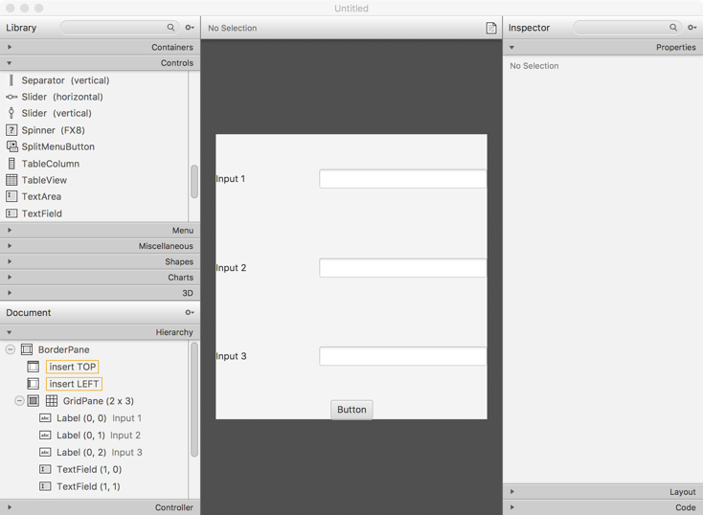
JavaFX Scene Builder introduction
JavaFX replaced Java’s Swing
Scene Builder is a drag-and-drop interface

Slide 6
When Experiment Offered
 | Online | Face-to-face
Summer 2016 | 17 students | 9 students
Fall 2016 | not offered | 23 students
Spring 2017 | 29 students | 26 students

Slide 7
Experiment
Assignments | GUI/text assignment
1 | text
2 | text
3 | text
4 | text
5 | GUI (introduction to GUIs)
6 | Group A: text / Group B: GUI
7 | Group A: GUI / Group B: text
8 | Group A: text / Group B: GUI
9 | Group A: GUI / Group B: text
10 | GUI
11 | student's choice
12 | student's choice
13 | GUI

Slide 8
Isometric Assignments
GUI assignments - two steps:
Design the GUI
Write the Java code.
Text-based assignment - one step: writing the main method code.
Consequently: GUI assignments generally had one less requirement than the text-based assignments.

Slide 9
What Was Reported
“In comments section please answer the following:
Approximately how long did you spend on this assignment in hours? For example, "1.5 hours" or "3 hours."
On a scale of 1 to 4, with 1 being the best, and 4 being the worst how much did you enjoy this assignment? For example, "1 - I loved it" or "4 - I hated it."
Based on your answer of 1, 2, 3, or 4, why did you like/dislike the assignment?
The above answers will not affect your grade. By voluntarily answering the above questions you will help us improve this course. Thank you so much for answering the questions!”

Slide 10
Research Question 1
How is student performance affected by drag-and-drop GUI assignments when compared to traditional text-based assignments?

Slide 11
Research Question 1
No SS for:
Grades
Time spent
Enjoyment
From the related literature, were the students responding that they liked the visual-based assignments more or that they simply liked the course, the instructor's enthusiasm for the approach, or something else?

Slide 12
Research Question 2
If given the choice, would students select GUI-based or text -based assignments?

Slide 13
Research Question 2 – Choose between GUI and text assignments (only showing SS)
 | GUI Group | Text Group
Percentage of students in course | 23% | 77%
Number of students | 21 | 53
Enjoyment (1-4) (lower is more enjoyment; higher is less enjoyment) | 1.7 (enjoyed assignments more) | 2.21 (enjoyed assignments less)

Slide 14
Looking at students that chose GUI/text for entire course
We divided the students into two groups:
Chose GUI at least once for one of the two assignments.
Chose Text both times.

Slide 15
Looking at students that chose GUI/text for entire course (only showing SS)
 | GUI Group | Text Group
Number of students | 21 | 53
Average final grade for course | 91.2% | 84.7%
Average hours spent on all assignments | 1.99 (119 minutes) | 2.67 (160 minutes)
Average Enjoyment (1-4) (lower is more enjoyment; higher is less enjoyment) | 1.44 (enjoyed assignments more) | 1.78 (enjoyed assignments less)

Slide 16
Why did students choice GUI or Text?
Reasons for Choosing GUI |  | Reasons for Choosing Text
GUI's used in real life | 23% | Easier/simpler | 51%
To improve skills | 23% | Save time | 18%
Fun | 18% | More familiar with text | 10%
Prefer GUI over text | 14% | Variety – already did GUI before | 10%
More challenging | 14% | Miscellaneous | 6%
Variety - already did text before | 5% | Dislike GUI's | 4%
Easier/simpler | 5%

Slide 17
Post-Course Question
“Question1: Based on your experience in this class, if you were not pressed for time, would you create the Java application with or without a GUI?
Question 2: Why?”
93% of all the respondents to Question 1 (regardless of what they chose in class) stated they would use a GUI outside of class.

Slide 18
Future Work
Marshmallow experiment – follow children for years.
Similarly, we are following students’ progress (without their knowledge in order to not taint the results) from Freshman to graduating.

Slide 19
Questions?

