Slide 1
Applying Machine Learning to Improve Curriculum Design
Robert Ball, Linda DuHadway, Kyle Feuz, Joshua Jensen, Brian Rague, and Weidman, D. Weber State University School of Computing

Slide 2
Curriculum
cur·ric·u·lum
noun
the subjects comprising a course of study in a school or college.

Slide 3
What is the problem?
What courses should be included?
Data Science?
Internet of Things?
The new parallel, computational, algorithmic, pythonic, web-based, cloud, embedded, database with verification and validation course?

Slide 4
Traditional Approach
Faculty may be inordinately influenced by personal experience and anecdotal evidence.
Student Jane Doe took a Cobol class and indicated that he got a job. He just gave me a high five!
Student John Doe took a Cobol class and can’t get a job. He is crying in my office right now…
Therefore… What courses should be offered?

Slide 5
What is the REAL problem?
Who are our students?
What are their ages?
Where did they come from?
How do I describe my “average” student?

Slide 6
Data Science to the Rescue!
Treat curriculum like any other data science project…
Because data science is cool!

Slide 7
There is no “average” student
“Typical” student direct from High School (17-18 years old)
“Transfer” student that has credit from other universities
Military veterans
Married student
Single student with dependents
“Returning” student - 5+ years since last college courses.
“Older Adults” – students that are much older – 40+ years old
Full-time working students
Etc. Etc.
Mix of many of the above.

Slide 8
Our Approach
Look at the data!
We obtained transcripts for ALL CS major students (12 years)
We performed the following on the data:
EDA (fancy acronym for statistics)
(Machine Learning)

Slide 9
Data – Raw transcripts of two universities
We got all the transcript information for the last 12 years for all CS majors.
CS major: Any student that ever declared themselves as a CS student AND took at least 1 course (whether passed or failed).
Two data sets:
Our university and another similar regional university
Two to see if trends are the same for both universities

Slide 10
Our approach part I: Statistics (top down)
Depending on the type of student their graduation rate.
Race/gender are irrelevant in the data.
Graduation rate (in 6 years).

Slide 11
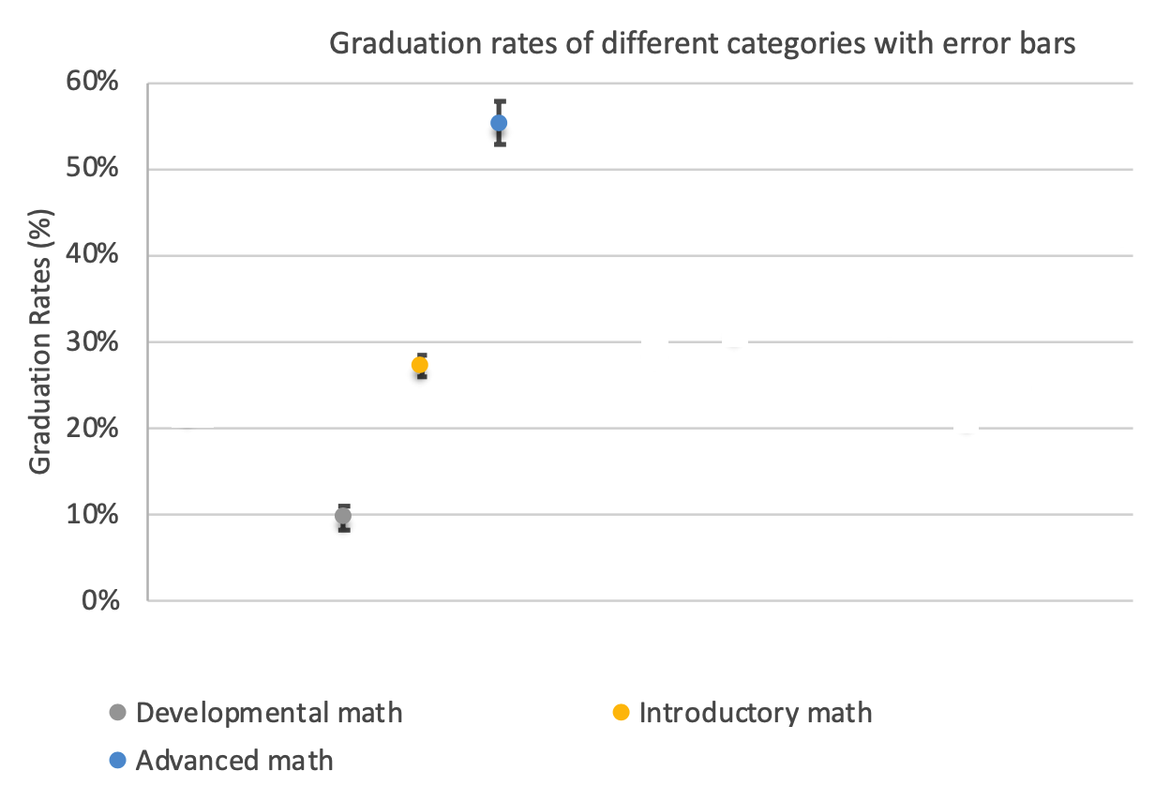
Looking Deeply – Math Example
First Math Course Taken At University
Developmental math:
< College Algebra
Introductory Math:
College Algebra → < Calculus
Advanced Math:
>= Calculus
Does the first math course you take affect you?
YES!

Slide 12
Our approach part I: Machine Learning (bottom up)
The idea behind using machine learning is to find the factors behind what leads to graduation.
Most important part: Features
Features examples:
Age
Gender
First math course
First English course
Ect.

Slide 13
(Some) Machine Learning Results
The lower the number the more important.
GR: Gini importance (decision tree)
OR: Log-odds ratio (logistic regression)
* Means negative correlation
 | Overall |  | CS 1 |  | CS 2 |  | CS DSA
Feature | GR | OR | GR | OR | GR | OR | GR | OR
Age | 3 | 7 | 4 | 7 | 4 | 13 | 4 | 9*
Gender | 7 | 12 | 8 | 11* | 8 | 8 | 8 | 10
Dev_Engl | 7 | 4 | 8 | 13 | 8 | 9 | 10 | 4
Intro_Engl | 4 | 2 | 8 | 5 | 8 | 5 | 5 | 5
Dev_Math | 7 | 9* | 7 | 8 | 8 | 7 | 10 | 11*
Intro_Math | 6 | 11 | 3 | 3 | 3 | 3 | 9 | 8
Adv_Math | 2 | 3 | 2 | 2 | 2 | 2 | 2 | 2
Intnl | 7 | 8 | 8 | 4 | 8 | 11 | 7 | 7*
AP | 7 | 6* | 5 | 6* | 5 | 4* | 6 | 3*
Transfer (any credit) | 7 | 13 | 8 | 12 | 7 | 12 | 10 | 13*
CS Transfer | 5 | 5 | 8 | 10* | 8 | 10* | 10 | 11
Concurrent | 7 | 10* | 6 | 9 | 6 | 6* | 3 | 6*
GPA | 1 | 1 | 1 | 1 | 1 | 1 | 1 | 1

Slide 14
Why would YOU care?
You sat through the keynote speaker,
You got a free bagel from the exhibit hall,
You got through all of Thursday half of Friday (you might have been here Wednesday too!),
So…

Slide 15
Final Thoughts
Institutions don’t have “average” students.
Every institutions has different student needs.
Institutions have ranges of students. Given 1000 students you will have 1000 stories.
In regards to graduating, the topic of the courses is less important than helping different groups with different needs to succeed.

Slide 16
Final Question
Are you offering the courses or course sequences that you need for the different types of students at YOUR university to succeed?
Is there only one way to graduate or do you have multiple paths?

Slide 17
Questions?

