Slide 1
Multi-class programs And The UML
Object-Oriented programs consist of connected objects
Delroy A. Brinkerhoff
Notes:
All but the most trivial of object-oriented programs consist of many classes and many objects. A working program binds the objects together to allow them to communicate and cooperate to solve the given problem. The current chapter explores the way that objects are bound together.

Slide 2
Connecting Objects
Classes are connected by class relationships
Objects are instantiated from classes
The connections between objects are derived from the relationships between the classes
The connections between objects
Bind the objects together
Allow the objects to work together
Provide communication pathways along which the object can send messages
Notes:
Relationships connect the classes in a program. When the program instantiates objects from those classes, it joins the objects with connections instantiated from the relationships. The connections bind the objects together, forming a program in which they work cooperatively to solve a problem. The objects work together by sending messages to each other.
The current chapter explores the class relationships, their meaning, and how they are implemented and used in a C++ program.

Slide 3
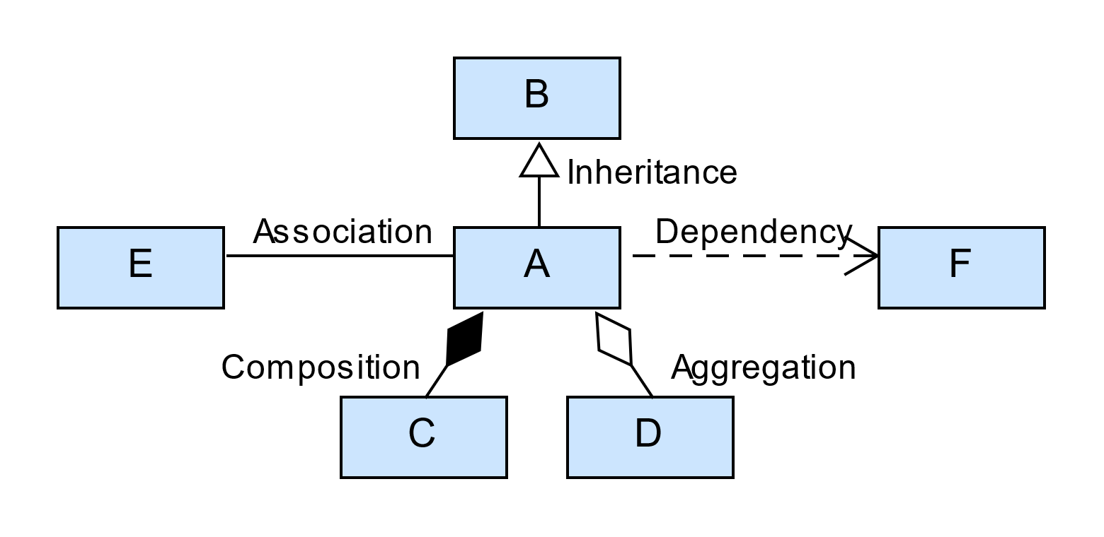
Class Relationships
Inheritance
Second characteristic of the object-oriented paradigm
Required for polymorphism
Constructive relationships
Aggregation
Composition
Association
Dependency
Notes:
The Unified Modeling Language (or the UML) identifies five class relationships. Of those five, inheritance or generalization holds a prominent position in the object-oriented paradigm – so prominent that it is the second of three characteristics needed for a system to be considered object-oriented. Inheritance is essential because polymorphism, and many of its prerequisite features, require it.
Aggregation, composition, and association are often described as "constructive" relationships. They help construct programs by providing specific connections between classes and, therefore, between objects. For example, aggregation and composition form a whole-part hierarchy where one class is the "whole," and another is the "part." Association creates a peer-to-peer relationship rather than a hierarchical structure. Dependency is a temporary, responsibility-sharing relationship.
The relationships connect class symbols forming a class diagram. Visually, we distinguish the relationships based on their decorations. We'll elaborate on these symbols throughout the chapter.

Slide 4
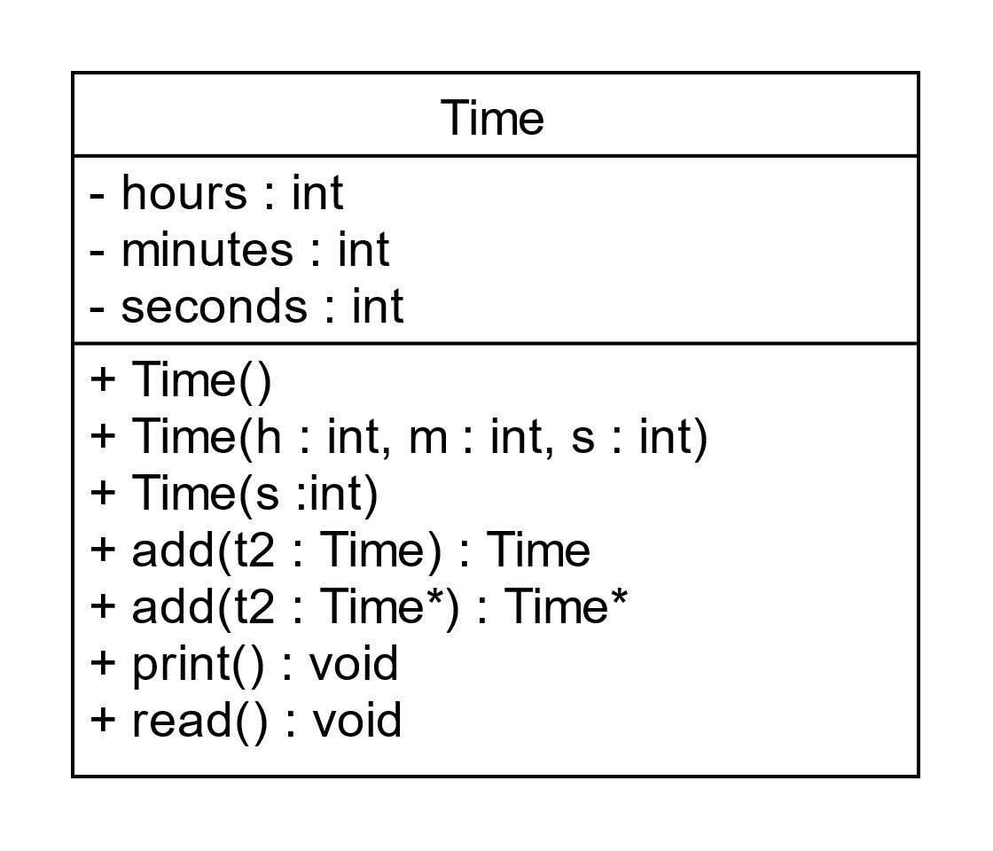
Sharing Class Responsibilities
Classes are responsible for managing their member data and providing and for providing functions to operate on it
Classes share responsibilities through their relationships
One class can “ask” another for help by sending it a message
Class relationships form message pathways
Notes:
When understanding how class relationships help solve a programming problem, imagining that each class bears some of the program's overall responsibility is often helpful. Each class is responsible for its member data and providing useful functions to operate on it. But sometimes, a class needs a little help from the other classes in the program. One class "asks" another for help by sending it a message, using the class relationships as message pathways.

Slide 5
Message Sending: A Whole / Part Example
Part
whole
class Engine
{
private:
public:
void start();
};
class Car
{
private:
Engine motor;
public:
void function()
{ motor.start(); }
};
Notes:
To demonstrate what it means to "send a message," we create two classes connected by composition – a whole-part relationship. Car is the whole class, and Engine is one of its parts. We build the relationship with a class-scope member variable in "Car."
Notice that the Engine class defines a function named "start." An instance of a Car can send the "start" message to its part, named "motor," from any of its member functions. Sending a message to an object is an object-oriented term meaning that one object calls a member function belonging to another object. Message sending is a one-way operation: Car can send a message to Engine, and Engine can respond, but Engine cannot send a message to Car.

Slide 6
Object-Oriented Programs
Program classes must match the entities appearing in the original problem
Car: how many doors, what color, etc.
Engine: size, how to measure RPM’s, oil pressure, etc.
Class relationships must match the way entities relate to each other
Whole/part: “A Car has an Engine” or “An Engine is part of a Car”
The meaning of the class relationship matches the way that entities relate to each other in the original problem
Notes:
When we create a class as part of an object-oriented program, its data and functions reflect (or mirror or match) some problem elements. Depending on how the program uses the classes, important member variables might include the car's color or how many doors it has. The class may have functions to lock and unlock the doors, to return the engine size or measure the Engine’s RPMs or the oil pressure.
Similarly, when we connect classes in a program, the connections reflect or mirror how the various parts of a problem connect. In the Car example, the Car class represents a whole object, while the Engine is one of its parts. For class relationships to reflect or match real-world connections, they must have well-defined meanings. For example, we represent the connection between a Car and an Engine as a whole-part relationship.

Slide 7
Categorizing Class Relationships
Semantics or meaning
Directionality or navigability
Lifetime
Sharing
Binding strength
Strong/tight implies
coincident lifetimes
exclusive ownership (no sharing)
Weak/loose implies
independent lifetimes
sharing is allowed
Notes:
To help us understand and organize the relationships, we create a categorization system with each relationship representing one category. Each category has four dimensions or properties: semantics or meaning, directionality or navigability, lifetime, and sharing.
We add a fifth, pseudo category, binding strength, that summarizes lifetime and sharing. The summary works because all relationships exhibiting a strong or tight binding have the same lifetimes and ownership. Similarly, all relationships exhibiting weak or loose binding have the same lifetimes and ownership.

Slide 8
Semantics / meaning Property
Inheritance
“is a”
A Student is a Person
Aggregation and composition
“has a” or “is a part of”
A Car has an Engine, or an Engine is part of a Car
Association
“has a” in both directions
A Contractor has a Project, and a Project has a Contractor
Notes:
The first property in the relationship categorization is semantics or meaning. Each relationship has a meaning that must match how two real-world entities are connected. We can often use a short phrase to help identify the best relationship between classes. This technique works for English but may not for other languages.
Inheritance represents an "is a" relationship. For example, “A Student is a Person,” or “A Convertible is a Car.”
If read from the whole class to the part, aggregation, and composition are "has a" relationships. “A Car has an Engine,” or “A Person has a Name.” If read from the part class to the whole, they are "part of" relationships. “An Engine is part of a Car,” or “Name is part of a Person.”
Association is also a "has a" relationship that reads well in both directions. A contractor has a Project, and a Project has a Contractor. We think of the classes in an association relationship as peers.
We'll defer our discussion of dependency until later.

Slide 9
Directionality / navigability Property
Every relationship is between two objects and is directional
Unidirectional or one direction (most class relationships)
Bidirectional or in both directions (only association)
Ways of thinking about directionality
The direction messages travel
Which object “knows about” the other
How a program can navigate or move from one object to the other
Notes:
The next property is directionality or navigability. Most relationships operate in only one direction, from one object to another, which means that only one object can initiate an operation. For example, the program can only send a message in one direction. Association is the only bidirectional relationship.
It's easy to think about one object sending a message to another, but there are other ways of thinking about directionality. We can imagine that one object "knows about" or is aware of the other, meaning it can somehow access the other object's features. We can also think about directionality as a program's ability to "move" from one object to another. As we'll see, doing this is precisely like following a pointer.
For example, a Person knows about its Name, but a Name doesn't know about the Person to which it's attached. Or the program can somehow go from a Car to its Engine, but not the other way.

Slide 10
Binding Strength: Lifetime and sharing Properties
Lifetime
Sharing
Coincident or same
Both objects and the relationship are created and destroyed at the same time
Independent
The objects and the relationship may be created and destroyed at different times
Exclusive
A whole object does not share it part object with any other object
Sharable
A whole object may share its part object with other objects in the program
Notes:
Lifetime and sharing are the last two properties, which we summarize as the objects' binding strength. We can abstractly visualize two objects, bound together tightly or strongly in memory, as one object nested inside the other. Conversely, two objects bound loosely or weakly are not nested but are connected, typically with a pointer.
Two objects with the same or a coincident lifetime are created and destroyed simultaneously. The program makes the connecting relationship when it creates the objects; the relationship persists as long as the objects exist, and the program destroys the relationship with the objects. Objects with different or independent lifetimes can be created and destroyed at different times. Furthermore, the relationship may be created or changed whenever it is convenient.
We view object sharing from the perspective of one of the related objects. For this example, we adopt the Car's perspective. In a tightly bound, exclusive relationship, Car does not share its Engine with any other object in the program. But, in a loosely bound, sharable relationship, Car may share its Engine with other objects – many objects can point to the same Engine object.

Slide 11
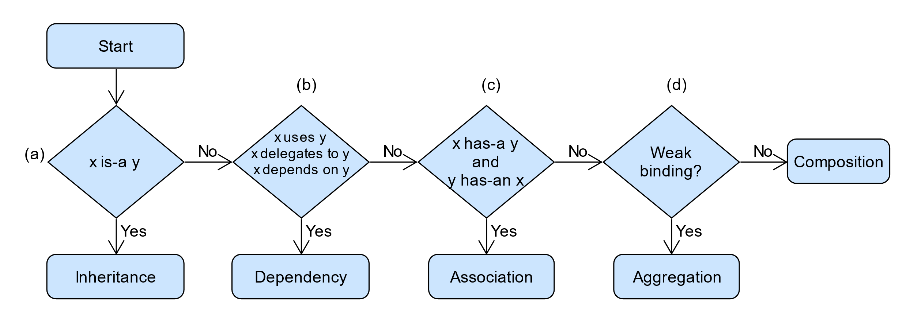
Identification with A Dichotomous Key
Notes:
People often use a dichotomous key to identify a plant or animal based on its observable properties. The word "dichotomous" means dividing or cutting into two parts. So, a dichotomous key consists of a sequence of stages that define two-way branching logic based on one of the property's values. The first three stages of the class relationship dichotomous key examine the relationship's semantics or meaning. The final stage looks at the binding strength: the relative lifetimes of the objects and their shareability. Sometimes the branch leads to a relationship, and other times it leads to the next stage in the key.
In stages (a) through (c), substitute the two class names for x and y. It's essential always to replace x and y with the same names.
Stage (a) tests the relationship with the "is a" phrase. In English, "A sedan is a Car" sounds correct, but neither "A Sedan has a Car" nor "A Car has a Sedan" does. If the "is a" test doesn't work in your spoken language, or if you want an alternate test, consider overlapping class features. For example, Name is a natural feature for a Person class, and also for the Student and Instructor classes. Inheritance allows the Student and Instructor to reuse the Name.
The "uses" test in stage (b) is difficult, even in English.
Refine the question by asking, "does x always use the same y?" Imagine that x is a FractionCalculator with an add function, and y is a Fraction. Does the fraction calculator always add the same fraction, or should it add different fractions? Now, imagine that x is a Person and y is a Date - perhaps the Person's birth date. Does a person's birth date change? Dependency or uses best represents the Fraction example, while the Person and Date are best connected by a "has a" relationship.
Alternatively, we can think about x sharing some of the program's responsibilities and ask, "does x delegate some of its responsibilities to y?" Or, "does x depend on y to fulfill its responsibilities?"
Stage (c) has a compound test, and both parts must read sensibly. So, "a Contractor has a Project" and "a Project has a Contractor." Association is the only relationship that operates equally well in both directions.
Both aggregation and composition are "has a" relationships – "a Car has an Engine" – so we must examine another property to distinguish between them. Imagine a Car driving down the road with its Engine. The two should remain tightly bound together, arguing for composition. But now imagine that the Car is a racecar and that we add a third class, Warehouse, representing a database that tracks the racecar's spare parts. Imagine further that the racecar damages and replaces its Engine. The sharing and need to change the relationship argue for the weaker aggregation relationship.

