Slide 1
Constructive Relationships
The fundamental structure of object-oriented programs
Delroy A. Brinkerhoff
Notes:
Software developers generally recognize two kinds of constructive relationships: whole-part and peer-to-peer. They use constructive relationships to design and build object-oriented programs. The relationships form the bindings that hold objects together and provide paths for the objects to communicate and cooperate.

Slide 2
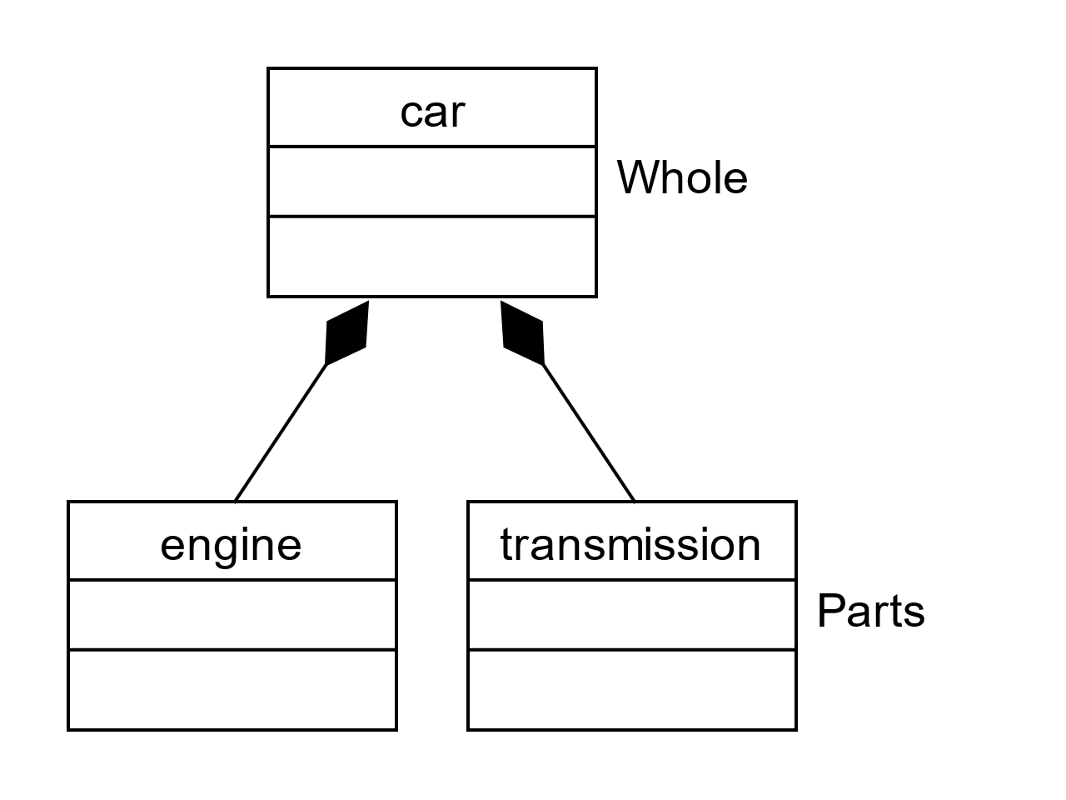
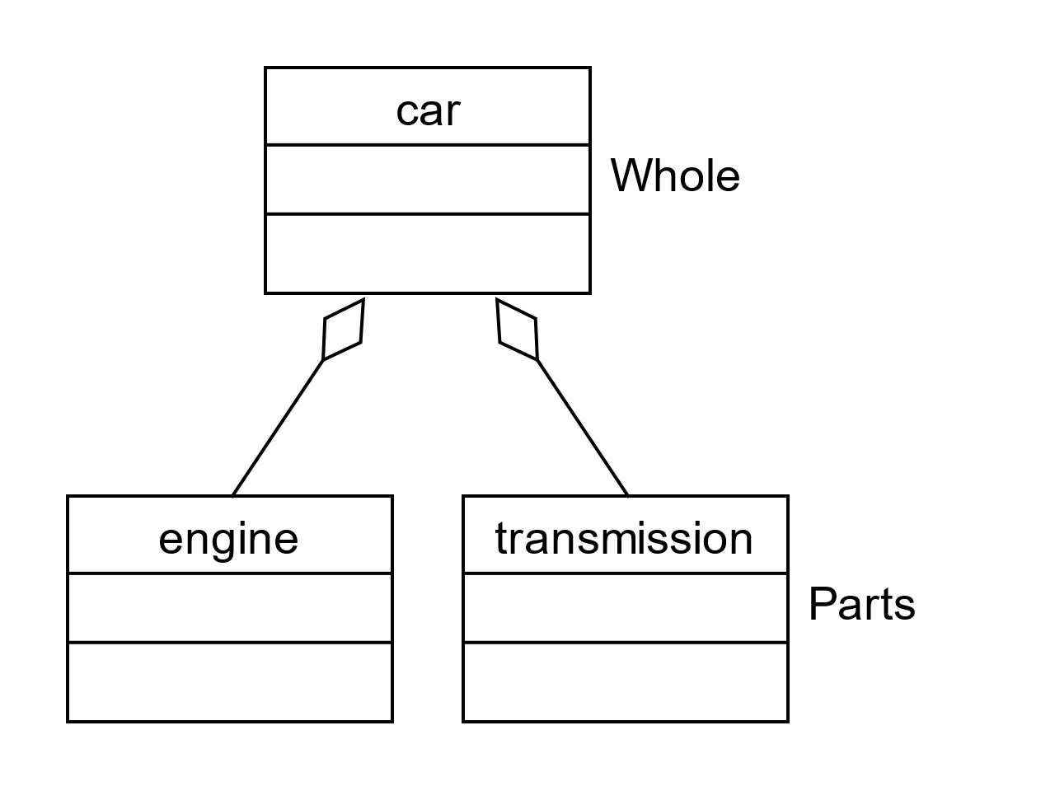
Two Whole-Part Implementations
Composition
Aggregation
Notes:
The Unified Modeling Language or UML recognizes two kinds of whole-part relationships: composition and aggregation. The similarities between the UML connector symbols suggest that the two relationships are similar. But, to justify two relationships, there must be some difference between the two. These similarities and differences are the topics of the following sections.

Slide 3
Two Whole-Part Implementations
Composition
Aggregation
“Has-A”
Notes:
We can read composition and aggregation in two different ways. We read them as a “Has-A” relationship from the whole to the part. For example, “a car has an engine” or “a car has a transmission.”

Slide 4
Two Whole-Part Implementations
Composition
Aggregation
“Is A Part-Of”
Notes:
But we can also read the relationships from the part to the whole. In this direction, we read the relationships as “Is A Part Of.” So, “an engine is part of a car” or “a transmission is part of a car.”

Slide 5
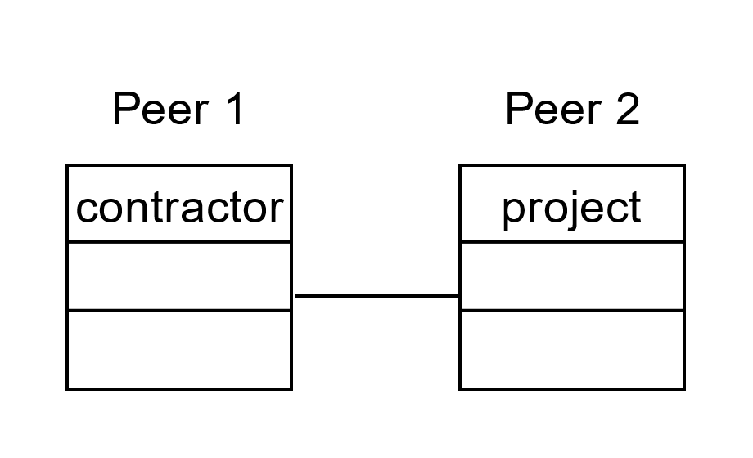
Association
Association is bidirectional
“Has-a” relationship that reads well in both directions
A contractor “has-a” project
A project “has-a” contractor
Notes:
Association is also a constructive relationship and is more general than either composition or aggregation. It is unique among the relationships being the only bidirectional one. We recognize it with the “has-a” phrase but note that it reads well in both directions. So, we can say “a contractor has a project” and “a project has a contractor” equally well.

Slide 6
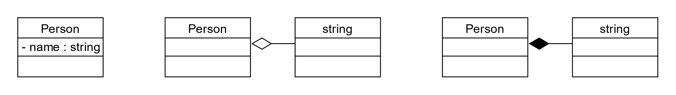
Modeling with Library classes
Notes:
We must consider a special, minor case when we model a problem with a UML class diagram. Strings are necessary for most computing, and all modern programming languages support them. Small, specialized languages often provide them as a fundamental or built-in data type, while newer, general-purpose languages commonly implement them as classes.
So, should we represent a string as an attribute in a class diagram? Or should we model it as a whole-part relationship with either aggregation or composition? How you model strings may depend on how they fit into a particular problem. The choice is yours if the problem doesn’t suggest a specific implementation.

