Slide 1
Building Composition: Whole-Part by embedding
The whole creates and passes data to its parts
Delroy A. Brinkerhoff
Notes:
Composition so tightly binds two objects that they have simultaneous lifetimes – they are created and destroyed at the same time. C++ implements composition by embedding or nesting one object inside another. The simultaneous lifetimes and object embedding dictate how we build a composition relationship.

Slide 2
Allocating memory For Whole Objects
class engine // part
{
};
class transmission // part
{
};
class car // whole
{
private:
engine cars_engine;
transmission cars_trans;
};
car my_car;
Notes:
When a program creates a variable, including an object, it allocates memory to hold the variable. When a variable is a whole object, the program must allocate enough memory to store all the embedded part objects plus any non-object whole-class member variables. For the program to allocate memory for the whole object, it must “know” the size of the parts; to “know” the size of the parts, the program needs the complete class specification for each part. So, to use composition, programmers must specify the part classes before the whole.

Slide 3
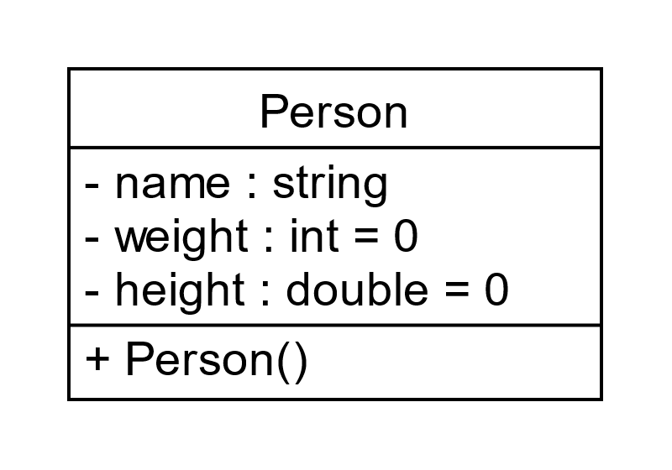
Composition with default constructors
class Person // whole
{
private:
string name; // part
int weight;
double height;
public:
Person()
: weight(0), height(0) {}
};
Notes:
Whenever a program creates an object, even an embedded one, it must be constructed or initialized. And initializing a new object is always the responsibility of a constructor function. Coupling this responsibility with the simultaneous lifetimes of the whole and part objects implies that the whole-class constructor must initialize all part objects by calling the appropriate constructor.
We use strings in programs so often that it’s easy to forget that “string” is the name of a C++ class with numerous constructors. In this example, the Person constructor initializes the member variables weight and height with elements in its initializer list. Crucially, the initializer list also initializes name with an implicit call to the string’s default constructor, which creates an empty string object.

Slide 4
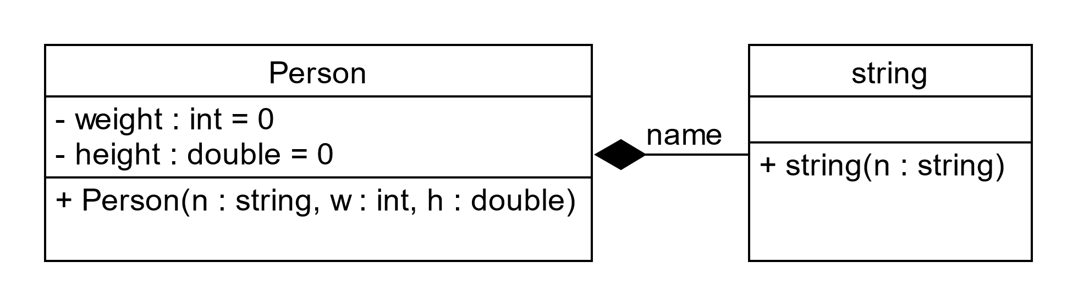
Composition without a default constructor
class Person // whole
{
private:
string name; // part
int weight;
double height;
public:
Person(string n, int w, double h)
: name(n), weight(), height(h) {}
};
Notes:
The next example makes the composition relationship between Person and string more apparent. It assumes that string doesn’t have a default constructor or (as is often the case) that we need to call a parameterized constructor.
The first statement in the whole-class constructor’s body can send a message to (i.e., call a function in) a part object. To ensure that the part objects are ready for immediate use, the whole calls the part constructors in its initializer list. C++ implements composition with a member variable and uses the variable’s name to call the part class’s constructor.
Programs often pass one or more of the whole class constructor’s parameters to a part class constructor. Consequently, the names appearing in the initializer list are not arbitrary: they match the whole class’s member variables and the constructor’s parameters.

Slide 5
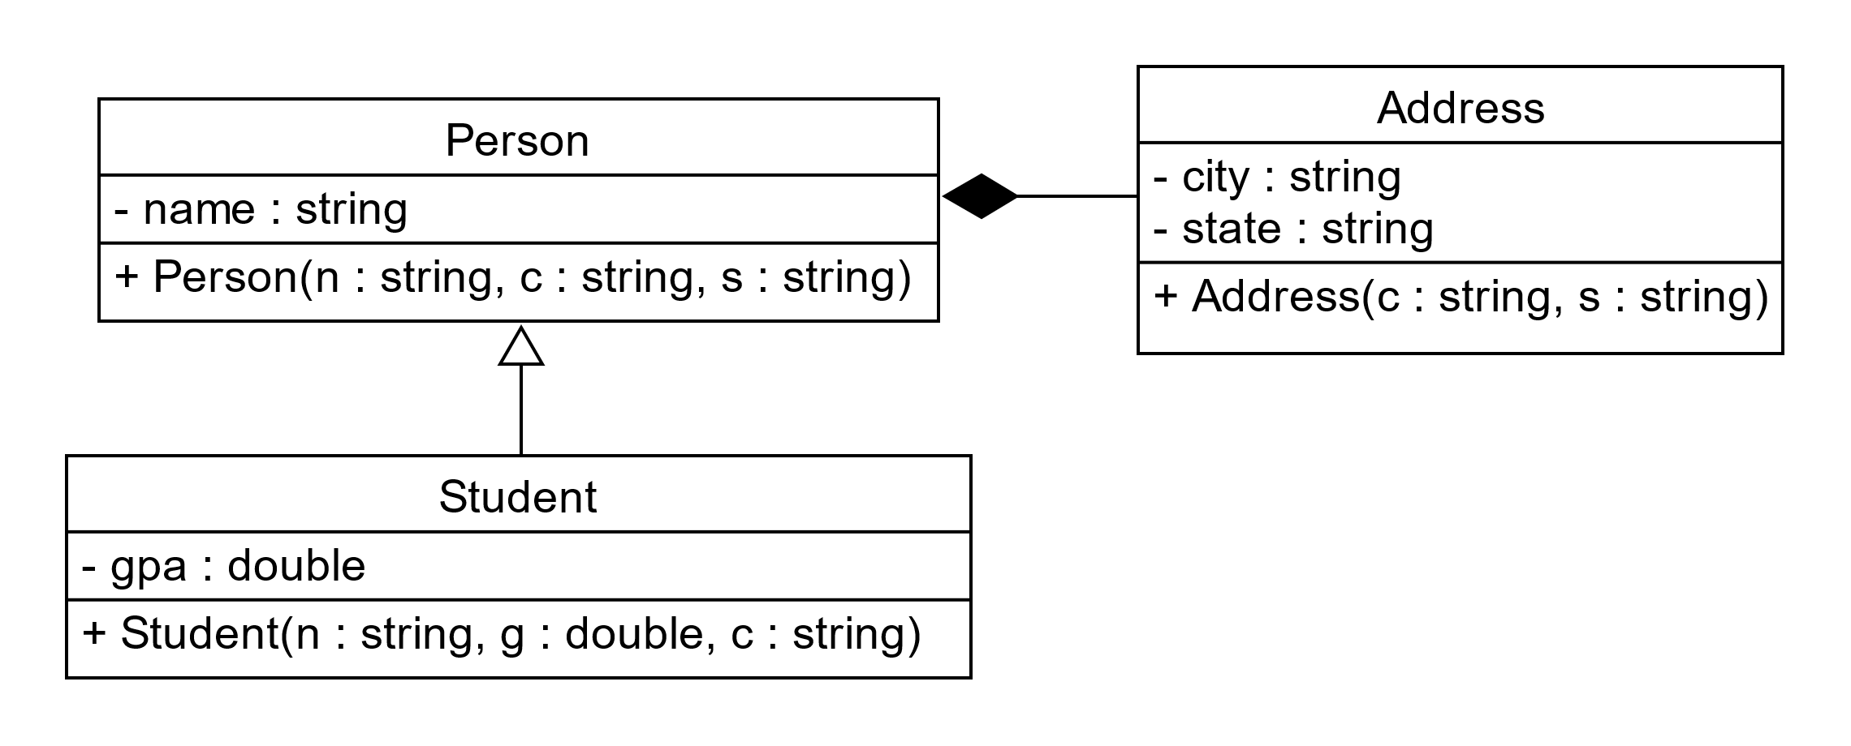
Inheritance & whole-part (1)
Notes:
Combining composition with other relationships increases the challenge of maneuvering the initialization data through the chain of constructor calls. The Student and Person classes form a short inheritance hierarchy in this example. Additionally, the example forms a composition relationship between the Person and Address classes.

Slide 6
Inheritance & whole-part (1)
Notes:
When a program instantiates a Student, it must pass data from the Student constructor to the Person and from the Person to the Address. Each class uses some of the constructor data to initialize one of its members and passes the rest to the next class in the chain.

Slide 7
Inheritance & whole-part (1) Continued
class Person // superclass and whole
{
private:
string name;
Address addr;
public:
Person(string n, string c, string s) : addr(c, s), name(n) {}
};
class Student : public Person // subclass
{
private:
double gpa;
public:
Student(string n, double g, string c, string s) : Person(n, c, s), gpa(g) {}
}
Notes:
The Student constructor has four parameters. It retains one to initialize its gpa member variable and passes the rest to the Person constructor. The program uses the superclass’s name to call its constructor. A superclass constructor call is always the first element in an initializer list. And the number of arguments in the call must match the number of parameters in the constructor function.
The Person constructor uses one parameter to initialize the member variable name and passes the rest to the Address constructor. The program uses the whole class variable name implementing composition to call the part class constructor.

Slide 8
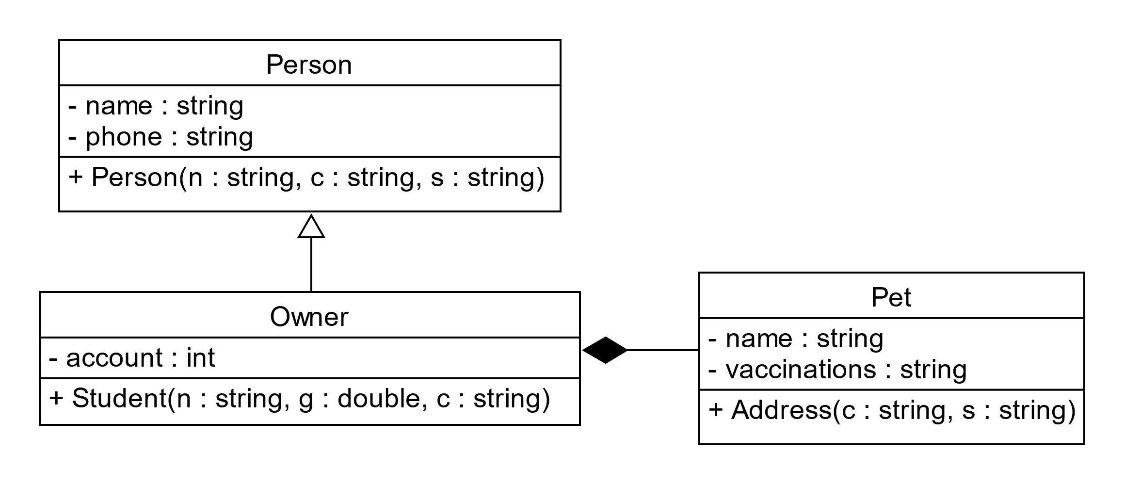
Inheritance & whole-part (2)
Notes:
The final example also combines composition and inheritance but moves the composition from the superclass to the subclass. As before, our interest begins when the program instantiates an Owner object and maneuvers the initializing data into the correct objects.

Slide 9
Inheritance & whole-part (2)
Notes:
The Owner constructor splits the data entering as constructor parameters. It first sends some of the data to its superclass, then some to its part class.

Slide 10
Inheritance & whole/part (2) Continued
class Person
{
private:
string name;
string phone;
public:
Person(string n, string p)
: name(n), phone(p) {}
};
class Owner : public Person
{
private:
int account;
Pet my_pet;
public:
Owner(string n, string p, int a, string pn, string v) : Person(n, p), my_pet(pn, v), account(a) {}
};
class Pet
{
private:
string name;
string vaccinations;
public:
Pet(string n, string v)
: name(n), vaccinations(v) {}
};
Notes:
The Owner constructor has five parameters. It passes two of these to its superclass, Person, and two to its part class, Pet, and uses the last to initialize its account member variable.

