Slide 1
Aggregation
Pointer member variables
Delroy A. Brinkerhoff
Notes:
Conceptually, the only difference between composition and aggregation is their binding strength. Whereas composition has strong binding, aggregation is weak. Their respective implementations reflect the difference between their strengths. C++ implements the weaker but more flexible aggregation relationship with pointer member variables in the whole class, one for each part.

Slide 2
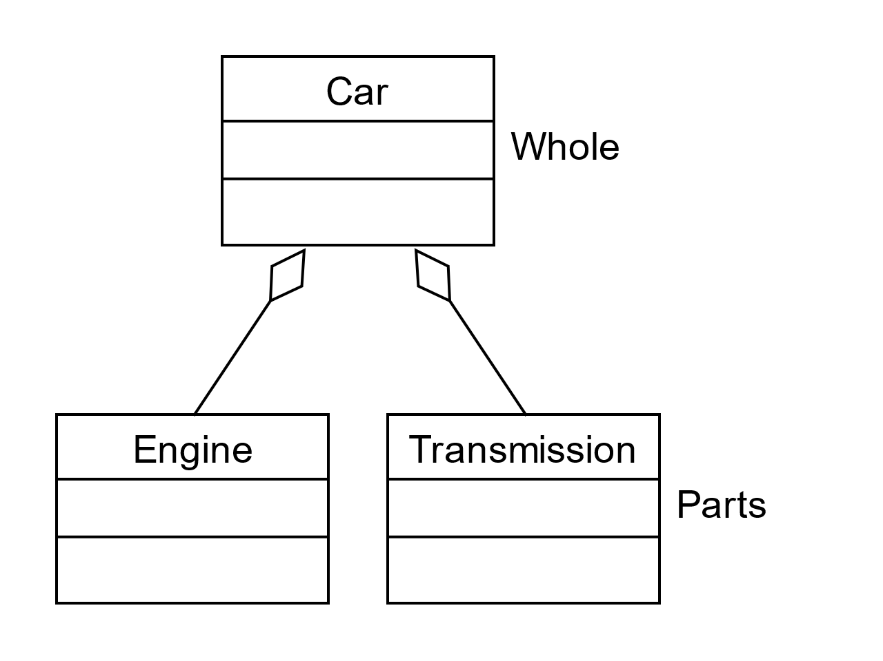
Aggregation Characteristics
Parts are bound weakly or loosely to the whole object with pointers
Parts and the whole may be created and destroyed at different times, so they have independent lifetimes
Parts can be changed or replaced whenever it is convenient
The parts may be shared with other objects in the program, making ownership of the part an important issue
Parts are implemented as pointer member variables in the whole class
Notes:
Like composition, aggregation creates a whole-part hierarchy. So, the role names “whole” and “part” are still natural and appropriate. Conversely, the connector symbol is arbitrary and unnatural. It replaces composition’s solid or filled-in diamonds with hollow or outlined ones. The connectors’ similarities reinforce the relationship’s similarities. Conceptually, the only difference between the two relationships is the strength or tightness of their bindings.
Replacing embedding with pointers causes aggregation’s weaker binding, leading to the other differences between the two relationships. The ease with which a program can change the addresses saved in pointers affects the object’s lifetime and sharing. First, it allows the program to independently create and destroy the whole and part objects, giving them independent lifetimes. The program can create, destroy, or change the relationship whenever convenient.
Finally, the whole object points to its parts, which exist outside the whole. Many objects can point to the same part object, making sharing straightforward. But sharing introduces another issue: which whole object is responsible for managing or destroying the part? Sometimes it’s convenient to think of a part as having an “owner” that is responsible for it. If the original problem doesn’t suggest an “owner,” we arbitrarily select one.

Slide 3
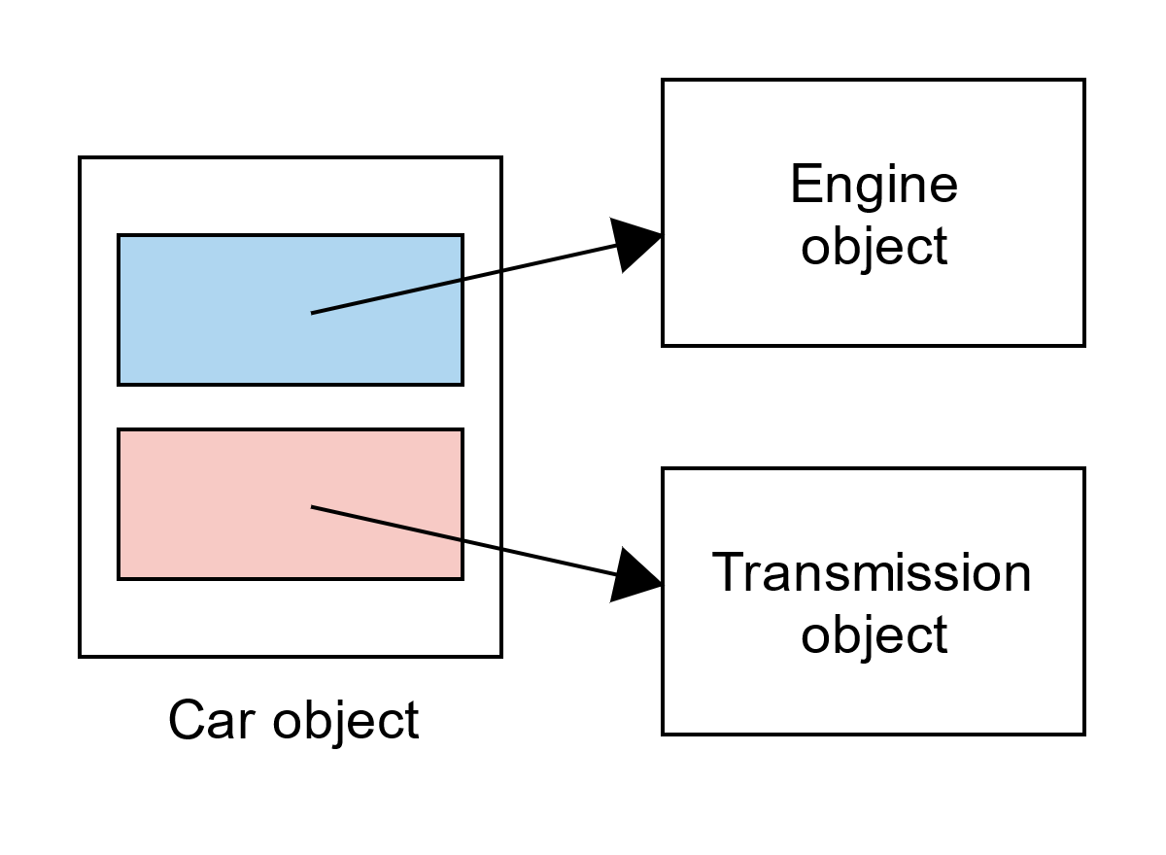
Implementing Aggregation
class Engine
{
. . .
};
class Transmission
{
. . .
};
class Car
{
private:
Engine* motor = nullptr;
Transmission* trans = nullptr;
. . .
};
Notes:
We return to the car example to illustrate the aggregation relationship. We again note that aggregation is a one-way relationship, so neither the engine nor the transmission “know about” or reference the car. As before, we specify the part classes before the whole, typically by including the appropriate header files before the whole-class specification. We build the relationship with two pointer member variables in the car class. If we don’t create the part objects in the whole-class constructor, we should initialize the pointers to null. Otherwise, they have random values that make working with them more difficult.
The picture abstractly illustrates the organization of the objects in memory.

