Slide 1
The Copy Constructor
Copying or duplicating an object
Delroy A. Brinkerhoff
Notes:
We’ve spent little time discussing how to copy or duplicate objects in our studies. So, it might seem like the copy operation is a rare and deliberate task. But it only seems like a rare operation because the compiler generates code silently and automatically to complete the copy.

Slide 2
Object copy
To copy an object means to duplicate or reproduce it. The original and copy
have the same data
are, in some sense, equal
are indistinguishable
are independent
Copying an object means making a new object, which is a constructor task
Operations triggering a copy operation
Assignment
Pass by value (aka pass by copy)
Return by value
Programs require these operations
Compiler auto-generates
Assignment operator
Copy constructor
Notes:
Understanding what we mean by copying or duplicating an object is essential for the current discussion. It means that the original and its copy contain the same member data. So, in some sense, the two objects are equal or indistinguishable and independent. Object independence is a critical measure of the completeness of the copy operation that we rely on throughout the discussion. If the original and copy are fully independent, the program should be able to change one object without affecting the other.
When a program copies an object, it makes a new one, which is always a constructor’s task.
Despite the little previous coverage, copying or duplicating an object is a frequent, necessary task. Three operations, frequently appearing in all object-oriented programs, require an object copy: An assignment operation and passing an object to, or returning it from, a function by value. These operations are so ubiquitous that the compiler automatically generates an assignment operator and a copy constructor to carry them out.

Slide 3
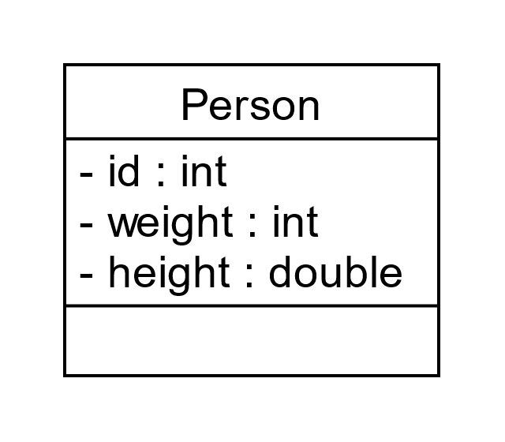

Simple object Copy The automatic copy constructor
Person::Person(Person& p)
{
memcpy(this, &p, sizeof(Person));
}
Person::person(Person& p)
{
id = p.id;
weight = p.weight;
height = p.height;
}
int id;
int weight;
double height;
Notes:
Earlier in the chapter, I proposed two terms to ease our discussion of aggregation. I proposed calling a class without pointer members a “simple class” and an instance of such a class a “simple object.” The compiler-created copy constructor works and is sufficient for simple classes. It creates a second object distinct from and independent of the first object. The two objects have the same fields, and each field saves the same value. After the copy, modifying one object doesn’t affect the other.
We can’t see the compiler-generated C++ code for the copy constructor, but we can see implementations with the same effect. The first version uses the memcpy (i.e., memory copy) function (prototyped in the <string> header file). memcpy is a very low-level function that copies some number of bytes, the third argument, from one memory address, the second argument, to another address, the first argument. Please see the review section at the top of the page for links to “this,” the address-of, and sizeof operators.
The second version is straightforward and understandable but perhaps less efficient. It implements a member-by-member copy with the assignment operator. Each field in the parameter object, p, is copied by assignment to the corresponding field in the new object, pointed to by “this.”

Slide 4
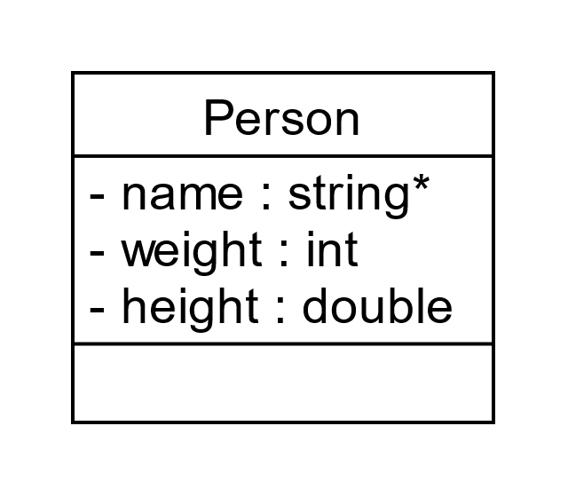
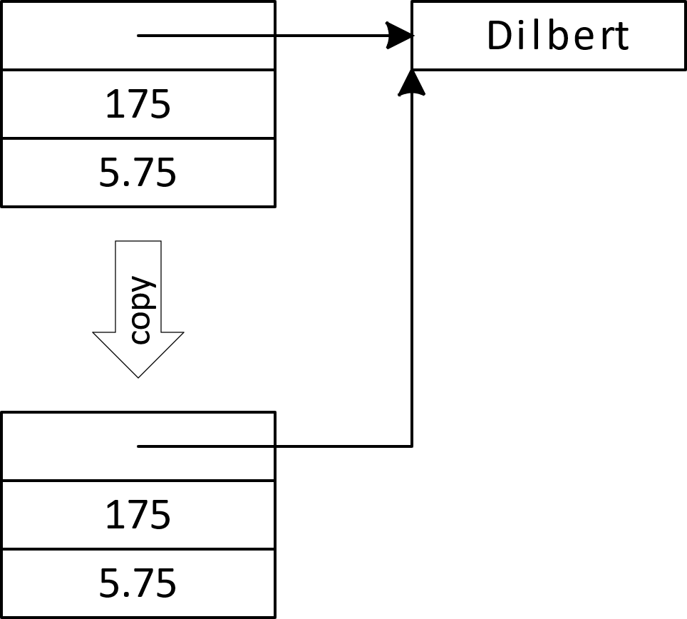
Copy Error
string* name;
int weight;
double height;
Notes:
I further proposed calling a class with at least one pointer member a “complex class” and an instance of such a class a “complex object. Using a compiler-generated or otherwise simple copy constructor to duplicate a complex object is problematic. A simple copy constructor duplicates all the fields bit-for-bit, including the addresses saved in pointers. In the case of aggregation, if the copy constructor duplicates the whole object, the result is two whole objects sharing a single part object. This situation may be desirable in some cases but probably not most. The two whole objects are not independent: Changing the name saved in one changes the name saved in the other.

Slide 5
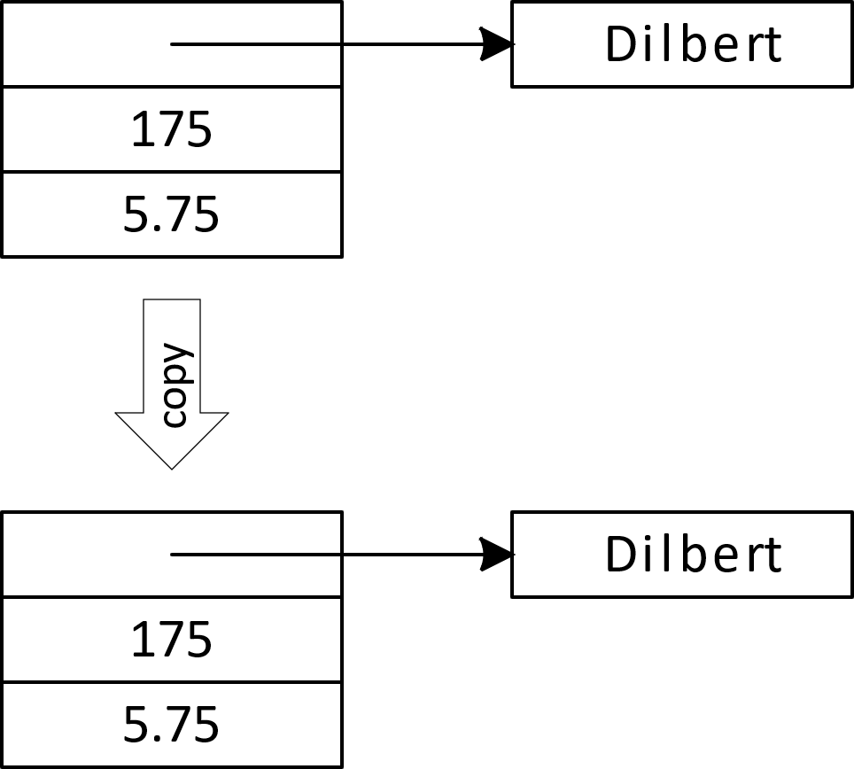
Overriding the copy constructor Copying a Complex Object
Person::Person(Person& p)
{
name = new string(*p.name);
weight = p.weight;
height = p.height;
}
Person::Person(Person& p)
{
memcpy(this, &p, sizeof(Person));
name = new string(*p.name);
}
Notes:
When a class has one or more pointer members, programmers must override or replace the compiler-generated copy constructor. The overridden, programmer-created function must duplicate each part object, not just its address. The slide shows two examples, but both duplicate the aggregated part using the same statement. The statement instantiates a new part and saves its address in a pointer member in the whole object. The use of the dereference operator in this situation is quite common.
We can use simple assignment or the memcpy function to copy fields with fundamental types like integers or doubles. However, if we use memcpy, the statement order is significant. Reversing the order creates a new part object and saves its address in the new whole object’s pointer. But then memcpy overwrites the address when it copies all the old whole object’s fields to the new whole. Overwriting the address in the pointer also creates a memory leak.

