Slide 1
Multiplicity
Representing many identical part classes
Delroy A. Brinkerhoff
Notes:
Whole-part relationships come in many varieties. Aggregation and composition are the main ones, but we can also vary how many parts each whole has. The subject of this section is the UML syntax specifying how many parts a whole has.

Slide 2
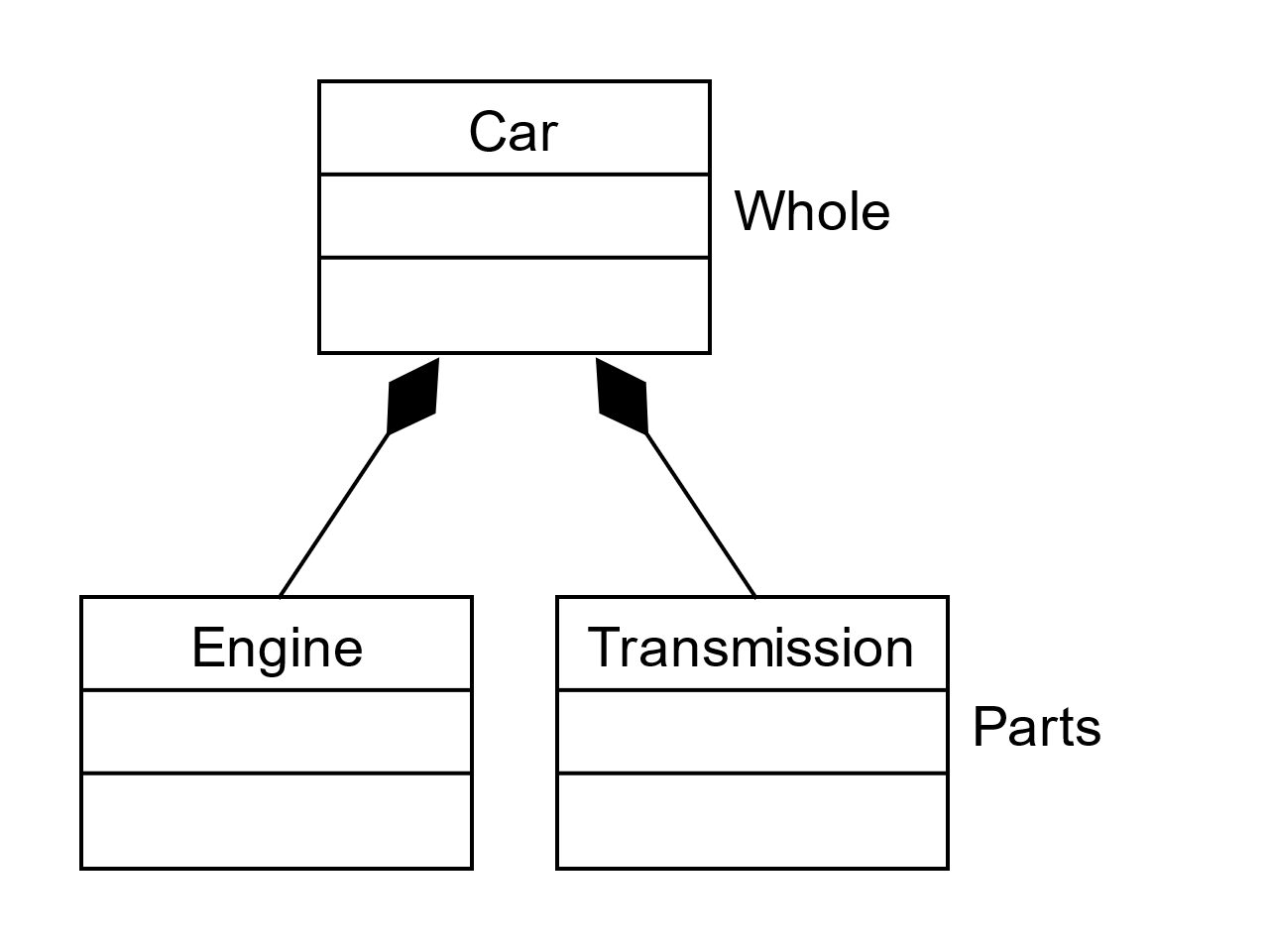
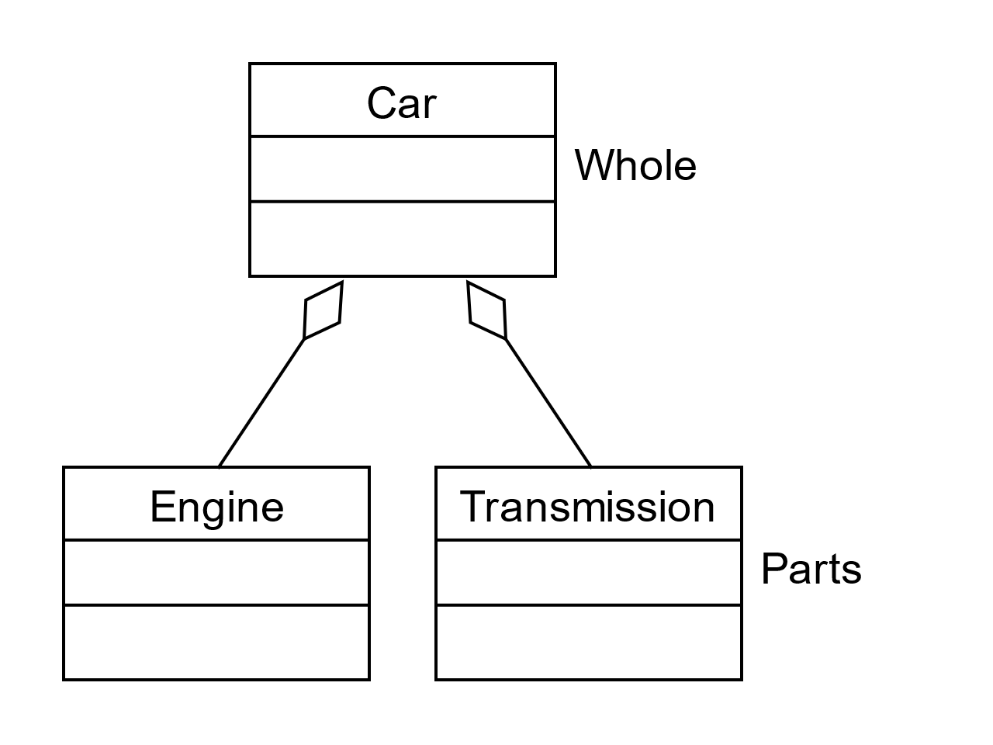
Multiple Parts
Notes:
Previous examples illustrate how a UML class diagram denotes a whole class with more than one kind of part class. But how does the UML present a whole class with multiple same-class parts?

Slide 3
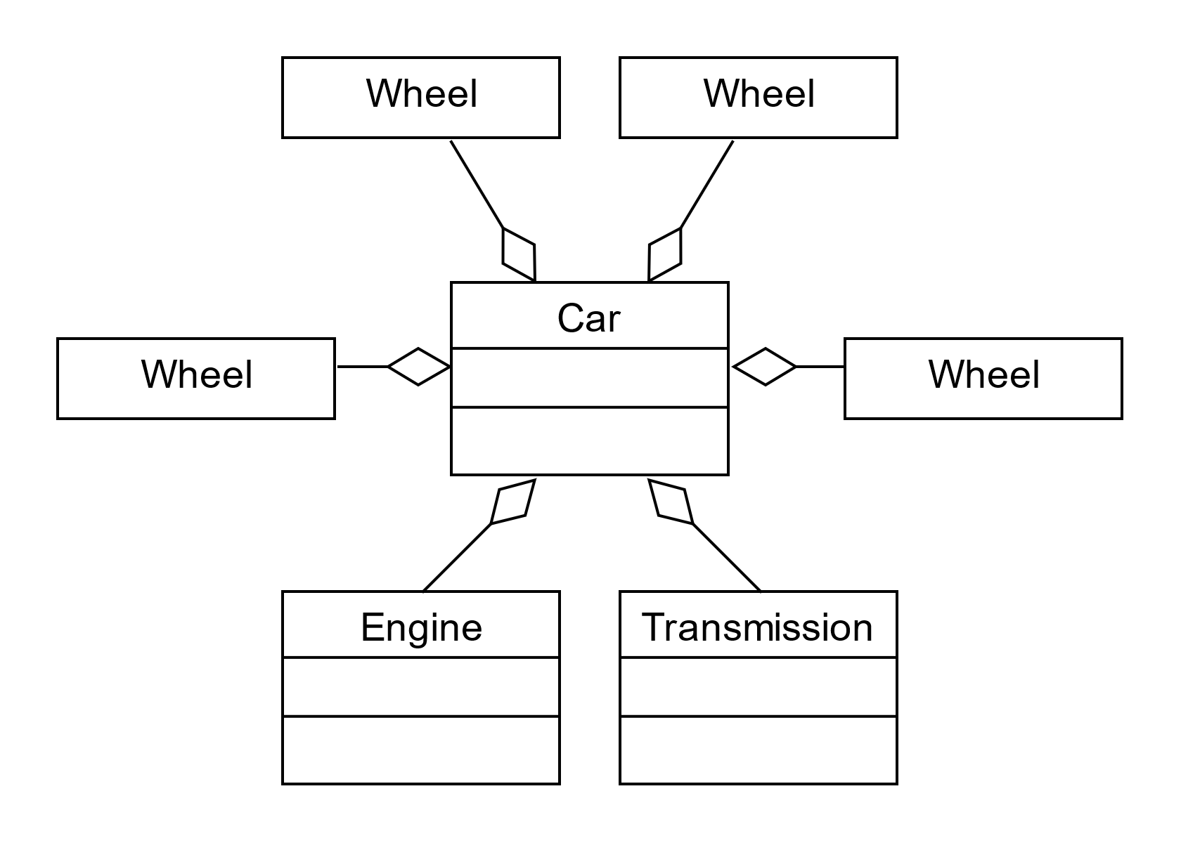
Whole with many identical Parts
Notes:
For example, suppose that we want to add wheels to the Car class. In some locations, three-wheeled cars are commonplace, and a California company is working on a two-wheeled electric car (some features make it a car rather than a motorbike). But, four wheels are typical if we focus on the vehicles most frequently appearing on U.S. roads. We can represent this situation with four separate class symbols, each connected with aggregation, as illustrated. But this approach uses a great deal of diagram real estate and takes a long time to draw. What happens when the diagram has many more than four parts?

Slide 4
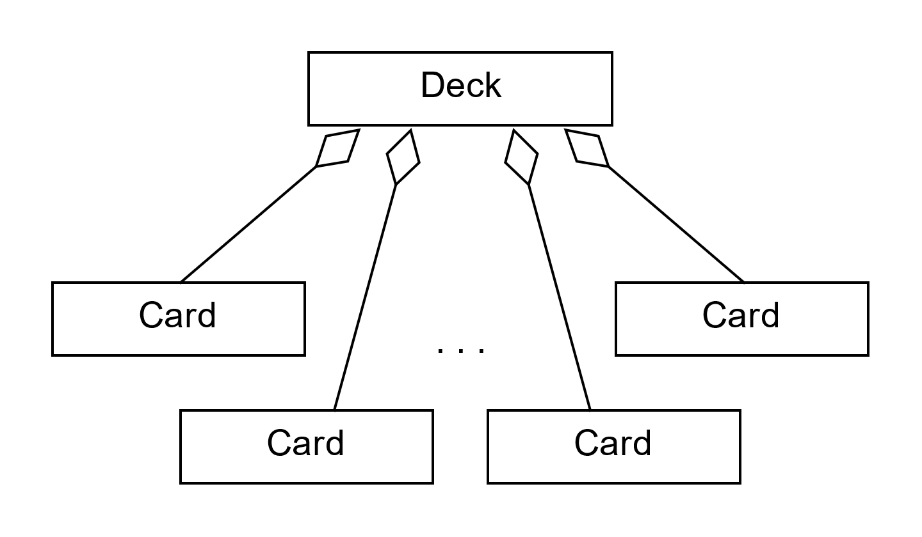
Too many parts to diagram
Notes:
Imagine that we are programming a card game. Numerous games have different deck sizes, but many use a standard 52-card deck. How should we diagram a Deck class that has 52 Card parts? If drawing four separate wheels took too much time and wasted too much diagram space, a whole class with 52 parts is unreasonable. And the resulting diagram would be hard to read because most readers would need to pause and count the Card classes to know how many the Deck had.

Slide 5
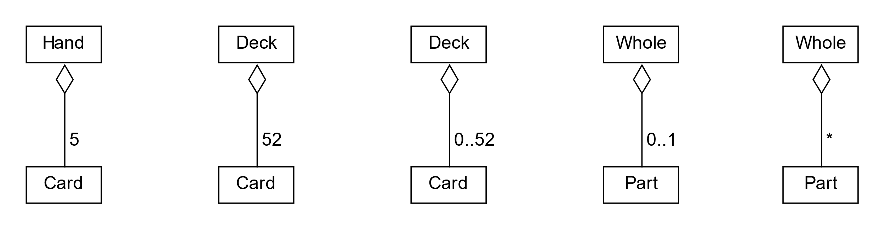
Multiplicity Operators
Notes:
The UML provides a set of multiplicity operators to alleviate this problem. The operators adorn the part side of the connector symbol, indicating the number of parts the whole class has.
A constant specifies an exact, fixed number of parts, which is helpful when specifying a composition relationship.
The UML uses two dots or periods to denote a range. This example indicates that an instance of the Deck class has zero to 52 Cards. We often use the range notation with aggregation, which allows the number of parts to vary over time. In this example, a full Deck has 52 cards, but the number decreases as the cards are dealt.
We generally read this special case as "0 or 1."
The asterisk means "many," an unspecified number. You will sometimes see "0..*" as a variation.

Slide 6
Implementing multiplicity
class Deck
{
private:
int count = 0;
Card* cards[52];
. . .
};
class Deck
{
private:
vector<Card *> cards;
. . .
};
Notes:
We can implement multiple whole-part connections with any variable capable of storing multiple objects. An array can save objects, allowing us to implement multiple composition connections, or it can save pointers, allowing us to implement multiple aggregation relationships. The C++ standard template library, or STL, provides a vector class that works well. But we can, if we choose, use linked lists, trees, hash tables, etc. The textbook has detailed examples based on arrays and vectors.

Slide 7
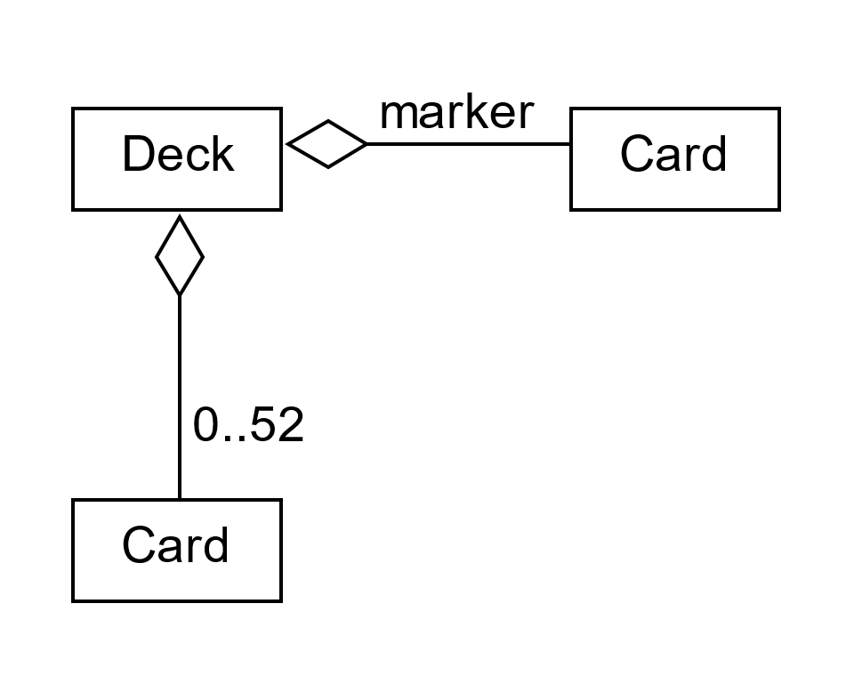
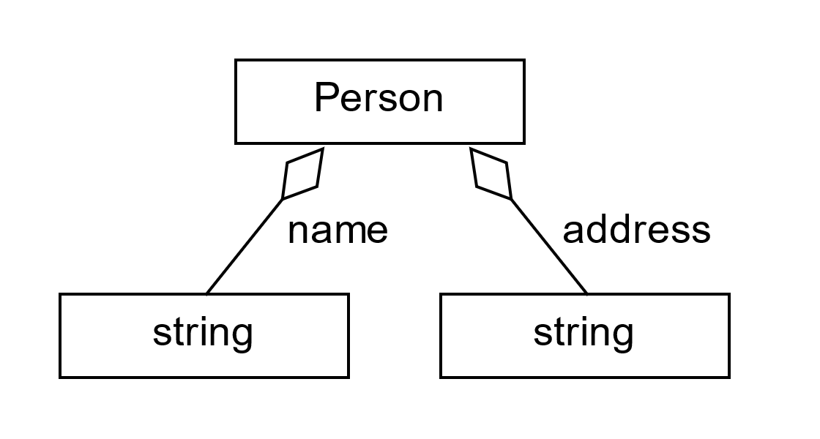
Same Class, Different Roles
Notes:
We can implement multiple whole-part connections with any variable capable of storing multiple objects. An array can save objects, allowing us to implement multiple composition connections, or it can save pointers, allowing us to implement multiple aggregation relationships. The C++ standard template library, or STL, provides a vector class that works well. But we can, if we choose, use linked lists, trees, hash tables, etc. The textbook has detailed examples based on arrays and vectors.

