Slide 1
Multiple Association
Association relationships between many peers
Delroy A. Brinkerhoff
Notes:
Although aggregation and association are similar, the latter is inherently more complex due to its bidirectionality. Aggregation operates in one direction, from the whole to the parts, requiring pointers only in the whole. Association operates in both directions, requiring pointers in both peers. The previous association examples relied on one-to-one relationships, but association also allows one-to-many and many-to-many connections. This section explores the complex structures possible with multiple associations.

Slide 2
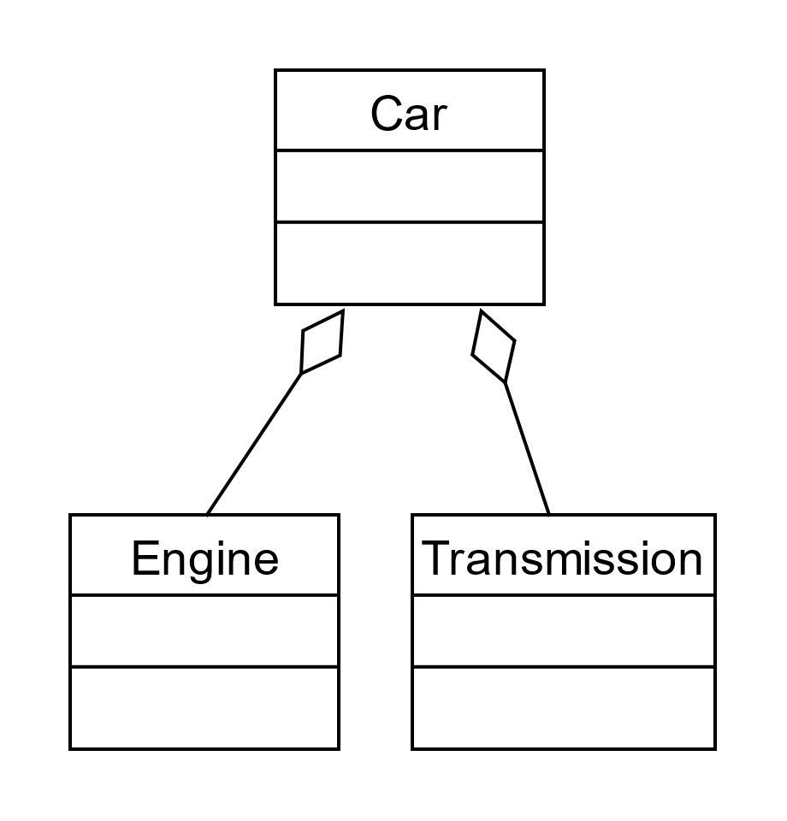
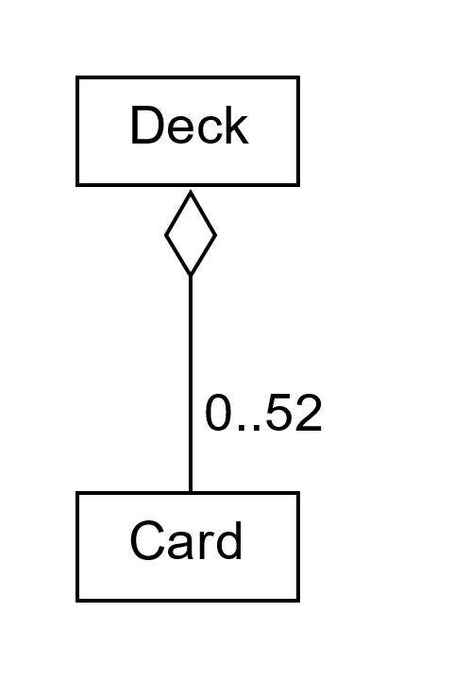
Aggregation Options
one part per class
Multiple parts per class
Notes:
Whole classes may have any number of parts. If the parts are instances of different classes, the UML class diagram shows the classes independently. If the parts are instances of the same class, designers use multiplicity operators to show how many parts the whole may have. In the absence of an explicit multiplicity, one is the assumed value.

Slide 3
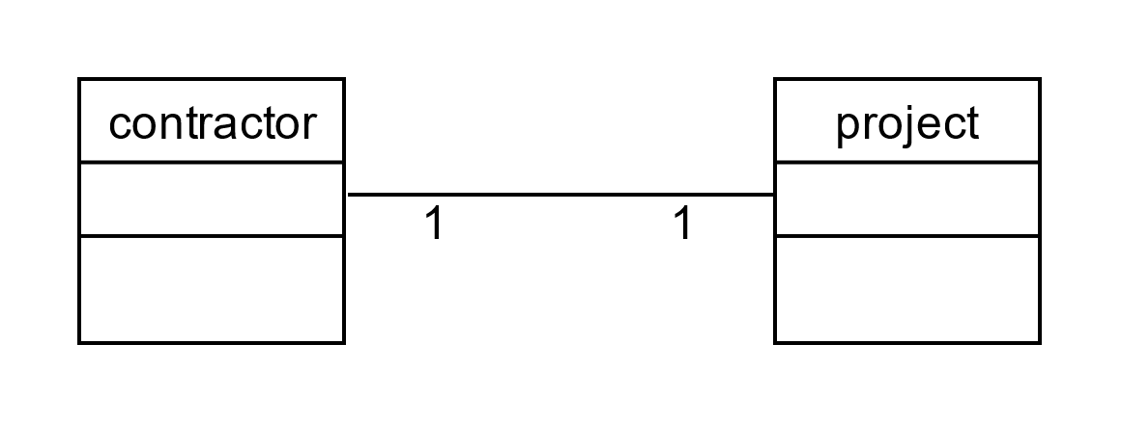
One-to-one Association
project* p; contractor* c;
Notes:
A one-to-one association requires a pointer in each peer. Maintaining two pointers whenever we update the relationship is the primary reason association is more complex than aggregation. The need for a forward reference in a C++ program also makes association more challenging for programmers. Specifying the multiplicity in this case is optional.

Slide 4
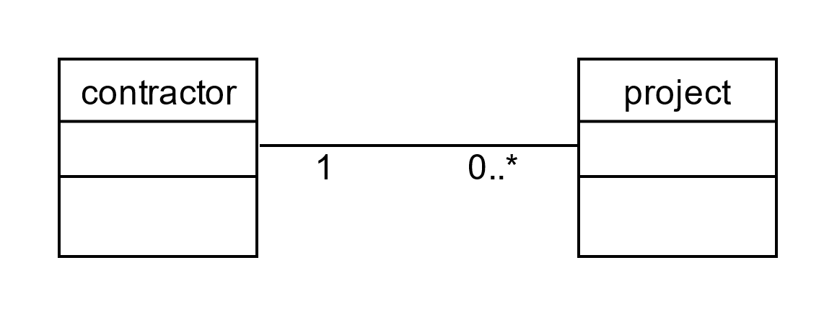
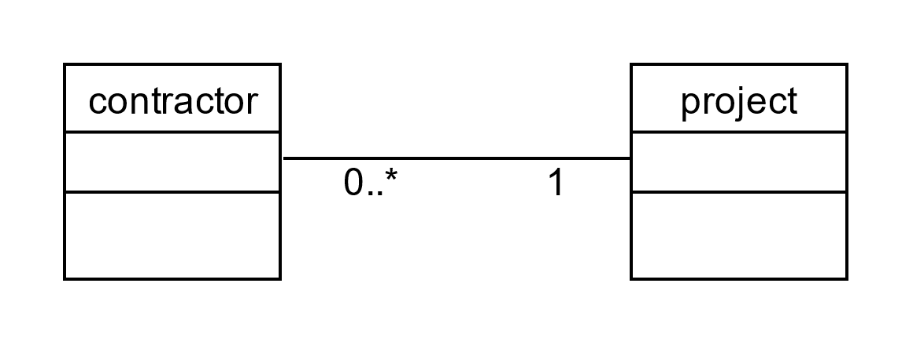
One-to-Many or Many-to-one Association
project* p[25]; contractor* c;
project* p; contractor* c[100];
Notes:
The equivalent terms “one-to-many” and “many-to-one” describe relationships connecting one class to many peers. In this example, we can say that “one contractor has many projects” or “one project has many contractors.” We implement these relationships with multiple pointers in one class. The examples illustrate pointer arrays, but we can use vectors, lists, queues, et cetera. As illustrated, the design doesn’t specify an upper limit on the many-side of the relationship, but C++ requires us to specify the size of an array created on the stack with a compile-time constant. We can remove the discrepancy by creating the array on the heap and replacing the constant with a variable, or we can replace the array with a more dynamic structure like a vector or list.
This organization introduces an easily overlooked challenge. It’s generally easy to determine where we should place members. For example, identifying information such as a contractor’s name and address describe a contractor and belongs in that class. But consider the pay rate and number of hours worked. If a contractor works on many projects, the pay rate and number of hours worked may vary from one project to another, arguing for the contractor to maintain these values. But if a project has many contractors, pay rate and hours worked may vary with experience and task, suggesting that the project should maintain the data. Of course, other combinations are possible, and we organize the members to solve the underlying problem best.

Slide 5
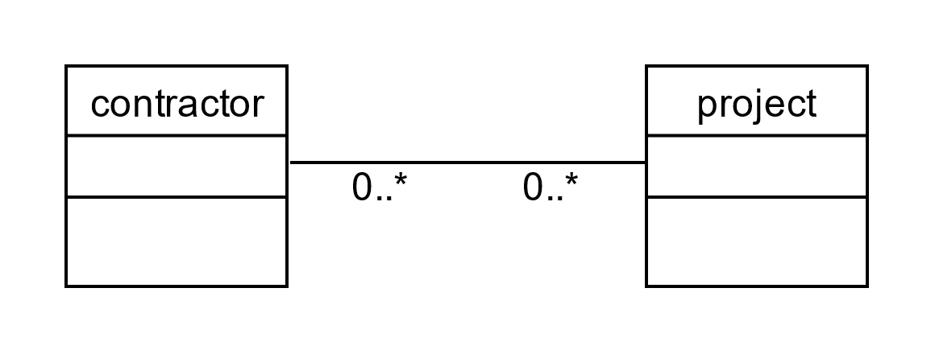
Many-to-Many Association
Notes:
Unlike aggregation’s hierarchical organization, association also allows us to create many-to-many relationships. This organization is flexible but difficult to visualize and implement, requiring multiple pointers in both classes. We can organize the pointers in each class with arrays, vectors, lists, queues, trees, et cetera.

Slide 6
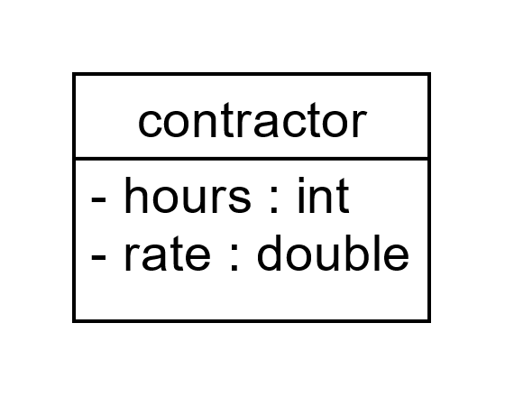
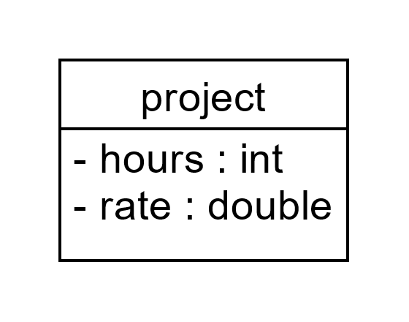
Member Location in Many-To-Many Association
If contractors maintain the time worked, they must work the same amount of time for each project.
If contractors maintain the pay rate, they must charge the same amount for each project.
If projects maintain the time worked, then each contractor must work the same amount of time.
If projects maintain the pay rate, they must pay each contractor at the same rate.
Replace single variables with arrays or containers?
Notes:
Many-to-many relationships can increase the challenge of identifying the best class for maintaining some members. The previous example proposed two scenarios. First, contractors may work on multiple projects at different pay rates and for different amounts of time. And second, projects may pay different rates for varying experience and skills. Consider the following problems:
If contractors maintain the time worked, they must work the same amount of time for each project.
And, if contractors maintain the pay rate, they must charge the same amount for each project.
If projects maintain the time worked, then each contractor must work the same amount of time.
If projects maintain the pay rate, they must pay each contractor at the same rate.
We could replace the single variables with arrays or containers such as vectors or lists. But we face the problem of keeping the corresponding elements synchronized. For example, if we use arrays, then index 5 in the hours, rate, and pointer arrays must apply to the same contractor-project connection, significantly increasing the programming effort and the likelihood of an error. That approach is antithetical to object-oriented programming, which should make programming more straightforward and less error-prone.

Slide 7
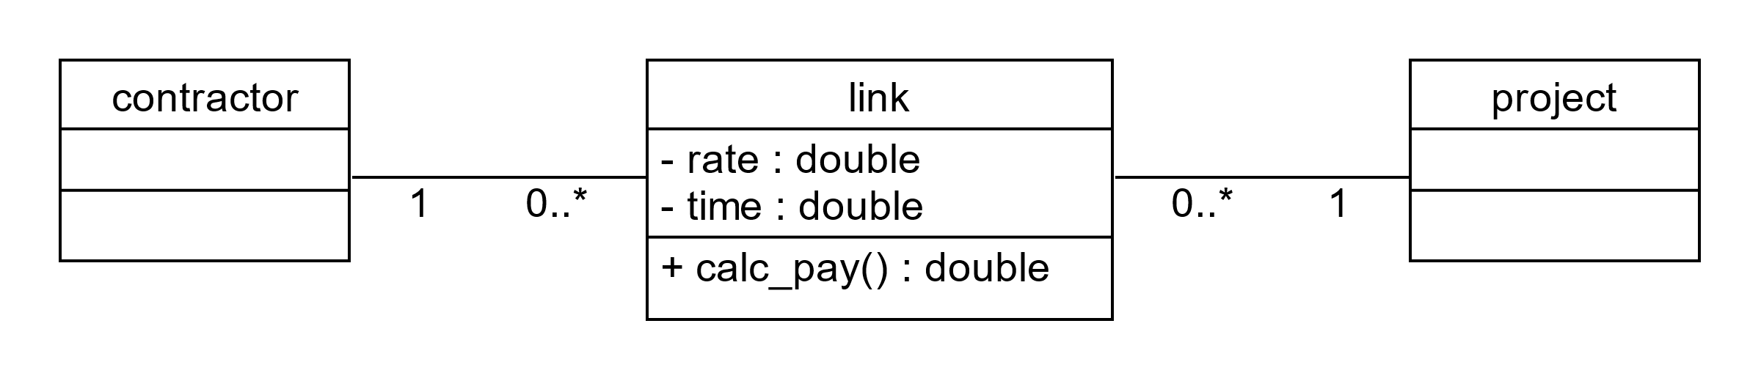
Link Classes
link* projects[25];
contractor* c;
project* p;
link* contractors[100];
Notes:
We elegantly solve this problem with a construct called a link class. When we instantiate classes connected by aggregation or association, we simultaneously instantiate the connections between the objects. The UML calls these connections links. The pay rate and time worked are attributes of the relationship between a contractor and a project, that is, of the link connecting them. We represent the link as a class and rate and time its members.
With this structure, the pay rate and the time worked are clearly properties of a specific contractor-project relationship. No one claims that maintaining the pointers is effortless, but links centralize information in one location. So, once the program follows a pointer, it finds the data and operations using the data in one place, avoiding returning to a contractor or project to search through other structures for additional data and maintaining strong encapsulation.

Slide 8
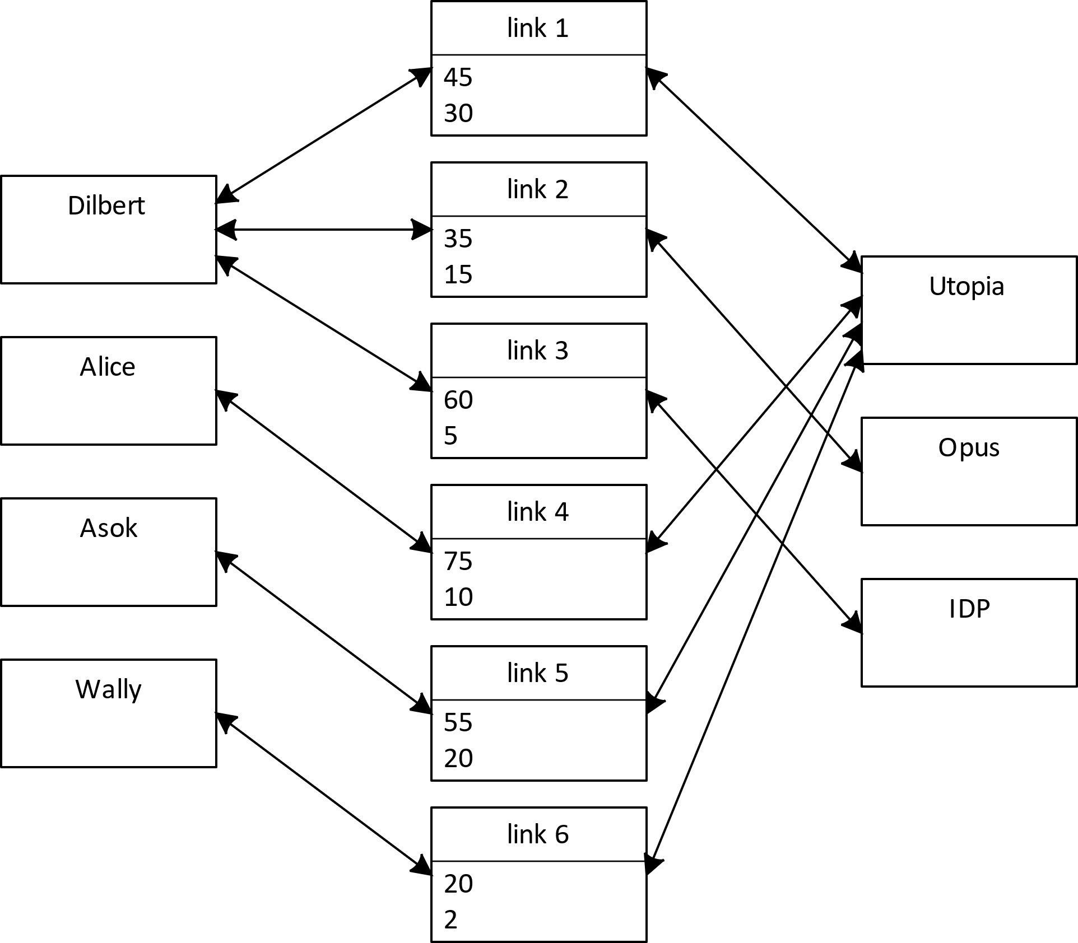
Many-to-Many Association with Link Classes
Notes:
The illustration demonstrates some possible links between contractors and projects. Each rectangle represents an object: instances of contractor, project, and link classes. The double-ended arrows represent pointer pairs: one pointer in the link class and the other in the contractor or project class. Contractors are not required to work on every project, and projects are not required to employ every contractor. So, the figure only illustrates a few of the possible interconnections. Instances of the link class allow contractors to work at different rates for different lengths of time on each project.

