Slide 1
Dependency
Uses / Using
Delegation
Delroy A. Brinkerhoff
Notes:
Dependency is one of the most challenging class relationships for us to understand. But recalling some of its previous names, “uses,” “using,” or “delegation,” can help clarify its meaning.

Slide 2
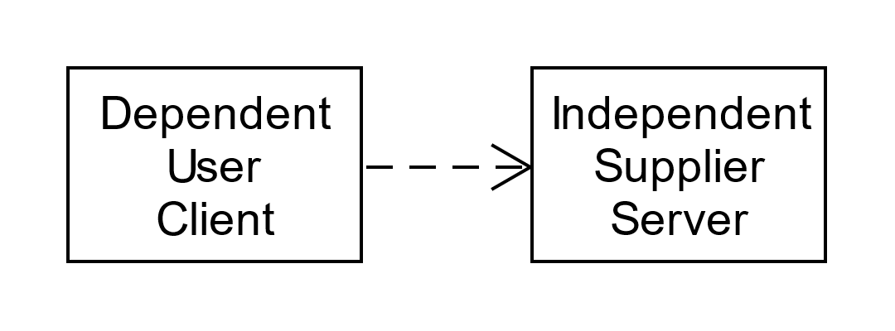
Dependency: Roles and meaning
Various role names
Formal names are “dependent” & “independent”
I prefer “client” and “supplier”
Best understood in terms of responsibilities
The client class depends on the supplier class to fulfill its responsibilities
The client class uses the supplier class to fulfill its responsibilities
The client class delegates some of its responsibilities to the supplier class
Notes:
The classes in a dependency relationship are variously named. Formally, they are called the “dependent” and “independent” classes. I prefer the names “client” and “supplier” because I find these names easier to remember and more clearly describe the interaction between the related classes.
The best way to understand the dependency relationship is in terms of class responsibilities. Every class has some data it manages and functions that operate on the data. We can think of the functions as services that the class provides to client classes. Sometimes a client needs help to fulfill its responsibilities. So, we can say, “A client depends on a supplier,” “A client uses the services of a supplier,” or “A client delegates some of its responsibilities to a supplier.”

Slide 3
Dependency Properties and Implementation
Parameter
Local Variable
Details
class bar { ... }
class foo
{
private:
T f1(bar b) { ... }
T f2();
};
T foo::f2()
{
bar b;
...
b.g();
}
Binding is intentionally temporary
Implemented with local variables & parameters
Lifetimes are independent
Relationship is created with the function call
Relationship ends when the function returns
Return types are insignificant
Suppliers may be pointers or references
Sharing:
Sharable when implemented as a local variable
Shared when implemented as a parameter
Notes:
Unlike other relationships, dependency is intentionally temporary. Inheritance and composition last while the related classes exist, and programs can build and destroy association and aggregation whenever necessary. Programs build a dependency relationship, use it, and then quickly destroy it. We achieve this behavior by implementing dependency with function calls.
Following the UML 2 guidelines, software developers typically implement the dependency relationship with a function parameter. For example, Fowler states, “The most common case I use for dependencies with classes is when illustrating a transient relationship, such as when one object is passed to another as a parameter.” The program creates the parameter, including pointers and references, when it calls the function and destroys it when the function returns. I base the property values for lifetime (“independent”) and sharing (“shared”) on this practice. For building a dependency relationship, the function’s return type is unimportant.
However, a parameter is a specialized local variable, so some practitioners, especially those following the UML 1 standard, also build dependency relationships with non-parameter local variables. UML 1 included the stereotypes «parameter», «local», and «global» to clarify the supplier’s scope, but UML 2 does not.

Slide 4
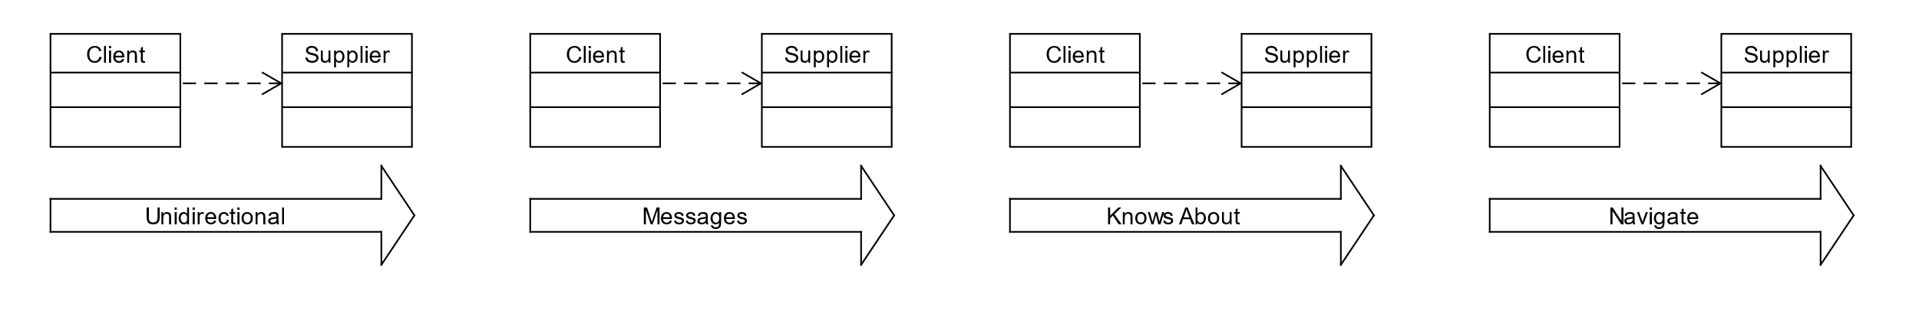
Dependency Directionality
Notes:
The UML dependency symbol is a dashed line decorated with an open arrowhead at one end. Like most class relationships, dependency is unidirectional, operating from the client to the supplier. That means the client can send messages to the supplier, the client “knows about” the supplier, and the program can navigate from the client to the supplier but not from the supplier to the client.

Slide 5
Some Dependency Problems
Dependency is “a semantic relationship between two model elements in which a change to one element (the independent one) may affect the semantics of the other element (the dependent one).” (Booch, Rumbaugh, & Jacobson)
“A dependency exists between two elements if changes to the definition of one element (the supplier or target) may cause changes to the other (the client or source).” (Fowler)
Using these definitions, all relationships are dependencies!
“Trying to show all the dependencies in a class diagram is an exercise in futility; there are too many, and they change too much.” (Fowler)
Understanding objects' behavior in a dependency relationship is more important than diagramming it.
Notes:
Unfortunately, dependency engenders some confusion among practitioners. Booch, Rumbaugh, and Jacobson, the original UML creators, define dependency as “a semantic relationship between two model elements in which a change to one element (the independent one) may affect the semantics of the other element (the dependent one).” Fowler offers a similar definition, stating that “A dependency exists between two elements if changes to the definition of one element (the supplier or target) may cause changes to the other (the client or source).” By these definitions, all class relationships are dependencies! Narrowing the relationship’s scope to local variables, especially parameters, mitigates the problem, leaving dependency as a helpful relationship.
Fowler also observes, “Trying to show all the dependencies in a class diagram is an exercise in futility; there are too many, and they change too much.” So, we only diagram dependency when it adds understanding to a design. In my opinion, it’s more important to understand the concepts behind a dependency relationship than it is to diagram it. I recommend treating dependency like program comments: the primary rule of thumb is to make the design more understandable and usable.

Slide 6
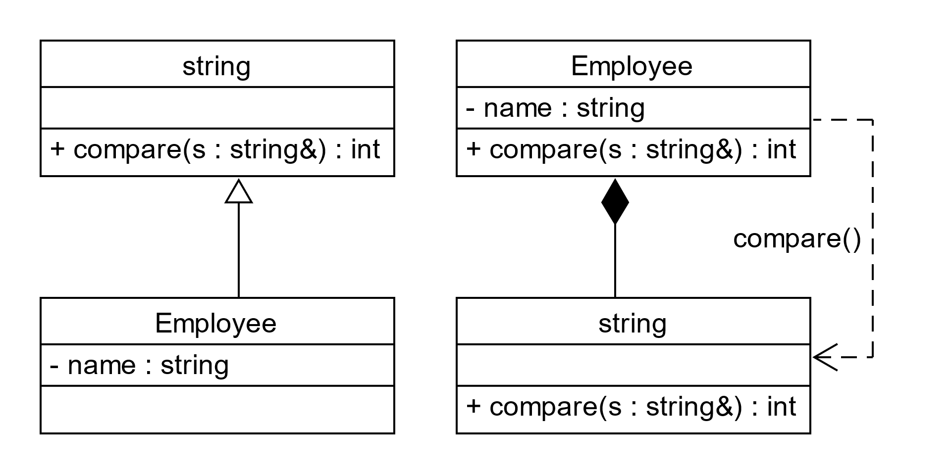
Implementation Inheritance
int Employee::compare(string& other)
{
return name.compare(other);
}
Notes:
There is one design problem for which dependencies are especially helpful. Rumbaugh describes and names the problem: “Sometimes it appears that the use of inheritance would increase code reuse within a program, when a true superclass/subclass relationship does not exist. Do not give in to the temptation to use this implementation inheritance; use delegation instead.” Recall that delegation was an earlier name for dependency.
The Employee class has a string member variable called name and wishes to use the string compare function to compare the name with another string. Inheritance permits such code reuse, but it also suggests that an Employee Is-A string, which doesn’t sound correct. A Has-A relationship, composition as illustrated or aggregation, sounds better: an Employee Has-A name. The labeled dependency clearly illustrates the Employee class relaying the compare message to the string part class.

