Slide 1
operator<< And operator>> with Inheritance
Chaining I/O operators with inheritance hierarchies
Delroy A. Brinkerhoff
Notes:
Imagine a program with three classes: Animal, Mammal, and Zebra. A Zebra is a Mammal, and a Mammal is an Animal. When programs create inheritance hierarchies like this one, it’s common to chain function calls in subclasses to their corresponding functions in superclasses. Some unusual syntax is necessary to implement the chaining.

Slide 2
Reviewing the inserter pattern: The Person class inserter
class Person
{
private:
name : string;
public:
friend ostream& operator<<(ostream& out, Person& me)
{
out << me.name << endl;
return out;
}
};
Notes:
Inheritance doesn’t affect the basic inserter pattern introduced in the previous section. The function is always a “friend.” It always returns an ostream reference. The function’s name is always the “operator” keyword followed by two less-than symbols. The first parameter is always an ostream reference. The second parameter is always a reference to the befriending class. The function’s body always accesses member variables through the second parameter name. And the function always returns the first parameter.

Slide 3
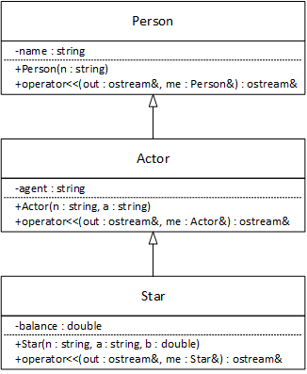
function chaining: Actor to Person
friend ostream& operator<<(ostream& out, Person& me)
{
out << me.name << endl;
return out;
}
friend ostream& operator<<(ostream& out, Actor& me)
{
out << (Person &)me << " " << me.agent << endl;
return out;
}
. . .
Actor a;
cout << a;
Notes:
The Actor inheritance hierarchy, introduced in the previous chapter, serves as the framework for the inserter-chaining demonstration. The Person and Actor operators follow the pattern just described. However, the Actor operator adds a new feature calling the Person operator.
The casting operator converts “me” from an Actor reference to a Person reference. Casting forms an expression whose class type is Person, but the cast does not change “me.” Expressions have statement scope, so the program discards the Actor to Person conversion when the cout statement ends.
An Actor is a Person by inheritance, so casting an Actor to a Person is a safe and reasonable operation. In conjunction with the inserter operator, casting an Actor reference to a Person reference forms a function call matching and calling the Person inserter. A cout statement with an Actor argument matches the Actor inserter function’s signature, running both the Actor and Person operators.
Although the inserter operator appears repeatedly in the statement, the appearances refer to different functions. The first “belongs” to the Person class. The remaining operators “belong” to the ostream class. Returning an ostream reference allows a series of inserter calls in the same statement.

Slide 4
function chaining: Star to Actor
friend ostream& operator<<(ostream& out, Actor& me)
{
out << (Person &)me << " " << me.agent << endl;
return out;
}
friend ostream& operator<<(ostream& out, Star& me)
{
out << (Actor &)me << " " << me.balance << endl;
return out;
}
. . .
Star s;
cout << s;
Notes:
The Actor class is a subclass of Person and a superclass of Star, forming a bridge between the top and bottom classes. The Star inserter function follows the same extended pattern as the Actor function. Specifically, the function casts the Star parameter to its superclass type, matching and triggering a call to the Actor function. A cout statement with a Star argument matches the Star function’s signature, calling it. The Star function calls the Actor function’s inserter, which calls the Person function, chaining calls from the hierarchy’s bottom to top.

Slide 5
Inheritance and the Extractor
friend istream& operator>>(istream& in, Person& me)
{
getline(in, me.name);
return in;
}
friend istream& operator>>(istream& in, Actor& me)
{
in >> (Person &)me;
getline(in, me.agent);
return in;
}
friend istream& operator>>(istream& in, Star& me)
{
in >> (Actor &)me;
in >> me.balance;
return in;
}
Notes:
We can leverage the similarities between the inserter and the extractor operators to create the latter functions. We switch the operators, replace ostream with istream and, for clarity, change “out” to “in.” Two functions call the string getline function to read strings into the person and agent names.

