Slide 1
operator[]
The index operator
Delroy A. Brinkerhoff
Notes:
Programmers frequently use square brackets to access array elements, making it easy to forget that the brackets are an operator. C++ forms the binary index operator with a pair of brackets. The left-hand operand is the address of an array or array-like object, and the right-hand operand is the index of one array element. We begin our exploration of the index operator by reviewing some prerequisite concepts.

Slide 2

Three Variable Characteristics
int counter = 123;
counter = 5;
balance = counter * 10;
cout << counter << endl;
Variables have three characteristics
  (I) Name
  (II) Content
  (III) Address
Compiler maps the name to the address
Notes:
Recall that variables, including array elements, have three characteristics: a name, contents, and an address. When the compiler compiles a program, it maps variable names to memory addresses. How it uses the addresses depends on where the names appear in statements. Variables on the assignment operator’s left side represent addresses where the program saves information; those on the right side represent addresses where it retrieves information. Using the assignment operator as a reference point, it’s clear why variables on the left side represent l-values and those on the right represent r-values. Without the assignment operator, it’s less clear, but whenever the program needs a value, the name represents an r-value.

Slide 3
The Fundamental or
Built-In index operator
char message[100];
char c = message[10];
message[10] = ‘X’;
The square brackets have multiple meanings
  Define arrays
  Index into arrays
Locate an array element by calculating an offset with address arithmetic
  array address + index × the element size
  message + 10 * sizeof(char)
Notes:
Understanding the original, fundamental, or built-in index operator helps us understand how to use an overloaded index operator. Like many symbols and symbol combinations, the brackets have many meanings. In this example, a program defines a character array long enough to hold 100 characters. So, defining an array is one way C++ uses the brackets.
The following statements demonstrate that an array index operation may appear to the right or left of the assignment operator. Regardless of which side of the assignment the index operator appears, it selects one array element, a second use of the brackets. When it appears on the right-hand side, it forms an expression retrieving the value saved at a memory address (an l-value). On the left-hand side, the expression represents a memory address where the program stores a value (an r-value).
The operator performs a straightforward address calculation. It locates an indexed element by multiplying the index by the size of each element, forming an offset, and adding to the array’s address. Recall that an array’s name is its address. The example illustrates the process for locating element 10 in the message array.

Slide 4
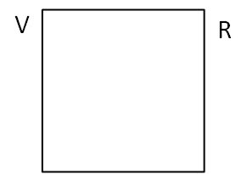
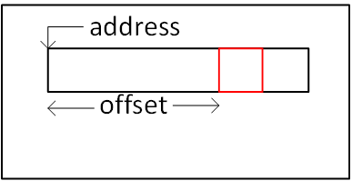
C++ References
Compiler maps a variable name to an address
To create a reference, it maps a second variable name to the same address
  Contents
  Storage location
offset = index × element size
element address = array address + offset
Notes:
The compiler maps a variable name to an address. It maps a second name to the same address when it creates a reference, with an assignment, or as a function parameter or return. Although it’s a little more complicated, the process is the same when the variable is an array element. Imagine that the large rectangle is an object with an array member. The compiler translates the index operator to code, calculating an offset and the element’s address. How the program uses the address depends on where the indexing operation occurs – it can be an r- or an l-value.

Slide 5
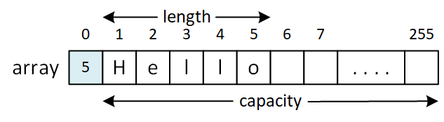
Overloading operator[]
class LPString
{
private:
char array[255];
public:
char& operator[](int index);
};
char& LPString::operator[](int index)
{
if (index > 0 && index <= array[0])
return array[index];
else
throw "Index out of bounds";
}
LPString message;
char x = message[5];
message[5] = 'A';
Notes:
Overloading and using the index operator now seems anticlimactic. One of the classes-and-objects examples demonstrated an old string representation called length-prefix, Pascal, or p-string. The example specified a class named LPString, implementing a length-prefix string. It consists of a fixed-length string, whose first element stores its length.
Crucially, the overloaded index operator returns a reference, allowing programs to use it on either side of the assignment operator. The operator function’s heart is an index operation into the member array. The array is a fundamental type, so the index operator is the original operator, not the overloaded one. The if-else statement validates the index, throwing an exception if it’s invalid. Note that this string representation is not zero-indexed, making a strict greater-than test appropriate.
Like the built-in index operator, programs can use an overloaded index operator on either side of the assignment operator.

