Slide 1
Introduction to Templates
Variables generalize data values
Templates generalize data types
Delroy A. Brinkerhoff
Notes:
C++ templates are a generalizing mechanism that helps programmers create reusable library classes and functions. A helpful parallel is viewing function variables as placeholders later replaced with values provided by an application program. Templates take the generalizing mechanism further by generalizing the data types in functions and class specifications.

Slide 2
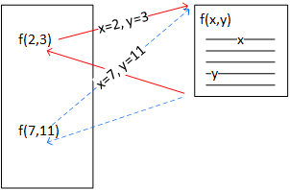
Function Parameters are placeholders
Functions define reusable operations
Parameters are placeholders for function data
  Programs pass data to function parameters
  Functions use parameters wherever they need the corresponding data
  Parameters can have different data each time the program calls the function
Notes:
Functions are among the oldest and most fundamental programming constructs, conceived when programmers noticed repeating code patterns in their programs. Functions help programmers manage complexity by grouping the repeating patterns into reusable programming components representing frequently used operations. However, they would be less reusable and, therefore, less helpful if constrained to work on a fixed set of values. So, modern programming languages parameterize functions, allowing programs to provide different values for functions to process – functions always perform the same operations but with various values. The parameter names are placeholders in the function used to access the program-provided values.

Slide 3
Same Operation
Different Data Types
C
C++
double sqrt(double x);
float sqrtf(float x);
long double sqrtl(long double x);
double sqrt(double x);
float sqrt(float x);
long double sqrt(long double x);
double sqrt(T x);
  T is a template variable matching any integral type
Notes:
The C programming language forced programmers to write multiple uniquely named functions to process different data types, even when the functions performed the same operations. Alternatively, C++ supports function overloading, still requiring multiple functions but permitting access with a single name.
Limiting the parameters to the fundamental types still results in many functions. Templates help manage the number of functions by using a general type, T, to represent all integral types (i.e., integers of all sizes).

Slide 4
When Overloading doesn’t work,
Use templates
int f(int a);
double f(double a);
char f(char a);
Person f(Person a);
Shape f(Shape a);
template <typename T>
T f(T p)
{
T t1 = p;
T t2 = …;
…
return t2;
}
Notes:
Application programmers can also use templates, which is especially helpful if we expand the allowed parameter types to include classes, such as “Person” and “Shape.” The first part of the function definition is “boilerplate” code introducing the template mechanism and the template variable T. Programmers can use any appropriate variable name, but T is traditional when there is only one template variable. Templates initially used the keyword “class” but now also allow “typename.” Both keywords still work, but “typename” seems more appropriate here because the function is not part of a class. Programmers use the template variable, T, wherever the function refers to the data type it’s currently processing.

Slide 5
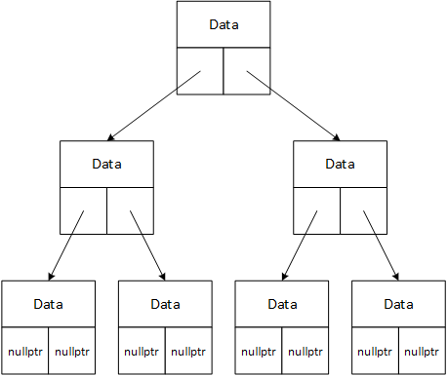
Generalized template classes
template <class T>
class BTree
{
private:
T data;
public:
void insert(T x);
T search(T key);
};
template <class T>
void insert(T x) { ... }
template <class T>
T search(T key) { ... }
Notes:
Data structures, called containers when implemented with C++ classes, store and organize data in various ways. Binary trees are data structures consisting of stored data and two pointers. The operations maintaining the tree must compare data but are otherwise independent of it. The independence makes binary trees good candidates for inclusion in programming libraries. The library programmers can create a family of overloaded functions to deal with the known fundamental data types. However, they can’t anticipate every class an application programmer may eventually create.
Library programmers use templates to generalize container classes. The first line is “boilerplate” syntax introducing the template mechanism and variable. As before, we can choose either the “class” or “typename” keyword, but here, “class” seems appropriate. The class specification, including its member functions, uses the template variable to refer to the stored data’s type. The template variable is a placeholder, which the compiler replaces with a “real” type when compiling a program.

