Slide 1
Template Classes
Generalized Class Members
Delroy A. Brinkerhoff
Notes:
C++ also allows programmers to create template classes, improving their portability across various hardware and software architectures. Templates generalize classes and their members, including data and functions. Creating data structures, called containers in C++ programs, is one of the most common uses of templates. Containers are relatively easy to understand, making them good candidates for demonstrating how C++ programs create and use template classes.

Slide 2
Activating Templates and introducing the variable
template <class T>
“class” used in documentation
Appropriate for template classes
template <typename T>
Notes:
The C++ syntax activating the template mechanism and introducing the template variable is the same for classes as for functions. When first introduced, C++ used the “class” keyword exclusively but now also accepts the “typename” keyword. Nevertheless, “class” is the most common version used in C++ container documentation. Furthermore, containers often store objects instantiated from classes, making the class keyword an appropriate choice.

Slide 3
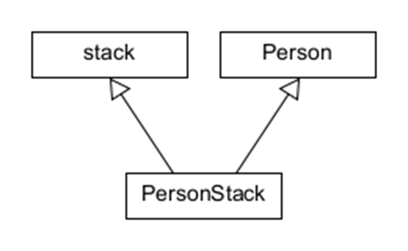
data Structures
Multiple inheritance
  Data structure operations from stack
  Data and operations from Person
Template class
  Data structure operations from stack
  Data specified by application
Notes:
C++ initially implemented containers as superclasses. Based on this approach, a C++ program created a client class with multiple inheritance. The client inherited attributes and operations from a data class and organizational code from the container class. This dichotomous architecture works because the operations organizing a data structure are (mostly) independent of the stored or contained data. However, that independence also supports another implementation based on template classes. A container class still provides the organizational operations but represents the contained data with a general template variable.

Slide 4
Specifying a template class
template <class T>
class stack
{
private:
static const int SIZE = 100;
T st[SIZE];
int sp = 0;
public:
void push(T data);
T pop();
int size();
T peek();
};
The “template” statement and variable
Notes:
A simple data structure, a stack, illustrates a C++ container implemented with templates. The boilerplate code of the template statement activates the template mechanism and introduces the template variable, T. Throughout the container class and its functions, the template variable represents the data type of the contained or stored data.
This version of the stack class uses a class constant, SIZE, to determine the stack’s size. The approach wastes space when smaller stacks are sufficient and fails when larger ones are needed. We’ll see how templates can help resolve this problem in a few moments.

Slide 5
Template Member Functions
template <class T>
void stack<T>::push(T data)
{
if (sp < SIZE)
st[sp++] = data;
else
throw "Stack Overflow";
}
template <class T>
T stack<T>::pop()
{
if (sp > 0)
return st[--sp];
else
throw "Stack Underflow";
}
Notes:
The member function template statement, highlighted in yellow, is identical to non-members. However, as highlighted in green, the template variable becomes part of the class name. So, when a program creates multiple stacks storing different data types, each type results in a distinct stack with unique function names.

Slide 6
Template Member Functions
template <class T>
int stack<T>::size()
{
return sp;
}
template <class T>
T stack<T>::peek()
{
return st[sp - 1];
}
int main()
{
stack<Person> p;
Person x("Alice");
Person y("Dilbert");
p.push(x);
p.push(y);
p.pop().display();
p.pop().display();
return 0;
}
Notes:
Client programs specify the type name that replaces the template variable when defining the container object. The class name “Person” replaces the template variable T in this example.

Slide 7
Template Constants
Without a default
With a default
template <class T, int SIZE>
class stack
{ ... };
template <class T, int SIZE>
void stack<T, SIZE>::push(T data)
{ ... }
stack<int, 10> s1;
template <class T, int SIZE = 100>
class stack
{ ... };
template <class T, int SIZE>
void stack<T, SIZE>::push(T data)
{ ... }
stack<int, 10> s2;
stack<int> s3;
Notes:
The final version of the stack class replaces the class constant with a template constant, which may include an optional default value. As highlighted in green, the constant name becomes part of the class name bound to the class’s member functions. If the template doesn’t provide a default value, the client must provide a value when creating the container object. If the template includes a default value, the client may accept it or override it with a different value.

