Slide 1
containers and comparators
Comparing and organizing container data with comparators
Delroy A. Brinkerhoff
Notes:
To enable the orderable STL containers to work with objects, each has overloaded functions that support the use of comparators. This video revisits two previously defined comparators, demonstrating how programs can use them to organize container data.

Slide 2
Data class
class Employee
{
private:
string name;
int position;
int id;
Notes:
The examples assume an Employee class with three member variables: name, position within a company, and an ID number.

Slide 3
alphabetical by name comparator
class compByName
{
public:
bool operator()(const Employee& e1, const Employee& e2) const
{
return e1.getName() <= e2.getName();
}
};
Notes:
The first comparator compares two Employee objects by name, organizing them alphabetically. Given two objects as parameters, it extracts the names from each one and compares them with the overloaded string less than or equal to operator, returning a Boolean value.

Slide 4
Grouped by position, sorted by ID comparator
enum { OFFICER, MANAGER, ENGINEER };
class compByNumber
{
public:
bool operator()(const Employee& e1, const Employee& e2) const
{
if (e1.getPosition() == e2.getPosition())
return e1.getID() <= e2.getID();
return e1.getPosition() <= e2.getPosition();
}
};
Notes:
The second comparator compares two Employee objects with a combination of two data members. First, by the employees’ positions within the company, with officers preceding managers, and managers preceding engineers, and second, by their respective ID numbers.

Slide 5
Sorting objects with comparators
vector<Employee> employees;
employees.push_back(Employee("Dilbert", ENGINEER, 400));
employees.push_back(Employee("Alice", ENGINEER, 100));
employees.push_back(Employee("Wally", ENGINEER, 200));
employees.push_back(Employee("Asok", ENGINEER, 700));
employees.push_back(Employee("PHB", MANAGER, 600));
employees.push_back(Employee("Richard", MANAGER, 500));
employees.push_back(Employee("Catbert", OFFICER, 300));
sort(employees.begin(), employees.end(), compByName());
sort(employees.begin(), employees.end(), compByNumber());
Notes:
Aside from specifying that the vector stores Employee objects, the syntax for creating a vector remains unchanged from the previous section. The example creates and stores several Employee objects, and then extends the previous example by sorting them first by name, and then by position and ID number. The STL sort function has three arguments: the first two are iterators, and the last is a comparator.
Notice the parentheses following the comparator names, indicating that the sort function calls or runs the comparators. We’ll see the reason for this observation in a few moments.

Slide 6
output
compByName()
compByNumber()
Alice 2 100
Asok 2 700
Catbert 0 300
Dilbert 2 400
PHB 1 600
Richard 1 500
Wally 2 200
Catbert 0 300
Richard 1 500
PHB 1 600
Alice 2 100
Wally 2 200
Dilbert 2 400
Asok 2 700
Notes:
The example prints the sorted vector. When compared by name, the output is in alphabetical order as expected. Sorting the vector by number creates three groups: company officers, managers, and engineers, with the employees ordered by ID number within each group.

Slide 7
Object to object mapping
map<Employee, Employee, compByName> employees;
map<Employee, Employee, compByNumber> employees;
Employee e1("Dilbert", ENGINEER, 400);
Employee e2("Alice", ENGINEER, 100);
Employee e3("Wally", ENGINEER, 200);
Employee e4("Asok", ENGINEER, 700);
Employee e5("PHB", MANAGER, 600);
Employee e6("Richard", MANAGER, 500);
Employee e7("Catbert", OFFICER, 300);
employees[e1] = e5;
employees[e2] = e5;
employees[e3] = e6;
employees[e4] = e6;
employees[e5] = e7;
employees[e5] = e7;
employees[e7] = e7;
Notes:
The final example maps employees to their immediate supervisor. The overloaded template constructor requires three class names: the key, the value, and the comparator. Unlike the sorting example, parentheses do not follow the comparator class name in this example because it replaces a template variable, and the map constructor uses it to call the comparator.
The example creates named objects so that it can use them in multiple locations. The objects act as keys inside the indexing brackets and as values when following the assignment operator.

Slide 8
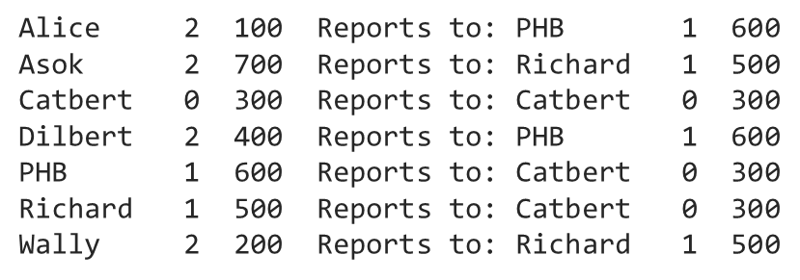
Output
compByName()
compByNumber()
Catbert 0 300 Reports to: Catbert 0 300
Richard 1 500 Reports to: Catbert 0 300
PHB 1 600 Reports to: Catbert 0 300
Alice 2 100 Reports to: PHB 1 600
Wally 2 200 Reports to: Richard 1 500
Dilbert 2 400 Reports to: PHB 1 600
Asok 2 700 Reports to: Richard 1 500
Notes:
Recall that C++ implements map containers as key-value binary trees. Consequently, the order of the nodes within the tree depends on the comparator used by the map. The map output is in tree order: first, alphabetically, and second, grouped by position and in ID order within each group.

