Slide 1
Aggregation with smart pointers
Automating heap memory management
Delroy A. Brinkerhoff
Notes:
Smart pointers aren't restricted to following the UML class relationships, but the relationships provide a convenient way to think and communicate about the connections the pointers form. Furthermore, smart pointers don't change, lessen, or widen the meaning of the UML relationships, but they decrease the potential for memory leaks by automating heap memory management. Memory leaks are notoriously difficult to detect and locate, so replacing raw with smart pointers can make programs more robust.

Slide 2
Aggregation with raw pointers
class Whole
{
private:
Part* part = nullptr;
};
Whole() {}
Whole(Part* p) : part(p) {}
~Whole()
{
if (part != nullptr)
delete part;
}
void set_part(Part* p)
{
if (part != nullptr)
delete part;
part = p;
}
Notes:
It's easier to appreciate how smart pointers benefit aggregation by comparing the raw and smart pointer implementations. Programmers can build the initial aggregation relationship with raw pointers using a constructor or a setter function. If built with a setter function, the class requires a default constructor and must initialize the aggregating member variable. A destructor is necessary to prevent a memory leak.
Smart pointers simplify the destructor and setter functions, making them more reliable and eliminating the need for the test and explicit delete operation. Indeed, if the destructor's only task is destroying the aggregated part object, smart pointers can eliminate the destructor.

Slide 3
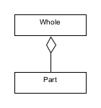
Simple Aggregation with Smart pointers
int main()
{
Whole whole("Widget");
whole.display();
whole.set_part(new Part("Bolt"));
whole.display();
return 0;
}
Notes:
Smart pointers don't affect the representation or meaning of aggregation. The simple aggregation example builds the initial aggregation relationship with a constructor and updates it with a setter function. The driver calls the display function, documenting the sequence of function calls with console output.

Slide 4
The Whole And
Part Classes
class Part
{
private:
string name;
public:
Part(string n) : name(n) {}
~Part() { cout << "Part dtor: “ << name << endl; }
void display() { cout << name << endl; }
};
class Whole
{
private:
shared_ptr<Part> part;
public:
Whole(string n) { part = make_shared<Part>(n); }
~Whole() { cout << "Whole dtor\n"; }
void set_part(Part* n) { part.reset(n); }
void display() { cout << "Whole: "; part->display(); }
};
Notes:
The example uses a shared pointer to implement aggregation, built initially by the constructor with "make_shared." The client changes the aggregated part with a setter that calls the shared pointer "reset" function. "reset" destroys or deallocates the previous part object before installing "n" as the new part. The destructors are unnecessary but, in conjunction with the display functions, demonstrate the function call sequence by displaying output when they run.

Slide 5
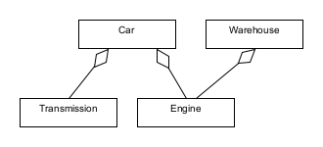
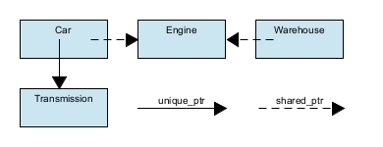
Shared Aggregation with smart pointers
Notes:
Aggregation is a weakly binding relationship, allowing a whole object to share its parts with another program object. When two whole objects share a part, which one "owns" it – which one is responsible for destroying it when the program no longer needs it? The previous aggregation discussion presented this problem as a race car with replacement engines stored in a warehouse. The current solution simplifies the problem with a single Engine shared by the Car and Warehouse.
An abstract representation of the objects in memory illustrates the smart pointer connections. Although the Car and Transmission relationship isn't involved in the sharing problem or solution, the example includes it to demonstrate some unique-pointer syntax. The solution implements the pointers sharing the Engine object with shared pointers. Aggregation is a one-way relationship, so the Transmission and Engine classes "don't know about" the Car and Warehouse classes. The video doesn't include the part classes for brevity, but students can find them in the textbook.

Slide 6
The
Car
Class
class Car
{
private:
unique_ptr<Transmission> trans;
shared_ptr<Engine> engine;
public:
Car(string t) : trans(make_unique<Transmission>(t)) {}
~Car() { cout << "Car dtor" << endl; }
void set_engine(shared_ptr<Engine> e) { engine = e; }
friend ostream& operator<<(ostream& out, Car& me)
{
out << *me.engine << " " << *me.trans.get();
return out;
}
};
Notes:
The Car class builds a connection to the Transmission with a unique pointer, resulting in a hybrid relationship. The connection has composition's exclusivity – no other program class can share the Transmission – but with aggregation's flexibility – the Car can establish, change, or terminate the relationship anytime. The constructors build pointers that are initially empty.
The Car builds a typical aggregation relationship with the Engine using a shared pointer and a setter function. The shared pointers assume the responsibility for managing (destroying or deallocating) the part objects, making the destructor unnecessary. Significantly, if the Car discards an Engine while the Warehouse maintains a reference to it, the shared pointers reduce their reference counts but do not destroy the Engine.
The expression "me.engine" refers to the shared pointer member variable. Therefore, the first asterisk represents the overloaded shared pointer dereference operator that returns the aggregated Engine object. The "get" function returns a pointer to the aggregated Transmission object, so the second asterisk is the standard address indirection operator.

Slide 7
The
Warehouse
Class
class Warehouse
{
private:
shared_ptr<Engine> engine;
public:
~Warehouse() { cout << "Warehouse dtor" << endl; }
void set_engine(shared_ptr<Engine> e) { engine = e; }
friend ostream& operator<<(ostream& out, Warehouse& me)
{
out << *me.engine;
return out;
}
};
Notes:
Like the Car class, Warehouse builds the aggregation relationship with a shared pointer and changes it with a setter function. The shared pointer assumes the responsibility for managing the Engine object. Also, like the Car class, the asterisk is the overloaded shared pointer dereference operator.

Slide 8
The driver
int main()
{
Car c("Automatic");
Warehouse w;
shared_ptr<Engine> e = make_shared<Engine>(440);
c.set_engine(e);
w.set_engine(e);
cout << "(1) Engine: " << *e << endl;
cout << "(2) Car: " << c << endl;
cout << "(3) Warehouse: " << w << endl << endl;
e = make_shared<Engine>(380);
//e.reset(new Engine(380)); // alternative
c.set_engine(e);
w.set_engine(e);
}
Notes:
The abridged driver illustrates the fundamental operations necessary to build and use shared aggregation. Students can find the complete driver and program output in the textbook.
The program creates Car and Warehouse objects, the Whole objects sharing the Engine. The "make_shared" function builds the Engine and wraps it with a shared pointer. The setter functions install the Engine in the Car and Warehouse. The cout statements call the inserter functions in each class. The program can make a new Engine object in two ways: It can make it with the "make_shared" function, wrapping it in a new shared pointer. Alternatively, it can discard the existing Engine and replace it with a new one using the "reset" function. Regardless of the chosen alternative, the program installs the new Engine with the setter functions.

Slide 9
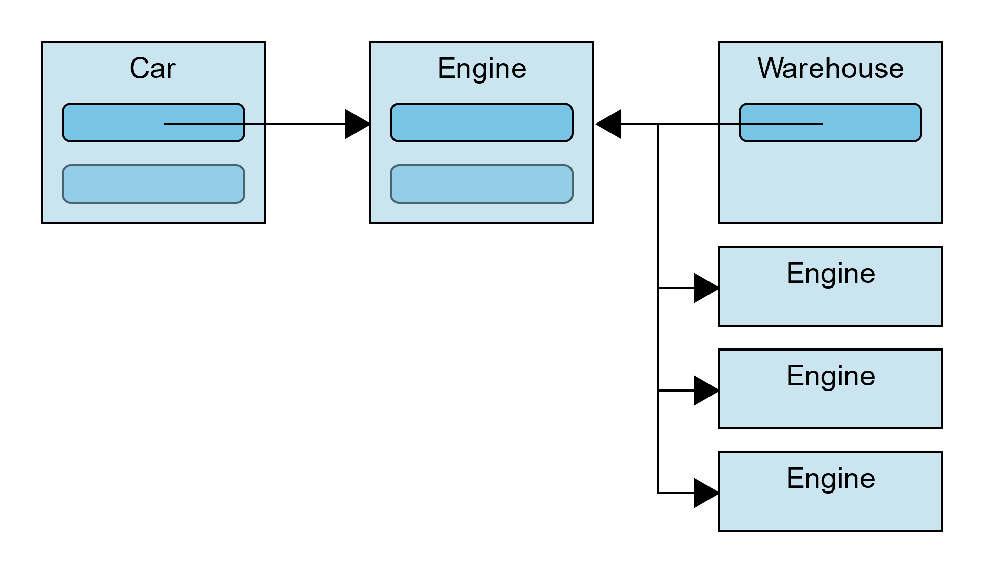
Multiple shared pointers
The Warehouse “owns” and manages the Engines
Previously implemented with an array of pointers:
  Engine* spares[10];
  Limits the number of Engines
Replace the array with an STL vector
Notes:
The original Car-Engine-Warehouse problem imagined a Warehouse managing multiple spare Engines and modeled it as an aggregation relationship with a multiplicity of 10. In that case, it seemed natural to make it the Engine owner responsible for destroying the Engines when the program no longer needed them. The Chapter 10 solution implemented the multiplicity as an array of pointers, limiting the number of Engines the Warehouse can manage. A more flexible solution relies on smart pointers and the STL vector class, both provided as templates.

Slide 10
The updated
Warehouse
Class
class Warehouse
{
private:
vector<shared_ptr<Engine>> engines;
public:
~Warehouse() { cout << "Warehouse dtor" << endl; }
void add_engine(shared_ptr<Engine> e) { engines.push_back(e); }
shared_ptr<Engine> get_engine(int index) { return engines[index]; }
void display(int index) { engines[index].get()->display(); }
friend ostream& operator<<(ostream& out, Warehouse& me)
{
vector<shared_ptr<Engine>>::iterator i = me.engines.begin();
while (i != me.engines.end())
out << "\t" << **i++ << endl;
return out;
}
};
Notes:
Nesting the template variable substitutions is necessary because both the vector and shared pointers are implemented as template classes. The vector stores shared pointers that, in turn, manage Engine objects. As with the previous examples, the destructor is unnecessary but is included to demonstrate that the shared pointers deallocate the Engine objects.
The Warehouse "add_engine" function calls the vector "push_back" function, adding the Engine object to the vector's end. In this version, the "get_engine" and "display" functions require an index argument to select a specific Engine from the vector.
The inserter function creates a vector iterator to loop through all the Engine objects stored in the vector. The auto-increment and double indirection operations, represented by the two plus and two asterisk symbols, are challenging to follow. The auto-increment has the highest precedence and runs first, advancing the iterator to the next vector element. However, the incrementation occurs after the expression uses the current value. The indirection operations are right-associative, so the first operation dereferences the iterator, returning a shared pointer. The second operation dereferences the shared pointer, returning an Engine object.

Slide 11
The updated driver
int main()
{
Car c("Automatic");
Warehouse w;
w.add_engine(make_shared<Engine>(454));
w.add_engine(make_shared<Engine>(440));
w.add_engine(make_shared<Engine>(429));
. . . . .
c.set_engine(w.get_engine(1));
cout << "(1) Car: " << c << endl;
cout << "(2) Warehouse:\n" << w << endl;
c.set_engine(w.get_engine(5));
cout << "(3) Car: " << c << endl;
cout << "(4) Warehouse:\n" << w << endl;
}
Notes:
An updated but abridged driver demonstrates how a program uses the modified Warehouse class. Students can find the complete driver and program output in the textbook. Client programs can add any number of aggregated Engine objects to the Warehouse, but when getting an Engine, they must specify its index location in the zero-indexed vector.

Slide 12
Smart Pointer Summary
Smart pointers automatically deallocate objects allocated on the heap
  Eliminate memory leaks
  Eliminate destructors whose sole task is destroying dynamic objects
  In the case of shared objects, they eliminate ownership protocols
Notes:
Smart pointers benefit programs by managing heap memory. The most significant benefit is eliminating memory leaks caused by discarded and forgotten objects. Smart pointers automatically deallocate discarded objects, functioning like a simple garbage collector. Destructors can implement any "clean up" code necessary, but programs often only use them to deallocate heap memory — shared pointers eliminate these destructors. When programs maintain multiple pointers to an object, they must establish an ownership protocol assigning responsibility for deallocating the referred object – smart pointers eliminate the need for assigning ownership.

