Slide 1
Rolodex problem
Modeling a physical device with a C++ program
Delroy A. Brinkerhoff
Notes:
A C++ program modeling a Rolodex, a simple card organizer, demonstrates how to read and parse lines from a file. Emphasizing the reading and parsing operations, the program limits “processing” to formatting the data as a table.

Slide 2
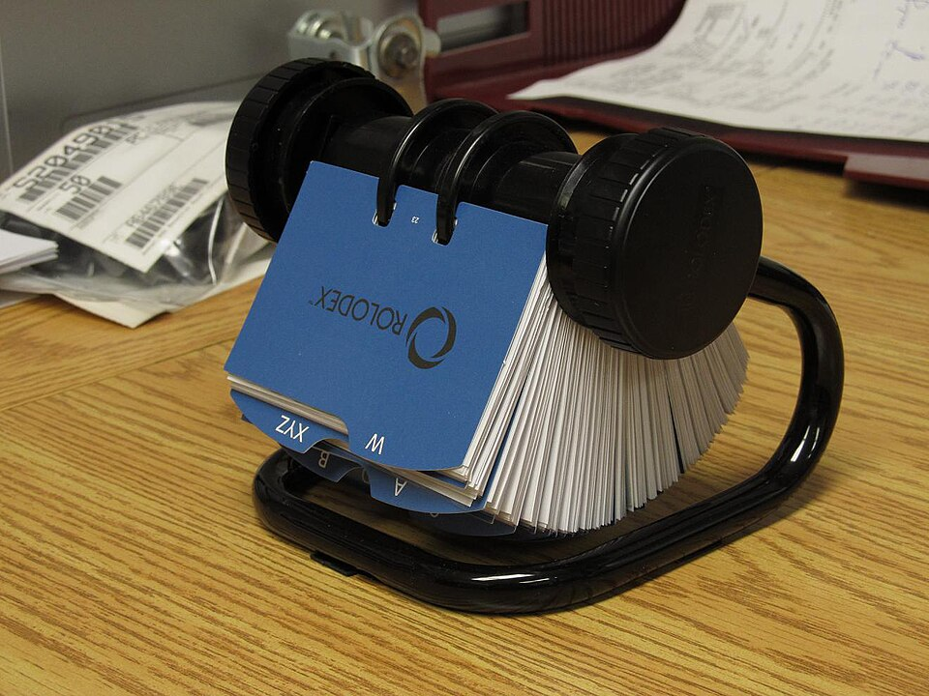
A Rolodex
By Poolcode (Own work) [CC BY-SA 3.0], via Wikimedia Commons
Notes:
A Rolodex consists of cards attached to a rotating axle at their bottom edge. Each card contains contact information about an individual or company. The Rolodex programs represent each card by one line in a text file.

Slide 3
Input
Bill Gates:1 Microsoft Way, Redmond, WA:(403) 123-4567
Cranston Snort:1600 Pennsylvania Ave:(306) 678-9876
Albert Einstein:Princeton, NJ:(456) 123-8765
John Smith:123 Elm St.:801-555-1234
Notes:
Delimiters partition each line into three distinct fields: a name, address, and phone number. Following a common POSIX tradition, the programs use a colon character to delimit or separate the fields and a newline to terminate each line. The “getline” functions include all non-delimiter characters in one of the fields, precluding colons in any field data and spaces surrounding the delimiters.

Slide 4
output
Bill Gates 1 Microsoft Way, Redmond, WA (403) 123-4567
Cranston Snort 1600 Pennsylvania Ave (306) 678-9876
Albert Einstein Princeton, NJ (456) 123-8765
John Smith 123 Elm St. 801-555-1234
Notes:
Once the fields are separated into different variables, formatting them individually is straightforward.

Slide 5
Parsing delimited input: the string class
John Smith:123 Elm St.:801-555-1234\n
string name;
getline(in, name, ':');
string address;
getline(in, address, ':');
string phone;
getline(in, phone, 'n');
//getline(in, phone);
Notes:
The string version of the program defines three string variables, one for each field. The “getline” functions read the fields up to the delimiter character. They remove the delimiter from the input stream but discard it rather than save it with the field data. The last read operation, extracting the phone number from the input stream, can specify the newline character as the delimiter or use the two-parameter version, defaulting to the newline as the line terminator.

Slide 6
Parsing delimited input:
C-strings
John Smith:123 Elm St.:801-555-1234\n
char name[20];
in.getline(name, 20, ':');
string address[35];
in.getline(address, 35, ':’);
char phone[20];
in.getline(phone, 20, ':’);
//in.getline(phone, 20,);
Notes:
The C-string version of the program is logically equivalent to the string version. It replaces the string variables with C-strings implemented as character arrays of various lengths and the string “getline” function with the C-string version. The second parameter of the C-string “getline” function is the defined length of the C-string array. The function reads at most one less character than this value, leaving one space for the null-termination character.

