Slide 1
ISAM / KSAM
Indexed Sequential Access Method
Keyed Sequential Access Method
Delroy A. Brinkerhoff
Notes:
ISAM and KSAM are synonyms describing a method for accessing large, sequentially created data files. The method requires a supplemental file of keys that index the data file, suggesting the method’s names.
ISAM is language-independent, meaning that programmers can implement it in various languages. Furthermore, C++ doesn’t provide functions specifically for implementing it. Instead, programmers synthesize an ISAM system with the direct access and file positioning functions presented in the previous sections.

Slide 2
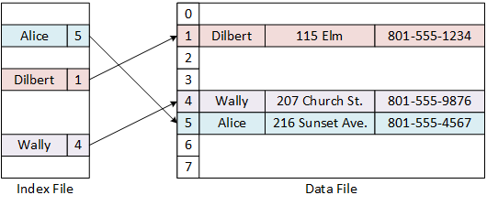
Isam architecture
Notes:
An ISAM system requires at least two files: The data file stores the information the system manages, while the index file assists in locating specific items or records in the data file. It’s convenient to visualize the files as tables divided into rows and columns. Each row represents a set of related data called a record, and the columns name the individual data items or fields. We can number the rows like an array and use the index values as “record numbers.” For example, “Alice” has record number 5. The illustration demonstrates the relationships between the records in the files.

Slide 3
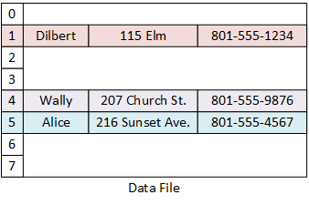
Data file
Fixed-length records
Consists of many fields
Too large to fit into memory
  Each record is relatively large
  There are many records
  Impractical to reorganize
New records are appended at the end of the file
Notes:
The data file grows “organically” in whatever order information arrives in the system, resulting in a chaotic and unordered structure. All the records have the same, unvarying length, typically consisting of numerous fields. In an authentic situation, the records are so numerous and large that the program can’t fit the data file into memory. The file’s size makes it difficult to search and impractical to reorder. Consequently, the system can only append new records sequentially at the end of the file, leaving it in its chaotic state.

Slide 4

Index file
Records have two fields
  A key duplicating one data file field
  A record number or absolute address of a data file record
Support a fast-search algorithm
An ISAM system requires one index file for each searchable data record field
Notes:
Each record or key in the index file consists of two fields. The first is a copy of one data record field, and the second is the address of the corresponding data record in the data file. For the address, programmers can use either the record number, as illustrated, or the record’s absolute file address or offset. The system maintains the index file in a specified order throughout its operation, making it easier to locate specific information. For example, if the program needs to access “Alice” in the data file, it locates her name in the index file and retrieves the record number 5, allowing it to proceed directly to record 5 in the data file.

Slide 5
Implementing Isam Operations
read(buffer, bytes)
write(buffer, bytes)
Moving the position pointer
  seekp(absolute)
  seekp(offset, direction)
  seekg(absolute)
  seekg(offset, direction)
  tellp() and tellg()
Notes:
C++ programs build ISAM systems with block read and write functions in conjunction with the seeking and reporting, or “telling,” functions. The challenge for programmers is to build higher-level ISAM operations using lower-level file functions. Describing the steps for adding and searching for a data record illustrates the process. A more concrete and detailed example follows in the next section.

Slide 6
Isam Operations:
Add a data record
3
1
New key
New card
4
2
Notes:
1. To add a new record, the program seeks to the end of the data file and asks the stream to tell it the current address. The program saves the address for a subsequent operation.
2. It creates a new data record and writes it to the end of the file.
3. Next, the program updates the index file by seeking to its end.
4. It creates a new key record, copying a field from the new data record and its saved address. At some point, depending on how programmers have implemented the ISAM system, the program must reorder and save the index file.

Slide 7
Isam Operations: search for a data record
3
1
Read
2
4
Notes:
1. Searching for a data record begins with the index file. The program searches for the key in the index file using a fast-lookup algorithm – the examples in the following section use a binary search.
2. Assuming that the program is searching for “Dilbert,” it locates the matching key record in the index file and gets the corresponding record number, 1 in this example.
3. The program seeks to record number 1 in the data file,
4. reading the complete record, retrieving Dilbert’s street address and phone number.

Slide 8
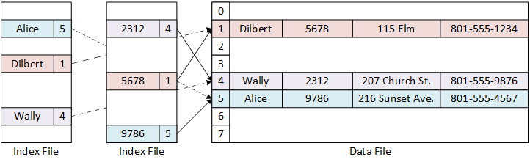
ISAM Example vs
Modern DBMS
Notes:
Generalizing the Rolodex example to a student or employee database may require adding an identification number to each record. For the program to search the data file for a specific ID, the ISAM system must include an additional index file whose keys bind ID numbers to record numbers. However, the records in a contemporary database may contain scores of fields, and searching on many of them is possible. Manually adding new index files and the operations surrounding them is tedious. Furthermore, a database may contain millions of records, too many to simultaneously maintain all the indexes in memory, requiring a more sophisticated searching algorithm. Modern database management systems elegantly solve these problems. Despite their power and elegance, their high-level, problem-oriented features still rely on the fundamental, low-level file functions illustrated by the Rolodex programs.

