Slide 1
Multiplication Table
multtab.cpp
Delroy A. Brinkerhoff
Notes:
The multiplication table problem revisits an example program from Chapter 3 that demonstrates nested for-loops. It adds a two-dimensional array to the program to illustrate how C++ programs define and use them.

Slide 2
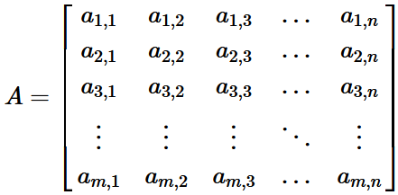
Matrix: two-dimensional array
Columns
Rows
a_{i,j} = a_{row,col}
Notes:
A simplified view of a matrix is as a rectangular array of mathematical elements arranged in rows and columns. Various disciplines use them to solve systems of equations, scale and translate coordinates, and perform other complex operations. Matrix notation predates digital computers and has influenced array terminology, practice, and organization. For example, the index order of rows and columns, and using the letters i and j to refer to a matrix element in the i-th row and j-th column, making them common loop-control variables.

Slide 3
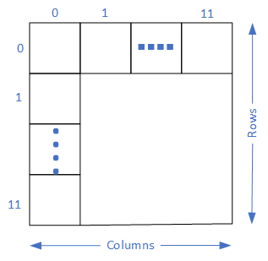
Two-dimensional array
int table[12][12];
0-indexed
0 ≤ i < 12
0 ≤ j < 12
Notes:
Defining an appropriate array is the first step to extending the multiplication program. Admittedly, the array doesn’t enhance the program, but it provides a familiar context for demonstrating array syntax. The definition includes the size of each dimension. Each size must be in a separate set of square brackets – C++ does not allow specifying the sizes as a comma-separated list in a single set of brackets. The first size is the number of rows – the downward dimension; the second size is the number of columns – the left-to-right size.

Slide 4
Filling The table
for (int row = 1; row <= 12; row++)
for (int col = 1; col <= 12; col++)
table[row - 1][col - 1] = row * col;
for (int row = 1; row <= 12; row++)
{
for (int col = 1; col <= 12; col++)
{
table[row - 1][col - 1] = row * col;
}
}
Notes:
Programs often use nested for-loops to process two-dimensional arrays systematically. In this example, the loop-control variable of the outer loop indexes the array’s rows, while the loop-control variable of the inner loop indexes the columns. Both loop-control variables begin at 1 and loop while they are less than or equal to 12. However, C++ arrays are always 0-indexed. The program compensates by offsetting the array indexes by 1.
The program fills the array with a single statement as suggested by the single terminating semicolon. The statement holds row constant at 1, while col varies from 1 to 12; then it holds row constant at 2, while col again varies from 1 to 12. This process continues, with the inner loop cycling 12 times for each outer loop cycle, until both control variables reach 12.
Braces are not required, but programmers can add either or both pairs if they choose.

Slide 5
Printing The Table
for (int row = 0; row < 12; row++)
{
for (int col = 0; col < 12; col++)
cout << setw(4) << table[row][col];
cout << endl;
}
Notes:
With two notable exceptions, printing the table follows the same pattern as filling it. First, the loop-control variables can begin at 0, and the loops use a strict less-than test. This change is possible because the operation uses the variables only as indexes. Second, printing the table requires the program to output an entire row before ending the line (i.e., before printing an end-of-line character), which requires two statements. The outer loop iterates over each row of the array. The inner loop prints each element in the row before the cout statement finishes the current row and begins the next. The braces shown here are necessary because the outer loop contains two sub-statements.

Slide 6
two-dimensional array function parameters
#include <iostream>
#include <iomanip>
using namespace std;
void fill_table(int tab[][12]);
void print_table(int tab[][12]);
int main()
{
int table[12][12];
fill_table(table);
print_table(table);
return 0;
}
Notes:
Moving the table-filling and printing operations into functions demonstrates how C++ programs process two-dimensional array arguments and parameters. The definition of the array variable remains unchanged. The syntax for calling the functions and passing an array argument is independent of how many dimensions the array has. However, the syntax for defining a two-dimensional parameter depends on the array’s size in an unexpected way.
The operations locating an array element in memory don’t require the size of the first dimension - the number of rows in this example. However, they do require the second and any subsequent dimension sizes. The text demonstrates how C++ locates array elements in the “Row-Major Ordering” section later in the chapter.

Slide 7
filling the array with a function
void fill_table(int tab[12][12])
{
for (int row = 1; row <= 12; row++)
for (int col = 1; col <= 12; col++)
tab[row - 1][col - 1] = row * col;
}
void fill_table(int tab[][12], int nrows)
{
for (int row = 1; row <= nrows; row++)
for (int col = 1; col <= 12; col++)
tab[row - 1][col - 1] = row * col;
}
Notes:
Moving the loops that fill the table into a function doesn’t logically change them. The critical feature is how the function defines the array parameter. In the first example, the client (main) and the function must follow a shared protocol specifying 12 rows and 12 columns. This protocol only requires passing one argument to the function, but it is inflexible.
The second example is more flexible but requires an additional argument specifying the number of rows in the array. C++ allows programmers to define an array parameter without specifying the number of rows, but it does require the number of columns. This syntax allows the function to operate on any array of integers with 12 columns and an unspecified number of rows, making it flexible and the most widely used.

Slide 8
Printing the array with a function
void print_tab(int tab[][12], int nrows)
{
for (int row = 0; row < nrows; row++)
{
for (int col = 0; col < 12; col++)
cout << setw(4) << tab[row][col];
cout << endl;
}
}
Notes:
Like the function that fills the table, the loops in the function that prints it are unchanged. Programmers can implement the function with a 12x12 parameter, or adopt the more flexible two-parameter version illustrated here, with the outer loop using the number-of-rows parameter.

