Slide 1
The Palindrome-Number Problem
Solving a palindrome puzzle
Delroy A. Brinkerhoff
Notes:
The following example uses a more complex puzzle to demonstrate problem-solving and general string functions. The example begins by stating the problem and then outlines a solution using a logic diagram that shows the sequence of high-level operations. The video’s focus is on solving the problem logically, not on programming it.

Slide 2
The Problem
Find the smallest positive integer whose square produces
a palindrome
at least 6 digits long
and does not begin or end with a 0
A palindrome is "a word, verse, or sentence ... or a number ... that reads the same backward or forward."
Work with numbers until the squaring operation is done, then convert the number to a string for testing
Notes:
The puzzle requires the solver to find the smallest positive integer whose square produces a sequence of digits that forms a palindrome at least 6 digits long and does not begin or end with a zero. A palindrome is a string of characters that reads the same backward or forward, without considering spaces, punctuation, or letter case. It’s convenient to use integers while identifying candidate numbers and squaring them. However, for the validation tests, it’s easier to convert the number to a string and use string functions.

Slide 3
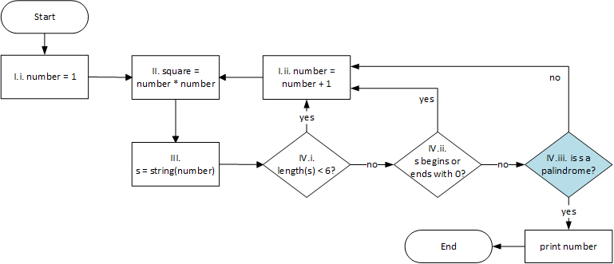
Logic diagram: Candidate Palindromes
Notes:
A logic diagram is similar to a flowchart, but the elements typically represent higher-level conceptual units, often labeled with pseudocode. They help problem-solvers capture and organize the high-level operations needed to solve a specific problem.
The puzzle seeks the smallest integer that satisfies the given constraints. So, the program begins with the smallest positive integer. Starting with 316 or 317 would make the final program more efficient, but starting at one helps to demonstrate a programming technique described momentarily. To avoid skipping potential candidates, the solution increments the number by one on each iteration.

Slide 4
Logic diagram: Numbers to strings
Notes:
Squaring a number is a straightforward operation that requires a single programming statement.
Converting the number to a string may be problematic, but it is logically a single step and is represented accordingly on the logic diagram. This task represents a well-known problem with various solutions available.

Slide 5
Logic diagram: Case Analysis
Notes:
Each of the puzzle’s constraints on the squared number represents an individual test. If a candidate fails any test, the algorithm rejects it and immediately moves to the next candidate. The order of the tests doesn’t affect the algorithm’s correctness, but arranging them from easiest or fastest to the hardest or slowest improves its overall efficiency. This sequence is an example of an organizational technique called “case analysis.” If an algorithm or program can determine the outcome of a sequence of tests early in the sequence and skip subsequent tests, it saves the “expense” of the later tests. Determining a string’s length is an easy operation, and starting the candidate search at one illustrates the value of case analysis.

Slide 6
Logic diagram: Identifying A Palindrome
Notes:
Ensuring that the squared number does not begin or end with a 0 is also easy. Numbers converted to strings rarely begin with a zero, but the example includes the test to demonstrate string operations further. Testing for palindromes is the most complex step, requiring the solver to design a new sub-algorithm.

Slide 7
Palindrome Algorithm 1
Imagine the string written on a whiteboard
Short palindromes are easily spotted
Long palindromes require a systematic test
Copying or rewriting is undesirable
Keep testing as long as the characters match
Notes:
Determining if a general string - not just a string of digits - is a palindrome is the focus of the rest of the video. How we conceptualize the problem affects the final algorithm. Imagine a long candidate string written on paper. The string’s length and physical representation make it awkward to change the individual characters. So, we might choose to leave the string intact and point at the individual characters with our fingers, beginning at opposite ends.

Slide 8
Palindrome Algorithm 1
Imagine the string written on a whiteboard
Short palindromes are easily spotted
Long palindromes require a systematic test
Copying or rewriting is undesirable
Keep testing as long as the characters match
Notes:
If the characters match, we move our fingers closer together, moving the left finger one character to the right and the right finger one character to the left. If the two characters are the same, we repeat this process, continuing until we find two characters that don’t match or until our fingers meet in the middle of the string.
If we have an odd number of characters, as we do in this example, we ignore the character in the middle. If we have an even number of characters, the process ends with our two fingers side by side in the middle of the string. There is no advantage to allowing our hands to cross and to continue to the ends of the string.

Slide 9
Algorithm 1, continued
A matched characters do not establish a palindrome
But mismatched characters do establish a non-palindrome
A palindrome is established only if our fingers meet in the center of the string
Notes:
Finding two characters that match is not sufficient to assert that the string is a palindrome, but if we find two characters that don’t match, then we know that the string isn’t a palindrome. We correctly identify a palindrome only when our fingers meet in the middle of the string.

Slide 10
Palindrome Algorithm 2
Notes:
Alternatively, if we imagine the string is stored in a computer’s memory, manipulating it is no longer tedious, allowing us to design a different algorithm. The definition of a palindrome as a string of characters that reads the same backward and forward suggests the following algorithm.
The second algorithm begins with the candidate string s, copies it to string r, and reverses r. If the strings “read the same,” that is, they are equal, the candidate is a palindrome; if the strings are not equal, the candidate is not a palindrome.
While the two algorithms look quite different, they will share some essential code when implemented.

