Slide 1
Class Development
Concepts, Observations, and Guidelines
Delroy A. Brinkerhoff
Notes:
Class developers approach their task from numerous perspectives, each contributing to some facet of the class’s capabilities. This video is descriptive, describing general object-oriented concepts and the practices of other class designers. It is also prescriptive, offering guidelines that served me well in my previous software engineering career. However, each new class is unique in some way, and it must reflect your own skill, style, and experience.

Slide 2
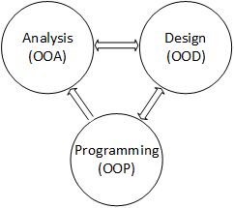
Software development phases
Analysis
Explores the problem
Looks for objects
Design
Adds and discards classes
Refine classes
Programming / implementation
Translates classes into code
Captures and organize results
as UML class diagrams
Notes:
Although there have been and currently are numerous software development methodologies in use, they all share some tasks. While they name the tasks differently and blur their boundaries, their primary goals remain the same. Three of these tasks or phases are present in all methodologies.
The phases denote specific development activities. Analysis identifies the objects, both physical and abstract, existing in a given problem, and generalizes them into classes. Initially, it’s generous about identifying classes. The design phase discards extraneous classes, adds classes that don’t appear in the problem but are needed by a program, and refines the classes by adding, removing, or modifying class variables and functions. The programming or implementation phase translates the classes into working code. Developers conveniently capture and organize this information with UML class diagrams.
There isn’t a recipe for identifying classes, variables, or functions. Consequently, developers typically cycle through the phases, refining the classes during each iteration. A design phase, at least a brief one, always follows an analysis, so the process never goes directly from analysis to programming, but, as indicated by the arrows, cycles exist between the other phases.

Slide 3
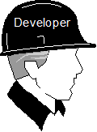
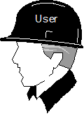
The two-hat Technique
Server or Supplier
Client or user
Focus on class development
Focus on class interface
Notes:
The two-hat technique provides a helpful perspective to guide class refinement. When designing a class, think of it as serving or supplying a set of services to a client class or program. When wearing our class designer hat, we try to make the best class we can without regard to how a program might use it. For example, the string class developer tries to include all the services that a good string class can provide – certainly more services than are needed by any one client program.
Alternatively, we switch hats when we need to use the class's services. While wearing our user hat, we treat the class as a black box, focusing on the services it provides and ignoring how it implements them. That is, we are unconcerned with the data the class maintains or with what happens in the function bodies.
Even if you are both the class developer and the class user, writing both sets of code simultaneously, take a moment and mentally switch hats and adjust your perspective as you shift your focus between designing and using a class. Switching hats helps maintain class boundaries and create a better public interface for each class.

Slide 4
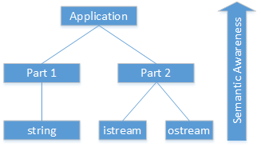
What Do Classes “Know”
The semantic content of a class may be abstractly represented by a hierarchy
Classes near the top are problem-oriented
Class near the bottom are service-oriented
Designed as a “shopping list”
May provide more services than needed in a given program – for example the string class
Notes:
Another helpful perspective is to think of a class as a living entity. Each class has a level of “semantic awareness,” meaning it knows a certain amount about the problem we are trying to solve. The level of awareness or knowledge can be represented abstractly as a tree or hierarchy. Classes at the top of the tree relate to a given problem and the application program solving it. Consequently, their “knowledge” is strategic and high-level, but lacks sufficient detail to affect an operational solution. Their task is to coordinate the actions of lower-level classes. Classes at the bottom of the tree are tactical and "know” a lot of limited detail about a small part of the overall problem.
The string class is a good example of a low-level class. It “knows” a great deal about how to work with strings, but it knows nothing about how its actions affect the larger solution of which it is but a small part. On the other hand, classes near the top of the tree are specialized and more problem-specific. When we design these specialized classes, we focus more on solving a specific problem and less on creating a general-purpose supplier class.

Slide 5
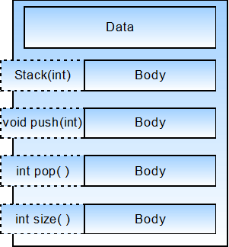
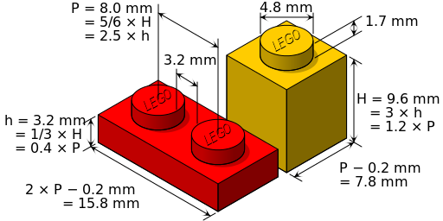
The Public Interface
by Cmglee - via Wikimedia Commons
Notes:
A good class design practice is to separate a class's interface from its implementation, meaning we separate how a program uses a class from how the class functions. Legos provide a good metaphor for this principle. Each Lego has one or more posts that conform to exact dimensional standards. Each Lego also has one or more sockets with precise measurements. The posts and sockets are the Lego’s interface that allows individual Legos to connect and to work together. They are how a builder uses Legos to build big, elaborate structures.
Similarly, a class also has an interface, which consists of all its non-private attributes and operations (i.e., non-private features). As attributes or data are generally private, they are not part of a class’s public interface. The illustration suggests that the public interface includes the signatures of the non-private operations or functions. A function’s signature includes its name, its return type, and the number and type of each parameter. In a sense, a class advertises its non-private features, forming its public interface.

Slide 6
Design Considerations
Attributes / Variables
Operations / Functions
Are typically private
Be able to articulate a good reason before making them non-private
Consider access functions instead
Provides stronger encapsulation
Separates the interface from the implementation
Non-private attributes are not easily removed or modified in future version
Are typically public
Make “helper” functions private to prevent them from becoming part of the public interface
The function implementation (i.e., the body) can change while the header or signature remains unchanged
Notes:
There are several class characteristics to consider when designing a new class. Use these guidelines as a starting point, and be able to articulate a good reason before deviating from them.
Attributes or member variables are generally private, which provides strong encapsulation. Making attributes private allows class developers to change them later without affecting client code that uses the class. Consider using access operations, covered later in this chapter, in place of non-private attributes.
Alternatively, operations or member functions are generally public, with “helper" functions the exception. There are occasions when two or more member functions may share some code. One approach is to duplicate the shared code in each function, but unless the code is relatively small, doing so needlessly increases the executable size. Even worse, it requires maintaining multiple copies of the same code. A helper function represents code that the class designer doesn’t want a client to call directly, but that helps other operations or functions complete their responsibilities.

