Slide 1
Access Functions
Accessing object data with getters and setters
Delroy A. Brinkerhoff
Notes:
Encapsulation is the first characteristic of an object-oriented system. It describes how objects package their data and operations together in an entity that programs treat as a whole. Objects expose their function signatures to client code by making them public, but hide their data by making it private. Objects never expose the bodies of their functions to client code. In this way, they separate their implementation from their public interface.

Slide 2
Access Functions: getters and Setters
A client may have a legitimate need to access a supplier object’s data
Making data public allows the client to inadvertently or maliciously change data
Getter and setter functions provide controlled access to supplier data
  Getters return copies or const values, preventing change to the supplier object
  Setters can perform validity checks and reformat input
Notes:
Encapsulation notwithstanding, sometimes client programs have a legitimate need to access an object’s private data. The conflict seems to force developers to choose between encapsulation, denying legitimate access, and making the data public, sacrificing encapsulation. Fortunately, the object-oriented paradigm provides a third alternative: getter and setter functions.
Getter functions allow clients to retrieve data from a supplier object safely. They maintain safety and encapsulation by returning a copy of the value stored in a member variable, or returning a constant pointer or reference. This technique allows a client to use the data without changing the supplier object.
Although setter functions allow clients to change an object, they permit the class designer to maintain some control over the stored data by performing validation (rejecting unreasonable values), conversion (e.g., from feet to meters), and formatting (e.g., a standard date format).

Slide 3
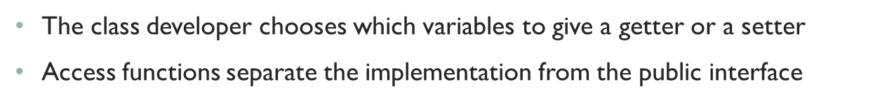
Legitimate vs. illegitimate
Access
Legitimate
illegitimate
Class Person
  Retrieve the name and social security number
  Retrieve and change the address
Class Stack
  Retrieve the stack pointer as the size
Class Person
  Change the Social Security Number
Class Stack
  Change the stack pointer
Notes:
Some simple examples help distinguish legitimate from illegitimate variable access. First, imagine that a client program is calculating a person’s taxes using data stored in an instance of a “Person” class. In the U.S., that process requires the person’s name, address, and Social Security number. If the person moves, the program must update the address. Second, recall that we previously saw how to implement a stack as an array and use a stack pointer as an index to indicate where the next push or pop operation occurs. The stack pointer also represents the stack’s size, which a client may need.
Alternatively, when the U.S. government assigns a person a Social Security number, the identification is permanent, and clients shouldn’t change it. Or, if a client changes the value of the stack pointer outside of the push or pop operations, it corrupts the stack, losing data or implying non-existent data.
Class developers control access by choosing which member variables to give getter or setter functions. They are not obligated to provide all variables with access functions, or to provide both functions to any variable. Access functions help separate a class’s implementation from its public interface.

Slide 4
Naming Conventions
int age;
string name;
int get_age();
int getAge();
string get_name();
string getName();
void set_age(int);
void setAge(int);
void set_name(string);
void setName(string);
Notes:
Class developers derive setter and getter function names from the associated member variables using a well-established naming convention. The return type of getters and the parameter type of setters match the variable’s type. Getters prepend the word “get” to the variable’s name, while setters prepend “set.” C++ developers usually follow one of two conventions: they join the “get” or “set” to the variable names using camel case (aka, camel notation) or an underscore. Sometimes developers may name access functions to reflect their purpose. For example, when returning a stack pointer as the stack’s size, the developer may name the function “get_size” or simply “size.”

Slide 5
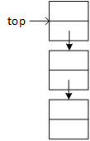
Stack Example
void push(char);
char pop();
int size();
Notes:
An example makes it much easier to understand how separating the interface from the implementation allows a class designer to modify a class. Suppose that a class designer creates a stack class with the illustrated member functions. “push” and “pop” add and remove data from the stack, and “size” returns the number of elements currently stored on the stack.
Imagine that the first implementation uses an array with a stack pointer pointing to the top of the stack. Each push operation increases the stack pointer, and each pop operation decreases it. The developer could expose the stack pointer for the client to use as the stack’s size, but instead provides the “size” function.
Now, imagine that for some reason, the developer chooses to reimplement the stack as a linked list. The list version organizes the stored data differently from the array version. Consequently, the “push” and “pop” functions perform their tasks differently. However, if the list version retains the function prototypes or signatures, clients can continue to use the stack “unaware” of the change.
However, the list version no longer has a stack pointer. If the original array version had exposed the stack pointer, the new version would be obliged to maintain it to prevent breaking existing client code. The size function separates the implementation from the interface, allowing the class developer to provide the needed information in another way. The function bodies are free to change while the signatures remain stable. This benefit applies generally to all access functions.

