Slide 1
Multiple Inheritance
Having more than one parent
Delroy A. Brinkerhoff
Notes:
Inheritance is a fundamental feature of the object-oriented paradigm, but the paradigm only requires single inheritance. Nevertheless, C++ supports multiple inheritance, meaning that a subclass may have more than one parent or superclass.

Slide 2
Multiple Inheritance
Concept
C++
A subclass has two or more superclasses
Is not required by the object-oriented paradigm
Is not universally supported
Controversial
Was included in C++ primarily to support container classes like lists, trees, etc.
Largely replaced by templates
Still used by I/O classes and exception handling
Always controversial and disliked
Notes:
Conceptually, multiple inheritance allows a subclass to inherit features from more than one superclass. The object-oriented paradigm doesn’t require it, not all programming languages support it, and it remains problematic and controversial.
C++ initially included multiple inheritance to allow the creation of general container classes. Containers are classes that contain and organize data, often instances of other classes. But this usage has been more elegantly replaced by templates, which we study in a subsequent chapter. Some iostream classes still use multiple inheritance, and sometimes it’s helpful when dealing with exceptions.

Slide 3
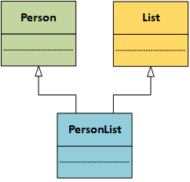

Multiple Inheritance
class Person
{
};
class List
{
};
class PersonList
: public Person, public List
{
};
Notes:
A List is a commonly-used data structure that linearly organizes data. The member variables and functions needed to manage the data are typically independent of it. Our goal is to create a List that can handle any kind of data. For example, imagine that we want to store instances of a Person class. We use multiple inheritance to create a class that “knows about” Person objects and how to organize them into a List.
Viewed abstractly, an instance of the new class has objects instantiated from the superclasses and a part containing features unique to the subclass.
Implementing multiple inheritance is straightforward. The superclasses form a comma-separated list at the point where the child or subclass is specified.

Slide 4
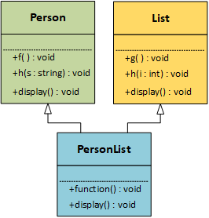
Multiple Inheritance: Function Calls
void PersonList::function()
{
public:
f();
g();
h("Dilbert");
h(100);
}
void PersonList::display()
{
public:
Person::display();
List::display();
}
Notes:
While dealing with multiple inheritance, we need to consider three possible situations when a subclass calls a superclass function.
If the superclass functions have different names, calling them doesn’t require additional syntax.
If two or more classes have functions with the same name but different parameters, the function-call arguments are sufficient to bind the call to the correct function.
However, if two or more classes have functions with the same name and parameters, we must clarify the function binding. Fortunately, all that is needed is the class name and the scope resolution operator.

Slide 5
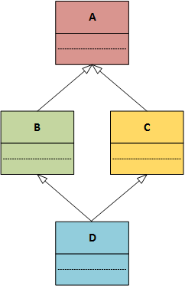
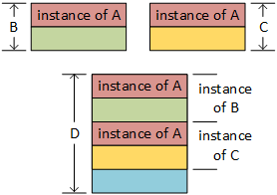
The Deadly Diamond
Notes:
Multiple inheritance does have one problem that is not easily solved: multiple inheritance paths from a subclass to a superclass. The so-called “deadly diamond” represents the most simple example of the problem. Suppose we ignore class D for a moment; the result is the basic inheritance described in the previous sections. Instances of classes B and C each have a component inherited from class A. Ignoring class A results in the simple multiple inheritance just described. But all four classes, related as illustrated, result in serious ambiguities.
An instance of class D contains objects instantiated from classes B and C. Furthermore, each of these objects includes an instance of class A. Suppose the class D object needs to call a class A function or utilize a class A member variable. Which of the embedded class A objects does the D object use? Solving this problem requires virtual inheritance, which lies beyond the scope of this text.

