Slide 1
Composition
Embedded Objects
Delroy A. Brinkerhoff
Notes:
Although both composition and aggregation are whole-part relationships, programmers implement them differently. We implement composition by embedding the part objects inside the whole object. Said another way, the whole contains the parts. This organization affects all composition characteristics.

Slide 2
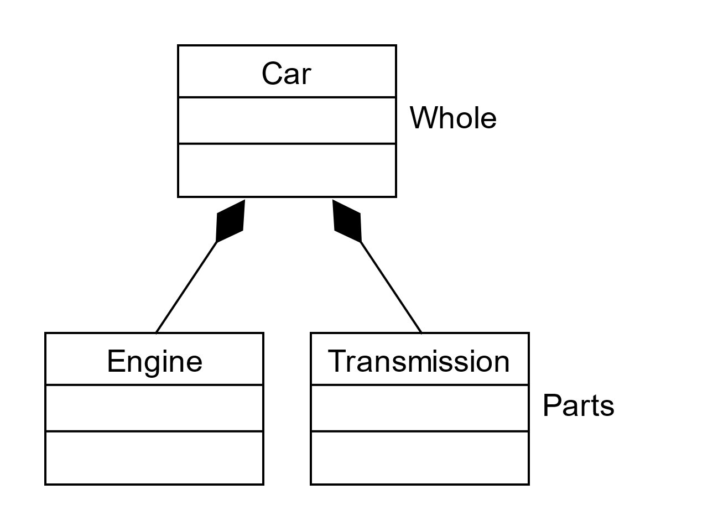
Composition Characteristics
Parts are bound strongly or tightly to the whole by embedding, nesting, or containment
Parts are created and destroyed simultaneously with the whole object is created and destroyed
Once created, the parts can't be replaced
The parts are not shared with any other object in the program
Parts are implemented as non-pointer member variables in the whole class
Notes:
Composition creates a whole-part hierarchy with the parts bound tightly to the whole, with great strength. While the composition connector symbol is arbitrary and artificial, the role names “whole” and “part” are natural for the relationship.
Implementing the relationship by embedding or nesting the parts in the whole matches the relationship’s semantics well. The whole and its parts have a simultaneous or coincident lifetime, meaning that the program creates and destroys the part objects with the whole object. The relationship is permanent, meaning once the program creates the whole object and its parts, it can’t replace or exchange the parts but can change or modify their contents. The whole object binds its parts too tightly to allow other objects in the program to access or share them. You should note the composition connector symbol for later comparison to the similar aggregation symbol.

Slide 3
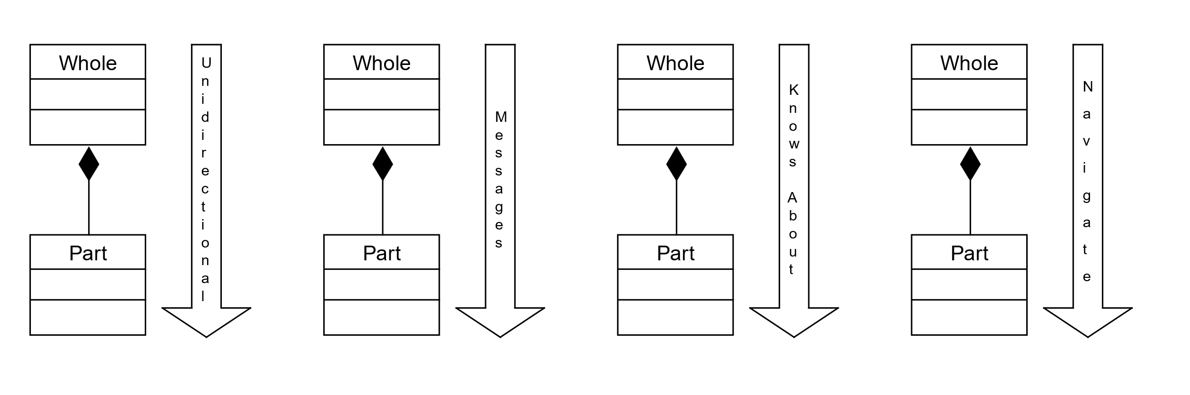
Composition Directionality
Notes:
Composition’s hierarchical nature suggests a unidirectional relationship between the whole and its parts. So, the whole can send messages to its parts, which can respond, but cannot initiate message passing. Looking at the C++ code implementing composition, which we’ll do in a moment, we can see that the whole class “knows about” the part, but not the other way around, and we’ll see how the program can navigate from a whole object to the part, but not in the other direction.

Slide 4
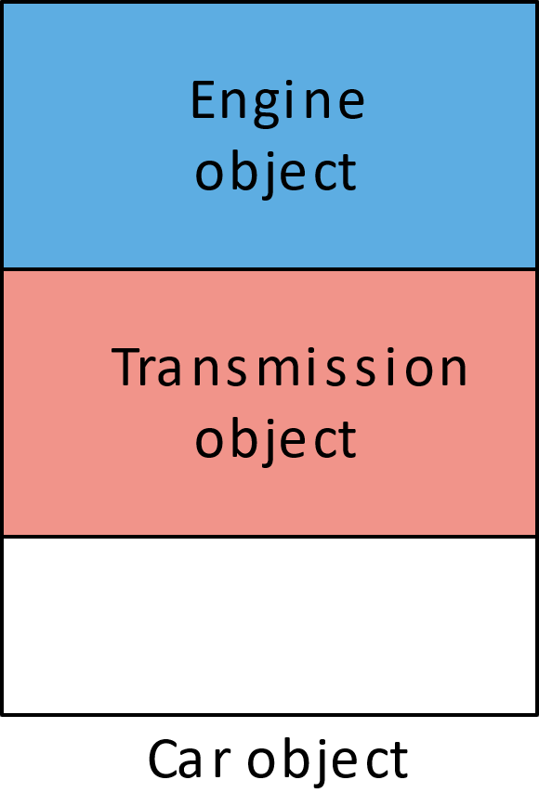
Implementing Composition
class Engine
{
};
class Transmission
{
};
class Car
{
private:
Engine motor;
Transmission trans;
};
Notes:
We use the previous car example to illustrate the composition relationship. Although the code fragment is brief, it demonstrates two significant features. First, composition is a one-way relationship, so neither the engine nor transmission references the car in any way. Next, we specify the part classes, engine and transmission, before the car. In a more extensive, authentic program, we would do this by including the appropriate header files before specifying the whole class. We build the relationship by defining two car-class member variables whose types are engine and transmission.
When the program instantiates the car class, it also instantiates an engine and a transmission. The picture illustrates an abstract representation of how the objects are organized in main memory with the parts embedded in the whole.

