Slide 1
Using Composition: Whole-Part by embedding
The whole sends messages to (i.e., calls functions in) its parts
Delroy A. Brinkerhoff
Notes:
Once it has established a composition relationship between two objects, a program must be able to use it to help solve a problem. This section demonstrates the C++ syntax for exploiting composition.

Slide 2
The Gorilla and Its Liver
In 1990, I attended a C++ conference
One session was an open discussion about maintaining encapsulation and sharing object data
Extract the object’s data to use it?
Maintain encapsulation by letting the object use its data for the program?
“A gorilla has a liver and is responsible for it. Cutting out the liver to use it somewhere is messy and annoys the hell out of the gorilla.”
Conclusion: keep the gorilla happy and let it use its liver.
Notes:
As mentioned earlier in the chapter, I attended a C++ conference in 1990. One session was an open discussion about object-oriented concepts, which quickly devolved into a two-hour heated argument about maintaining an object's encapsulation. One group suggested that extracting an object's data was the most efficient way to use it. Another group maintained that extracting an object's data violated good encapsulation.
A strong encapsulation proponent summarized, "A gorilla has a liver and is responsible for it. Cutting out the liver to use it somewhere is messy and annoys the hell out of the gorilla." At the "discussion's" end, the consensus was to keep the gorilla happy and its liver intact.

Slide 3
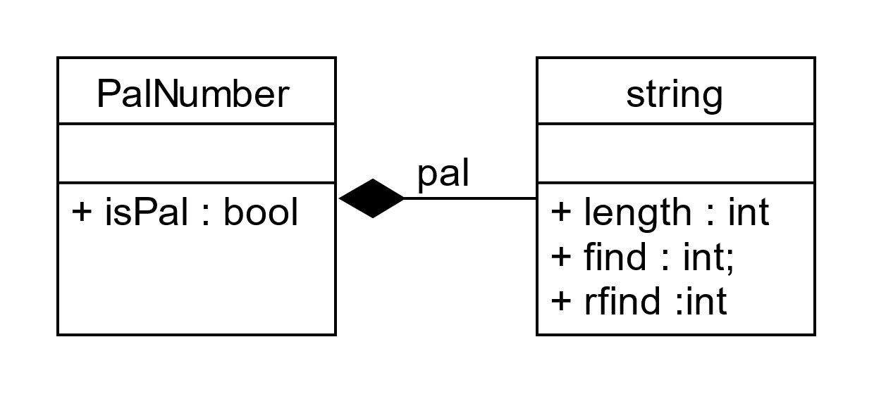
Using Simple Composition
class string
{
public:
int length() { ... }
int find() { ... }
int rfind() { ... }
};
class PalNumber
{
private:
string pal;
public:
bool isPal()
{
pal.length() ...
pal.find() ...
pal.rfind() ...
}
};
Notes:
Previously, we explored the problem of determining if a sequence of digits formed a palindrome. Imagine creating an object-oriented solution based on a class named PalNumber with a function called isPal. We'll use the string class to demonstrate a composition relationship. The diagram names the relationship, and we use it as the name of the implementing variable or object. So, pal is our gorilla.
Assuming that pal isn't empty, it has data in the form of some characters. We could extract and operate directly on those characters, but extracting the characters violates pal's encapsulation. The best object-oriented practice is leaving pal intact and "asking" it to use its data on the program's behalf using its public interface, that is, its member functions.
These statements demonstrate how programmers use composition. The whole object, PalNumber, sends messages to a part object, string. Equivalently, the whole calls a part's functions.

Slide 4
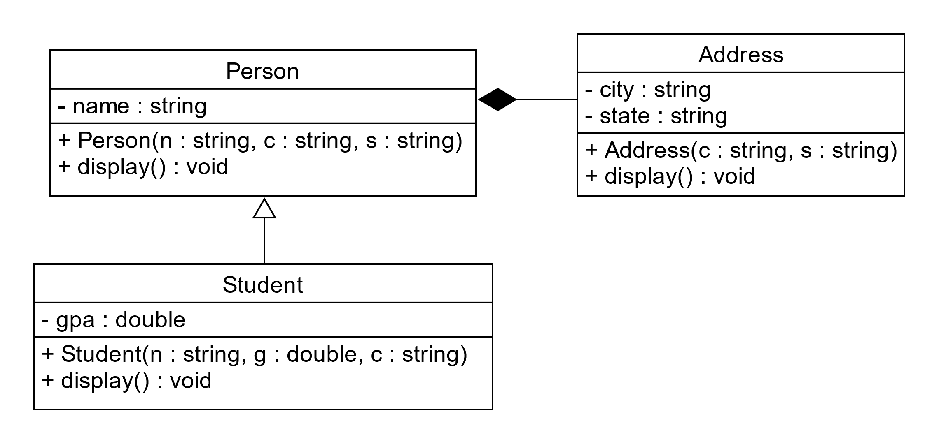
Inheritance & COMPOSITION (1)
Notes:
We extend this example from the previous section by adding a display function to each class. Although the display function has a void return type and doesn't have arguments, it does demonstrate the basic syntax for using composition. By this point in our studies, you should be able to generalize the syntax to more complex functions.

Slide 5
Inheritance & COMPOSITION (1)
Notes:
Using composition is easier than building it. The program chains the display functions so that when it displays a Student object, the Sudent's display calls the Person's display, which calls the Address's display.

Slide 6
Using Composition with inheritance (1)
class Address
{
public:
void display()
{
cout << city << ", " << endl;
}
};
class Person
{
private:
Address addr;
public:
void display()
{
cout << name << end;
addr.display();
}
};
class Student : public Person
{
public:
void display()
{
Person::display();
cout << gpa << endl;
}
}
Notes:
The example builds an inheritance relationship between the Student and Person classes, where the former is the superclass, and the latter is the subclass. The example also builds a composition relationship between Person and Address. Person is the whole class, implementing the relationship with the addr member variable.
The Student display function calls the Person display, which calls the Address display.

Slide 7
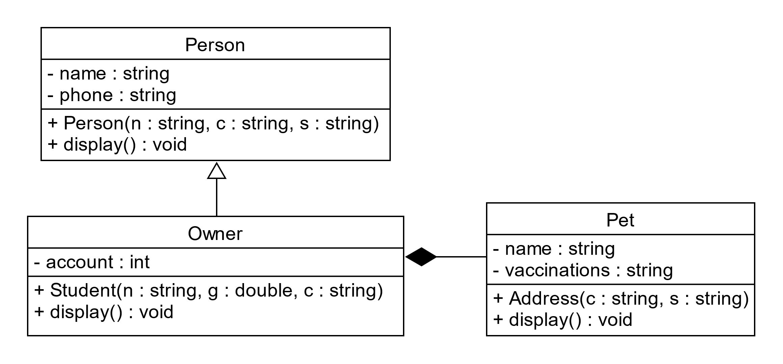
Inheritance & COMPOSITION (2)
Notes:
Similarly, this example also adds a display function to each class. But moving the composition relationship from the superclass to the subclass also changes how the functions are chained.

Slide 8
Inheritance & COMPOSITION (2)
Notes:
The Owner is both the subclass and the whole class. Its display function calls the other functions, and it's left to the programmer to determine the best order of the calls.

Slide 9
Using Composition with inheritance (1)
class Pet
{
public:
void display()
{
cout << name << " vaccinated on “
<< vaccinations << endl;
}
};
class Person
{
public:
void display()
{
cout << name << endl;
cout << phone << endl;
}
};
class Owner : public Person
{
private:
Pet my_pet;
public:
void display()
{
Person::display();
cout << account << endl;
my_pet.display();
}
};
Notes:
Observe that the class relationships determine the calling syntax. The first function call is from a sub- to a superclass and uses the superclass name and the scope resolution operator. The second call is from a whole class to a part and uses the variable (or object) name and the dot selection operator.

