Slide 1
Using Association
Simple to complex
Delroy A. Brinkerhoff
Notes:
Association’s bidirectionality allows programmers to build class structures whose complexity spans a broad spectrum from simple to elaborate. Despite its breadth of complexity, we can understand association’s most frequent uses with only a few examples.

Slide 2
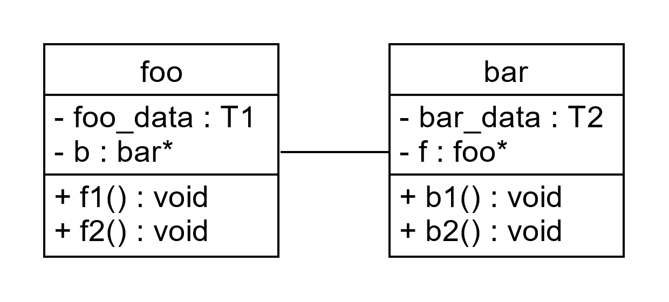
Simple Association: generic example
void foo::f2()
{
b->b1();
}
void bar::b2()
{
f->f1();
}
void foo::f1()
{
...foo_data...
}
void bar::b1()
{
...bar_data...
}
Notes:
Recall that each object in a program has a set of distinct responsibilities summarized by the class diagram. These responsibilities include managing an object’s member variables and responding to messages from other program objects. Recall further that objects send and respond to messages by calling and running member functions, which we can view as services the object provides to a program.
Keeping the example general and compact, we focus on the fundamental patterns of association and how we use them in a program. The example collectively represents the class’s member variables as foo_data and bar_data, each acting as placeholders for any number of variables. T1 and T2 are unspecified data types, also serving as placeholders. Again, we generally don’t include the variables implementing a class relationship in a class diagram but do so here to clarify the code fragments.

Slide 3
Simple Association: generic example
void foo::f2()
{
b->b1();
}
void bar::b2()
{
f->f1();
}
void foo::f1()
{
...foo_data...
}
void bar::b1()
{
...bar_data...
}
Notes:
It’s difficult to demonstrate a negative – that is, to demonstrate something we will not do. So, we first explore what we can do and use that as the context for describing what we won’t do. The associated objects can send messages to each other just as a whole object can send messages to its parts in an aggregation relationship. Unlike aggregation, both objects in an association relationship can initiate message sending, but the level of complexity is otherwise the same.
Member functions typically manipulate or use an object’s data on behalf of a program. Association remains “simple” if the function calls don’t form a cycle. An example of a cycle, an example of what we won’t do, is writing f1 so that it calls b1 and b1 so that it calls f1. Function calls can correctly form cycles but at a significant increase in program complexity.

Slide 4
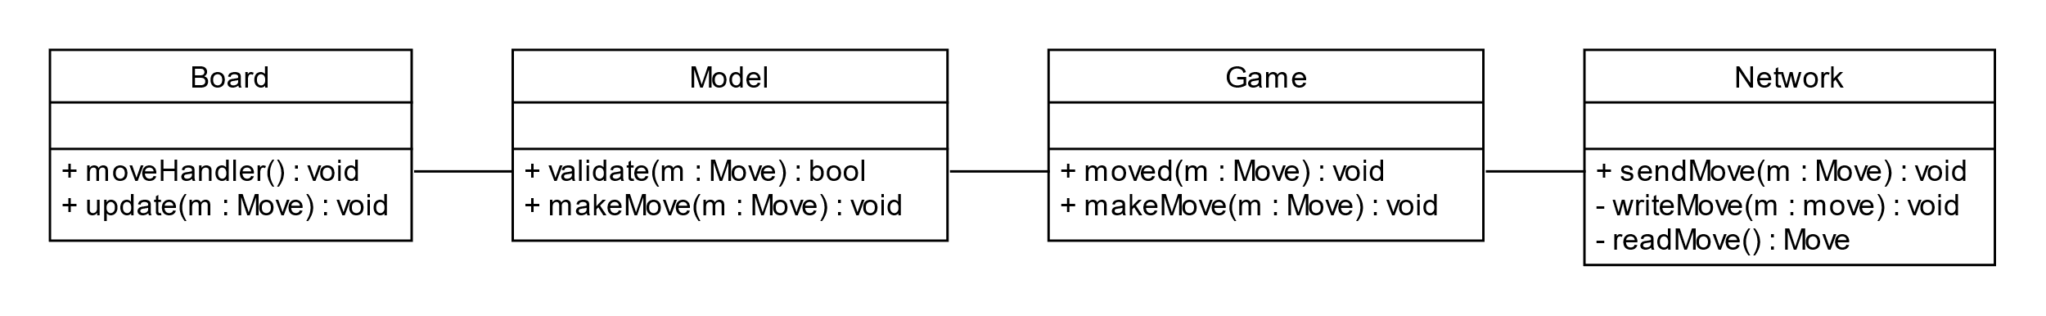
Complex But Typical Association
Notes:
The next example, excerpted from a past class project for an upper-division course, is more concrete and realistic. Although the class structure is extensive, viewing it as pairs of related classes makes it understandable. The class diagram describes some classes in a program implementing a board game played by two players on different computers. The program’s player interface uses the model-view-controller or MVC design pattern.
A design pattern is a statement of a common problem and its general solution. The MVC pattern separates a graphical user interface or GUI (“gooey”) into three sub-systems. The View is the visible part displayed on the screen. The Controller provides the human input to control the program. And the Model provides the interface’s logical representation; for example, the size and location of a window or button. Or, as in this example, the state of the board, including the location of the game pieces. The Smalltalk programming language introduced the MVC design pattern, and Java bases its swing classes on it.

Slide 5
Complex But Typical Association
Notes:
Users often interact with or control a program through its visible interface. So, the View and Controller are often combined. In the game example, the Board class implements the View and the Controller. One function, moveHandler, reads the player’s move. A second function, update, changes the board’s visual display based on a move made by the other player on another computer.
Although the Board displays the current state or condition of the game, it’s often inefficient or impossible for the program to access that information from the visual display. For example, imagine that the program implements a chess game, and one player attempts to move a rook, bishop, or queen multiple spaces. All spaces between the piece’s starting and ending positions must be empty. The Board’s data is organized to facilitate drawing a visual view of the gameboard, not to locate a specific game piece or space quickly. So, from the visual representation, it’s difficult for the program to determine if the spaces are empty.
The Model class is responsible for maintaining the game’s logical state, including the position of each game piece and the condition of each board location. The program can efficiently access and assess the condition of any location on the board with this logical state. This organization makes the Model responsible for implementing the game rules and validating any attempted move. And it must update its saved data to reflect the valid moves of each player.

Slide 6
Complex But Typical Association
Notes:
The program begins by instantiating a Game object, which instantiates and controls the other program objects. Sometimes, it does little more than relay messages from one object to another.
Finally, the Network class connects the program running on two different computers. When the Model confirms to the Game that a move is valid, the Game sends the sendMove message to the Network. The writeMove and readMove functions send and receive moves over an internet connection.

Slide 7
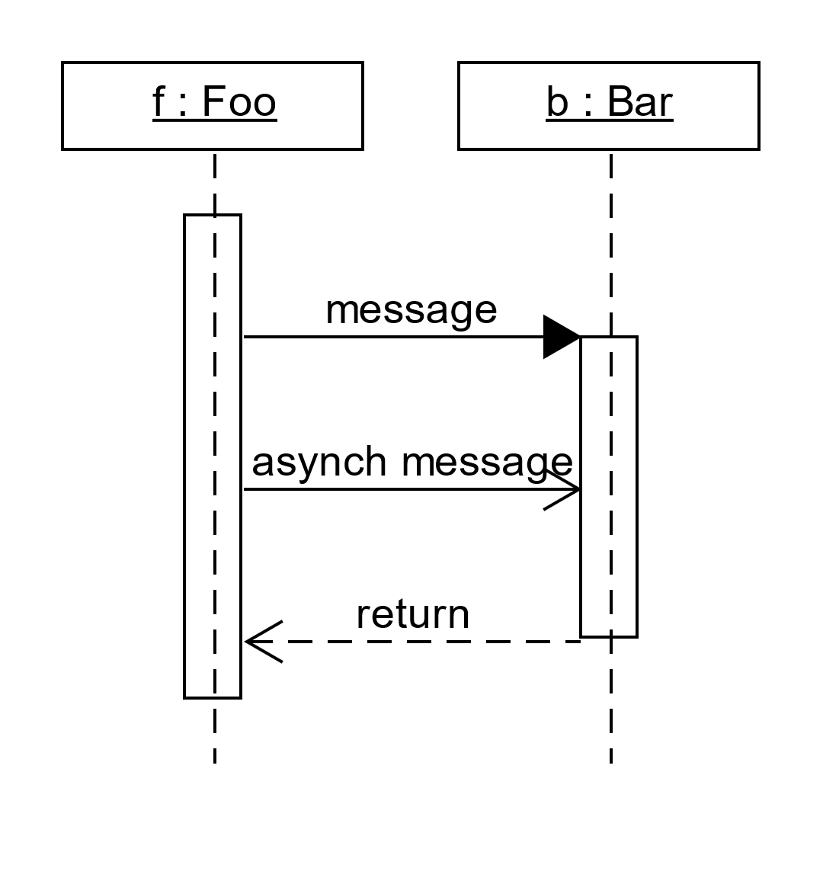
UML Sequence Diagrams
Notes:
UML sequence diagrams are beyond the scope of the text and its associated course, but they provide a convenient way to visualize the messages passed between the program’s related objects. The horizontal rectangles represent objects and show their names and class types. The example uses short variable names to conserve space, but “real” programs should use more descriptive names. The vertical, dashed lines represent the objects’ lifetimes, showing when the objects exist in the program. The vertical rectangles are activation boxes showing when an object runs a function.
The solid arrows represent messages or function calls. The dashed arrows are function return values or replies to messages. And the open arrows are asynchronous functions, which are beyond the scope of this course. Time increases in the downward direction, showing the function call sequence.

Slide 8
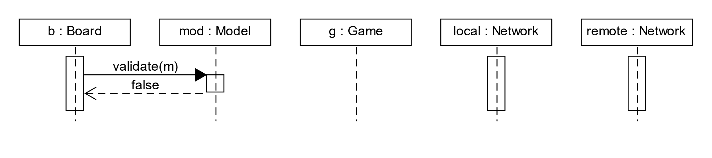
Scenario 1: Making An illegal Move
Notes:
The first scenario begins with the local player’s mouse gestures on the Board object initiating a move. The Board sends the validate message to the Model, “asking” it to validate the move. The function argument, m, is an instance of the Move class, not shown here for simplicity and compactness. The validate function detects the illegal move and returns immediately. The Model’s activation box is short, denoting the validate function’s relatively short runtime. None of the Game functions run, so it doesn’t have an activation box. The activation boxes below the Network objects indicate they continuously run functions monitoring the internet connection.

Slide 9
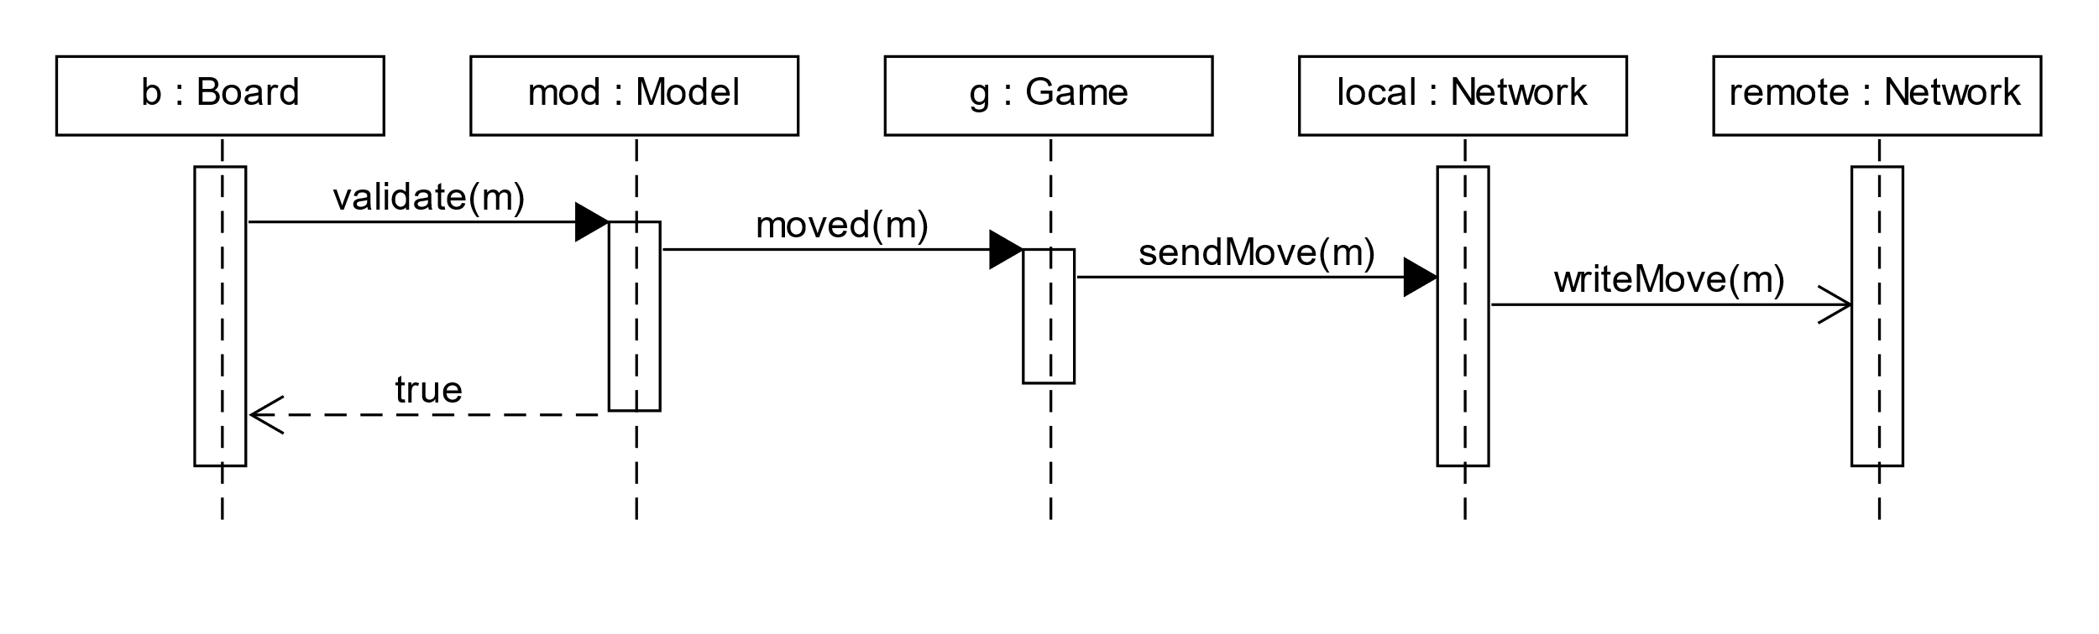
Scenario 2: Making A Legal Move
Notes:
The second scenario begins as the first, with the local player’s mouse gestures on the Board initiating a move and the Board sending a validate message to the Model. However, the move is valid in this scenario, and the Model passes it to the Game, which relays it to the local Network.
The diagram includes two Network objects. The first runs on the local computer, while the second runs on the remote. So, the diagram describes a single program running simultaneously on two computers. The local Network object sends the move over an internet connection to the remote.
The activation boxes in this scenario denote the increased running time of the object’s functions. After writing the move to the remote computer, the functions return, one after another, until the Board is notified that the move is valid and updates its view.

Slide 10
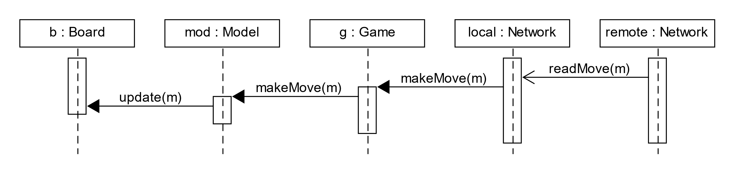
Scenario 3: Receiving a Move
Notes:
We can choose how to view the final scenario. We can view it as a separate, third scenario describing the program’s behavior when it receives a move from the remote player. Or, we can view it as a continuation of the second scenario but with the perspective shifted to the second computer, reversing the roles of the remote and local computers.
The local Network object reads the move from the remote computer and relays it to the Game. The Game passes the move to the Model, which updates the logical game state and passes the move to the Board for display. Each object’s responsibilities are clearly delineated and maintained during each interaction. Messages propagate from one object to the next, with each object performing the operations it’s responsible for.

Slide 11
association Error: Infinite Cycle
class project
{
private:
string title;
contractor* c;
public:
void display
{
cout << title << endl;
c->display();
}
};
class contractor
{
private:
string name;
project* p;
public:
void display()
{
cout << name << endl;
p->display();
}
};
Notes:
The final example demonstrates the potential for even short functions to exhibit complexity and subtle errors. Previous examples have used a display function to write an object’s data to the console. This operation is straightforward with unidirectional class relationships but becomes error-prone when used with association’s bidirectionality. Calling either display function causes an endless cycle because the functions call each other. We solve the problem by designating one function as the primary and eliminating the call in the other. The choice is arbitrary unless the underlying problem suggests which function should be the primary.

