Slide 1
operator=
Overloading the assignment operator
Delroy A. Brinkerhoff
Notes:
Object assignment is another fundamental operation. Like the copy constructor, it is so fundamental that the compiler automatically creates an assignment operator for each class in a program. The compiler-created operator works for “simple” classes without pointer members but fails for “complex” classes with pointers. Programmers must override the assignment operator for complex classes.

Slide 2
Assignment operator vs. Copy Constructor
Copy Constructor
Assignment operator
Copies data to a new object
Person p1(p);
Person p2 = p;
Copies data to an existing object
Person p(…), p2(…);
…
p2 = p;
Notes:
The assignment operator and the copy constructor are similar and share some tasks and code. However, there is one essential difference between them. The copy constructor always creates a new object. The first example clearly illustrates calling the copy constructor, but the second, with the assignment operator, is unexpected.
Alternatively, the assignment operator copies data to an existing object that may already contain data. Furthermore, programmers can use it in more complex statements. The example creates two objects and uses them in some way. The ellipses represent code omitted for simplicity. The assignment operation copies object p to p2, overwriting any data previously saved in p2. These differences make the assignment operator inherently more complex than the copy constructor.

Slide 3
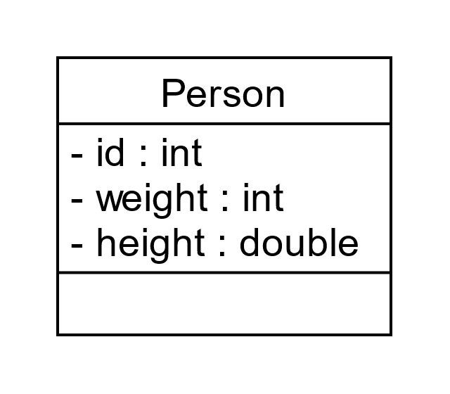

Simple object Copy The compiler-created operator=
Person& Person::operator=(Person& p)
{
if (this == &p)
return *this;
id = p.id;
weight = p.weight;
height = p.height;
return *this;
}
int id;
int weight;
double height;
Notes:
The compiler-created assignment operator works well for “simple” objects without pointer members. After the copy, modifying one object doesn’t affect the other. Although not illustrated here, programmers can also implement the operator with memcpy. However, the operator has two statements that the constructor does not.
The test checks for self-assignment (assigning an object to itself) and returns early if it is detected. Recall that the “this” pointer stores the left-hand object’s address, so the test requires the program to get the right-hand object’s address with the address-of operator. This step improves the operator’s efficiency and, if used, protects the memcpy function, which cannot handle overlapping memory locations.

Slide 4
Simple object Copy The compiler-created operator=
Person& Person::operator=(Person& p)
{
if (this == &p)
return *this;
id = p.id;
weight = p.weight;
height = p.height;
return *this; // p2 = p1 = p;
}
int id;
int weight;
double height;
Notes:
The object copy is complete when execution reaches the return statement at the bottom of the function. So, the returned value doesn’t participate in the copy operation. However, it does allow programmers to write statements chaining the operator: p2 = p1 = p. Programs evaluate the assignment operator right-to-left, evaluating p1 = p first and using the returned value as the right-hand operand for the next assignment: p2 = p1. The function returns a reference, so it must dereference the “this” pointer.

Slide 5
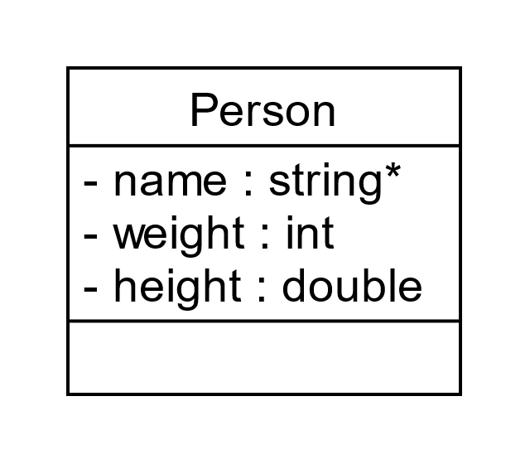
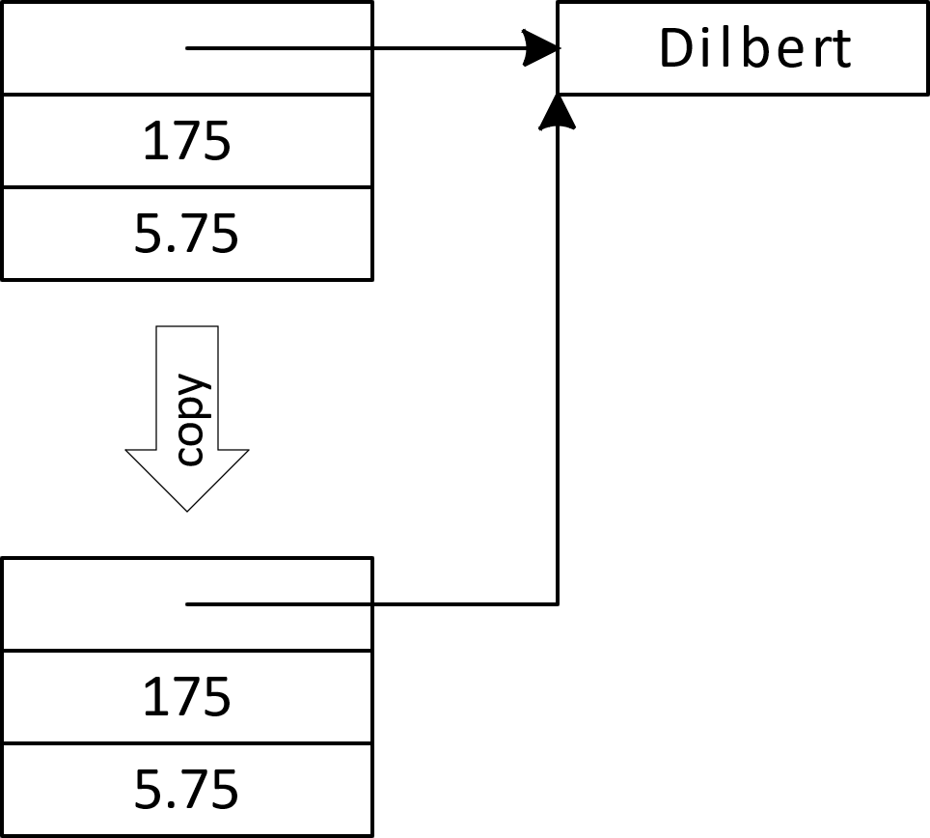
Copy Error
string* name;
int weight;
double height;
Notes:
The compiler-created assignment operator fails when the class is “complex,” having one or more pointer members. A simple copy constructor duplicates all the members bit-for-bit, including the addresses saved in the pointers. This process saves the addresses but does not duplicate the objects the addresses point to.

Slide 6
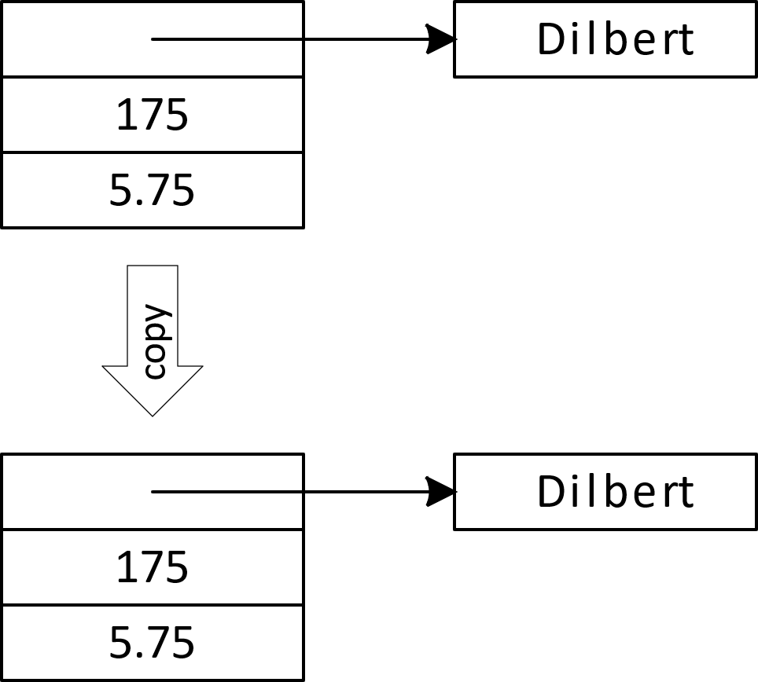
Overriding the copy constructor Copying a Complex Object
Person& Person::operator=(Person& p)
{
if (&p == this)
return *this;
if (name != nullptr) delete name;
name = new string(*p.name);
weight = p.weight;
height = p.height;
return *this;
}
Notes:
When a class has one or more pointer members, programmers must override or replace the compiler-generated copy constructor. The overridden, programmer-created function must duplicate each object a member points to, not just its address. For each pointer member, the operator instantiates a new object and saves its address in a pointer member in the left-hand or “this” object. The “new” operator calls the string class’s copy constructor, which requires an object rather than a pointer, so the function dereferences the argument or right-hand object.
The function checks for self-assignment, deletes existing data, duplicates all data members, and returns a reference to the argument.

