Slide 1
Mahjong Tiles
Outlining A Polymorphic Solution
Delroy A. Brinkerhoff
Notes:
Polymorphism is most useful in large, complex programs, making it difficult to find authentic demonstrations appropriate for a lower-division programming textbook. So, the Mahjong tiles example excerpts one component from a computer game and outlines one operation relying on polymorphism to illustrate its power and syntax.

Slide 2
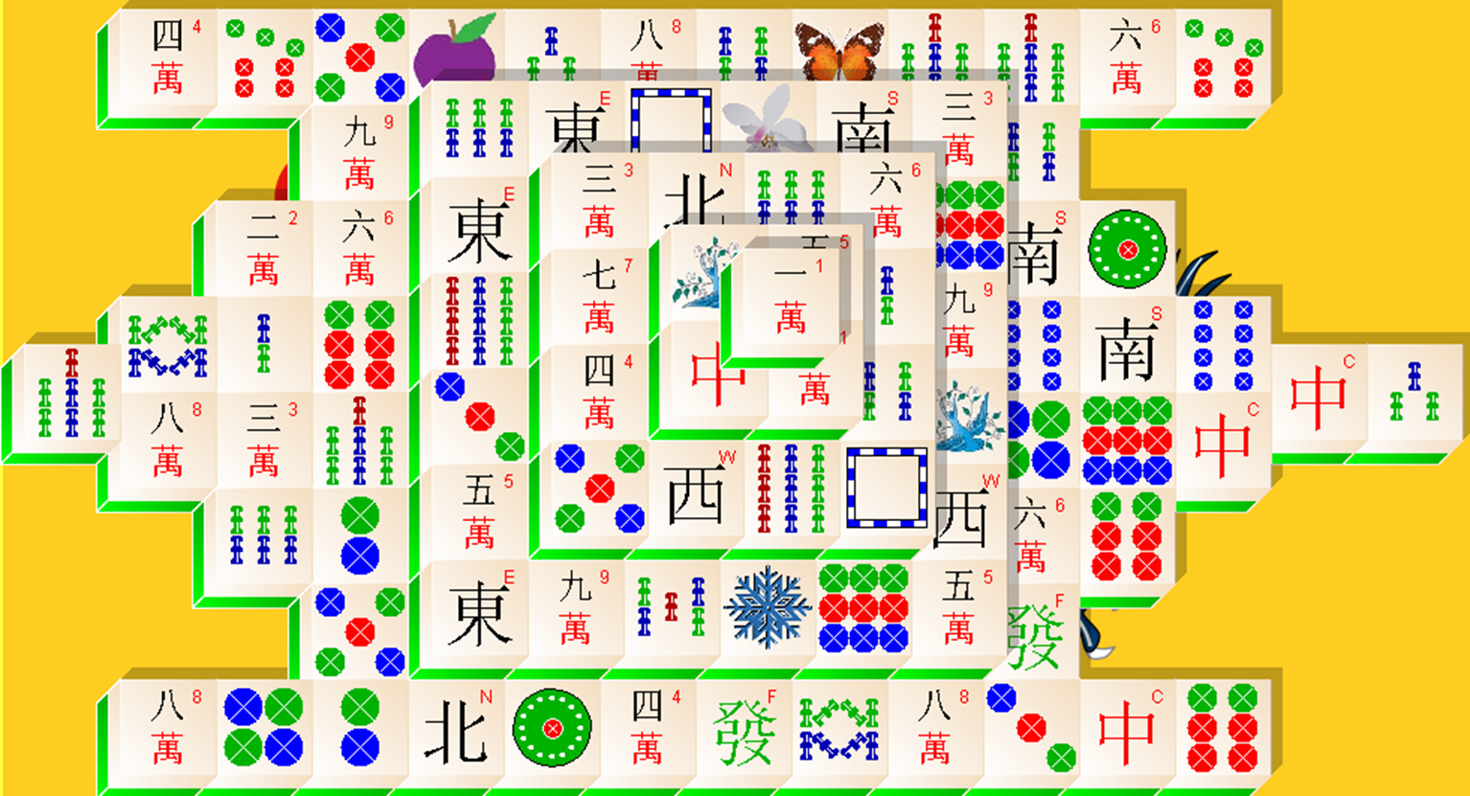
Mahjong Stacked Tiles
Notes:
Mahjong solitaire is a board game with 144 tiles stacked in a three-dimensional pattern. The game has seven different kinds of tiles. Some have characters painted on their face, while others have circles, bamboo sticks, or pictures. The program instantiates the tiles and places them randomly on the board. During play, the player selects two tiles, and if they satisfy the game rules, the program removes them from the board. The program stores the tiles in a custom data structure where their location is functionally related to their positions on the board, enabling rule implementation.

Slide 3
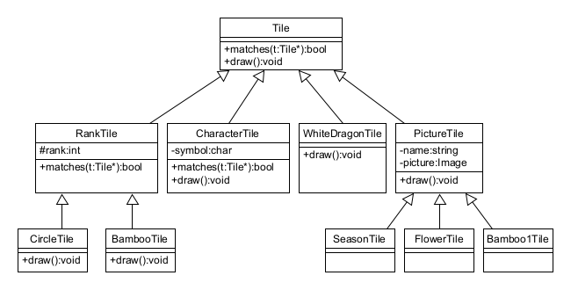
Tile Class Diagram
Notes:
The program instantiates each tile from one of seven tile classes. The CharacterTile represents three kinds of tiles, while the program never instantiates Tile, RankTile, or PictureTile objects. The easiest way for the program to manage the different tiles is to upcast them to Tile pointers, which the data structure stores.
The tiles have numerous functions, but the diagram only illustrates two, both virtual. During gameplay, the Tile “draw” function draws or paints a blank tile, and the subclass “draw” functions add tile-specific details. The drawing operations are beyond the scope of an introductory text, which only outlines them. The “matches” functions implement a crucial game rule while illustrating polymorphism’s behavior and syntax.

Slide 4
Matching Tiles
Tile* t1 = first selected tile;
Tile* t2 = second selected tile;
if (t1->matches(t2))
{
remove(t1);
remove(t2);
}
t1 ≠ t2
t2 can’t be null
Must be instances of the same class
Rank tiles must be the same rank
Character tiles must have the same symbol
Notes:
The pseudocode illustrates how the program relies on polymorphism to implement the matches game rule. The player selects two tiles by clicking on them with the mouse. The program finds the tiles in the data structure and saves their addresses in the two pointer variables. The variables can point to any Tile object, but the objects are upcast to Tile pointers. Given the two pointers, the program determines if they “match” with a call to the “matches” function. The call is bound to the correct “matches” function through polymorphism. If the tiles match, the program removes them.
There are five matching rules: First, t1 and t2 must be different tiles, implying they must have different addresses. Second, the parameter tile, t2, can’t be null. Third, both tiles must be instances of the same class. Fourth, two RankTiles must have the same rank. And, lastly, two CharacterTiles must have the same symbol.

Slide 5
Tile matches
class Tile
{
public:
virtual bool matches(Tile* t)
{
if (this == t)
return false;
if (t == nullptr)
return false;
return typeid(*this) == typeid(*t);
}
};
Notes:
The Tile “matches” function handles the first three matching requirements. The program removes successfully matched tiles by pairs, implying that a successful match requires two valid and independent tiles. The first two tests ensure the tiles meet these requirements while protecting the third.
The first test improves the function’s efficiency and prevents the third from returning a false match. If t1 and t2 are the same tile, removing it twice may cause a runtime error, depending on the data structure and graphical user interface implementations. Even if it doesn’t cause a runtime error, it leaves an odd tile the program can’t match. The second test prevents some runtime errors caused by using a null pointer as an operand or parameter.
The third test is crucial and more challenging to understand. The typeid function requires an object argument, not a pointer, so the program dereferences the implicit object’s address, saved in the “this” pointer, and the explicit parameter, t. typeid returns an object describing its parameter’s class type. If the two typeid calls return the same object, “this” and “t” are instances of the same class. The equality operator compares the objects returned by the typeid calls, forming a Boolean-valued expression, which the “return” operator returns.

Slide 6
Logical-And and
Short-circuit evaluation Review
left | right | Left && right
F | F | F
F | T | F
T | F | F
T | T | T
Operands are evaluated left to right
Short-circuit evaluation stops the evaluation when the result is determined
Notes:
Before exploring the remaining “matches” functions, we need to quickly review the logical-AND operator and how it works with short-circuit evaluation. Recall that logical-AND only results in a “true” value when both operands are “true.” The operator is left-associative, meaning programs evaluate its operands left to right. If the left-hand operand is “false,” the operation always produces a “false” value, regardless of the right-hand operand. Short-circuit evaluation interrupts the expression evaluation when the final result is determined.

Slide 7
RankTile Matches
class RankTile : public Tile
{
private:
int rank;
public:
RankTile(int r) : rank(r) {}
virtual bool matches(Tile* t)
{
return Tile::matches(t) && rank == ((RankTile *)t)->rank;
}
};
Notes:
By examining it in evaluation order, we can most easily understand how the RankTile matches function processes its single statement. First, it calls the Tile matches function, and if that function returns “false,” evaluation stops, and the RankTile function returns “false.” Otherwise, processing continues with the sub-expression forming the logical-AND’s right-hand operand.
Variable t is a Tile pointer, but the Tile class doesn’t have a “rank” member. So, the program down-casts t to a RankTile pointer. The equality operator’s right-hand expression has two sets of parentheses. The inner set is the casting operator. The outer set is grouping parentheses, which is necessary because the arrow operator has higher precedence than the casting operator. The arrow selection operator retrieves the value saved in the “rank” member. The equality operator compares the “rank” values in “this” and object t, and the “return” operator returns the test’s results.

Slide 8
CharacterTile Matches
class CharacterTile : public Tile
{
private:
char symbol;
public:
CharacterTile(char c) : symbol(c) {}
virtual bool matches(Tile* t)
{
return Tile::matches(t) && symbol == ((CharacterTile *)t)->symbol;
}
};
Notes:
The CharacterTile “matches” works similarly, changing only the class and member variable names.

