Slide 1
File I/O Prerequisites
Operating system features impacting programs
Delroy A. Brinkerhoff
Notes:
Operating systems provide a host environment for running programs, including access to files and the file system. Some aspects of file access depend on the operating system, not a programming language. These include how programs locate files and, in some cases, any distinction between text and binary files.

Slide 2
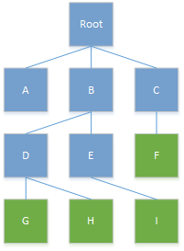
Fundamental file system features
Directories (Folders) vs. Files
  Files contain data and programs
  Directories are specialized files
Tree structure
  Root at the top: / or \
  Leaves at the bottom (no subtrees) are files
  Directories may or may not be logically empty
Notes:
The file system consists of files linked together to form a hierarchy or tree, with the root at the top. Files provide persistent storage for data and programs. Directories are specialized files with distinct behaviors and purposes, so we use the term “directory” to avoid confusion with “regular” files. Some operating systems also treat hardware like files, such as the console, disk drives, or network connections.
Linux and similar operating systems use the / character as the root’s name, while Windows uses the \ character. Interior tree nodes with children or subtrees (shaded blue) are directories (aka folders). Leaves are the nodes at the bottom without subtrees (shaded green); they are files or logically empty directories.

Slide 3
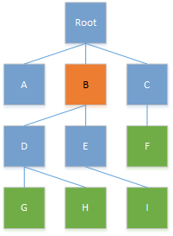
Current working directory
A program’s host environment includes its current working directory (CWD)
  Apparent location of a running program in the file system
  . represents the CWD
  ./program
  .\program
  Starting location for finding resources
Notes:
Part of the hosting environment is a program’s “current working directory” – its apparent location in the file system. The single “.” represents the current directory, and while we can use it as part of any file’s name, we use it most frequently when starting programs from a command-line interface like bash or power shell. The choice between the forward and backward slash depends on the hosting operating system.

Slide 4
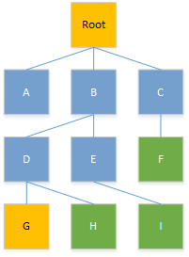
Absolute file path name
Always begins at the root (may include a drive letter)
A unique path to a file or directory
Independent of the program’s CWD
The same symbol naming the root is used for the file path separator
  /B/D/G
  \B\D\G
  C:\B\D\G
Notes:
When programs access files, either reading from or writing to them, they must specify the file’s name. If the file and program are not colocated – if the file is not in the CWD – the program must specify a path through the file system to the desired file.
An absolute or full path always begins at the root (which may include a drive letter on some systems) and describes a unique path to a file, G in this example. The same character naming the root also forms the “file path separator.” The separator divides or delimits the directory and file names, marking branch points as a program descends the file system tree.
Programs typically use absolute path names when data files have a fixed location and various programs or people access them.

Slide 5
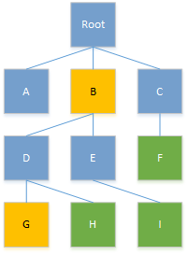
Relative file path name (1)
Access or visibility relative to the program’s CWD
Represents the path’s starting and ending
  B/D/G
  B\D\G
  Inaccessible or invisible from A or C
Notes:
Relative path names are an alternative to absolute paths. These paths are relative to a program’s CWD and take many forms. This version begins with a directory one or more levels below the root. It descends the file tree, uniquely naming a file, G. The path separator separating the path elements depends on the hosting operating system.

Slide 6
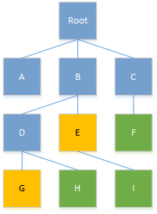
Relative file path name (2)
Backtracking: going up before going down
.. represents the parent or super directory
  ../D/G
  ..\D\G
  ..
  Can climb multiple levels
    ../../../x
    ..\..\..\x
Notes:
Sometimes, there isn’t a direct path from the CWD to the accessed file, making it necessary for the program to ascend the tree and descend a different branch. The name “..” represents a file’s parent – the directory one level up in the file system tree. The figure illustrates a program with E as its CWD. For the program to access file G, it must ascend the tree to B before descending to G. Programs can use “..” alone to access a parent directory or repeat it to ascend multiple levels.

Slide 7
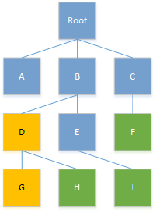
Relative file path name (3)
A relative path can consist of a single name
  File
  Directory
    G
Notes:
Finally, a file or directory name, by itself, is a relative pathname. This example assumes that D is a program’s CWD, allowing it to access file G without additional path names or separators. The example programs accessing files in the previous chapters used this relative path notation.

Slide 8
Line separator (terminator)
POSIX (e.g., Linux)
Windows
See the quick\n
red fox jump\n
over the lazy\n
brown dog.\n
See the quick\r\n
red fox jump\r\n
over the lazy\r\n
brown dog.\r\n
Notes:
The final system-dependent feature C++ programmers must contend with is files containing lines of text, like program source-code files. Bell Labs created the C and C++ programming languages on Unix systems, which separate the lines with a single ASCII line-feed character or newline. Later, all POSIX systems adopted this convention. However, DOS and later Windows separate the lines with a pair of characters: the ASCII carriage return and line-feed.

Slide 9
Text vs. Binary Files
if (c == ‘\n’)
Windows (text files)
  Input: \r\n → \n
  Output: \n → \r\n
  What about binary data (e.g., images, audio, video)?
  Opens files in text mode by default
ifstream in("filename", ios::binary);
ifstream in;
in.open("filename", ios::binary);
Notes:
The different conventions only cause problems when programmers port or move a program between systems. Imagine that a program searches for a \n to process a file by lines. Moving from a POSIX system to Windows is problematic, potentially leaving a \r unprocessed. Although searching for a pair of characters is more difficult and less efficient, the most significant problem arises when moving a program from Windows to a POSIX system: the program never finds the \r\n pair, failing to detect the line break!
Windows programs solve the problem by mapping a \r\n pair to a single \n on input and map a \n to a \r\n pair on output. However, this mapping can corrupt binary files like images, audio, and video that don’t contain lines or even textual characters. The solution to the secondary problem is allowing programs to specify how to open a file. Text mode is the default, but programs can specify binary mode with a flag, detailed in the next section. POSIX systems ignore the flag, improving program portability.

