Slide 1
Bugs and Debugging
If debugging takes bugs out of a program,
programming must put bugs into a program
Delroy A. Brinkerhoff
Notes:
It seems reasonable that if debugging takes bugs out of a program, programming must put bugs into a program. This video introduces six bug classes and suggests how programmers locate and correct two of them.

Slide 2
bug classes
Syntax incorrect sequence of keywords, punctuation, etc.
Assembly linker or loader unable to create a final executable
Logical programmer didn’t correctly solve the problem
Run-time program fails by crashing or never completing
Task synchronization multiple tasks do not coordinate correctly
Heisenbug program behaves differently while being debugged
Notes:
An incorrect sequence of keywords, punctuation, symbols, and identifiers causes syntax errors. Programmers must correct these errors before any others. Assembly errors arise when the compiler cannot assemble the machine-code-level components into an executable. The video concludes by discussing these errors.
Logical and run-time errors occur while the program executes. Programs that run to completion but produce incorrect results have a logical error. Those that abort or fail to end have a run-time error. Subsequent videos suggest how to find these errors. The last two classes are beyond the scope of the textbook and videos.

Slide 3
Syntax and syntax errors
Programs consist of a sequence
  Keywords
  Symbols
  Identifiers
Syntax
  Rules specifying the correct sequences or patterns of programming elements
Invalid sequence or pattern of programming elements
  Wrong order
  Missing
  Extraneous
Notes:
Programs follow a specific pattern of keywords, symbols, and programmer-created identifiers or names. The rules that specify the allowable sequences of these elements make up a programming language’s syntax. A syntax error is a sequence of elements that violates these rules. Elements may be in the wrong order, missing, or have extraneous elements inserted. The compiler component detects and reports syntax errors.

Slide 4
Command-line compiler
dab@Neptune:/tmp$ g++ hello.cpp
hello.cpp: In function 'int main()':
hello.cpp:6:40: error: expected ';' before 'return'
6 | cout << "Hello, World!" << endl
| ^
| ;
7 | return 0;
| ~~~~~~
Function
File
Line and column
Error
Error location
Syntax checking end
Notes:
Various compilers report syntax errors differently, but they generally provide the same information. The example deliberately omits a semicolon at the end of a statement to illustrate what a typical diagnostic message contains. The g++ command-line compiler produced the error diagnostic illustrated here. The diagnostic gives the programmer information to help locate the error, including the function name where the compiler detected it, the file containing the function, the line and column number, the specific syntax error, and where syntax checking stopped.

Slide 5
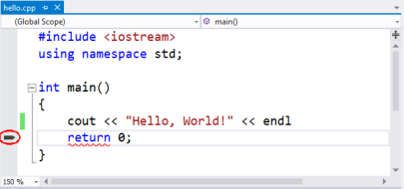
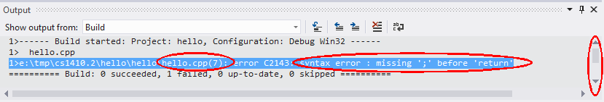
IDE
Visual Studio
Notes:
Integrated development environments like Visual Studio provide similar diagnostic information, but also offer superior code navigation. Studio’s “Output” window displays the diagnostic resulting from the omitted semicolon. Depending on the output window size and the amount of diagnostic information, you may need to scroll to the top of the window. The window shows the file name, line number, and the exact error. The IDE diagnostic may seem to provide less information than the command-line version, but double-clicking the blue-highlighted message opens the correct file in the editor and automatically scrolls to the correct function and line number. It also marks the line with a pointer in the left margin. However, the marker and line number indicate the line after the omission. This observation leads to four steps for debugging syntax errors.

Slide 6
Debugging Syntax errors
Use diagnostic information effectively
Notes:
Diagnostic messages often identify a specific syntax error and its location. The accuracy of the identification varies from correct to vague and misleading to missing. The location information is often more reliable, but not infallible. The compiler reports where it detects the error, which may be past the error’s actual location. Consequently, programmers begin at the error’s reported location and search backward, never forward. Furthermore, they never rely solely on the stated error; instead, they rely on their own experience and knowledge of the language’s syntax.

Slide 7
Debugging Syntax errors
Use diagnostic information effectively
Be aware of “Error Recovery”
Notes:
The compiler treats the pattern of keywords, symbols, and identifiers as signposts that guide it through a program. When it encounters a syntax error, it can become lost, and while it’s lost, it can’t generate code or continue checking the program’s syntax. So, it skips some or all of the remaining program. Sometimes, after skipping some code, it recognizes a new starting point and continues. It can’t generate more machine code, but it can continue syntax checking the remaining source code. This technique is called “error recovery.” It doesn’t correct the error but recovers enough to provide useful diagnostic information. Sometimes, correcting an error increases the error count when programmers recompile the program. Rather than adding another error, the correction lets the compiler locate existing errors it previously skipped.

Slide 8
Debugging Syntax errors
Use diagnostic information effectively
Be aware of “Error Recovery”
Recognize how the compiler impacts diagnostic order and error correction
Notes:
C++ compilers use a “one-pass” processing strategy, meaning they read and process a file once, from beginning to end. Consequently, they display any error diagnostics in the order they detect them. However, a single error can produce multiple messages, and with multiple errors, their associated messages can become intermixed. Therefore, the most effective strategy for correcting syntax errors is to begin with the first one, correct it, and recompile the program. As you gain experience, you can often fix more errors before recompiling.

Slide 9
Debugging Syntax errors
Use diagnostic information effectively
Be aware of “Error Recovery”
Recognize how the compiler impacts diagnostic order and error correction
Understand syntax rather than relying on obscure error codes
Notes:
Finally, some compilers, notably Visual Studio, include rather obscure error codes in the diagnostics. Unfortunately, the codes are not consistent between compilers or even between different versions of the same compiler. Consequently, searching for the code is generally fruitless, and learning them is even less useful. It’s more productive to learn the language’s more stable and consistent syntax. The best way to learn the syntax is to read and write code.

Slide 10
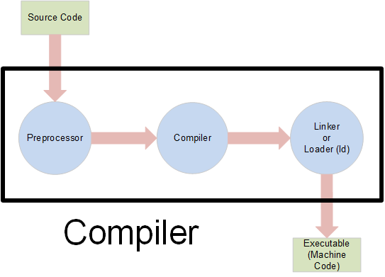
The Compiler System
Notes:
Windows calls the last component in the compiler system the “linker,” while Linux and Unix-derived operating systems call it the “loader.” Regardless of the name, this final component combines various files to create the executable version of a program. Although “linker error” or “loader error” are more common, the textbook uses “assembly error” to generalize the error across different systems.

Slide 11
Assembly (Windows Linker) Error
1>------ Rebuild All started: Project: Error3, Configuration: Debug Win32 ------
1>C:\Program Files (x86)\MSBuild\Microsoft.Cpp\v4.0\V110\Microsoft.CppClean.targets(75,5):
warning : Access to the path 'E:\TMP\CS1410 PAST\ERROR3\DEBUG\ERROR3.EXE' is denied.
1>C:\Program Files (x86)\MSBuild\Microsoft.Cpp\v4.0\V110\Microsoft.CppClean.targets(75,5):
warning : Access to the path 'E:\tmp\cs1410 past\Error3\Debug\Error3.exe' is denied.
1> Error3.cpp
1>LINK : fatal error LNK1104: cannot open file '****************.exe'
========== Rebuild All: 0 succeeded, 1 failed, 0 skipped ==========
Notes:
Assembly errors generally arise when programs span two or more source code files. Chapter 6 describes the general problem and the steps programmers take to avoid and solve it. This video concludes by describing a special case that only occurs on Windows systems. Windows does not allow a user to delete a “busy” file - a file opened and in use by a program. If we compile and run a program from Studio, it opens a console window to display the program output. If we modify and rebuild the executable without closing the console, the executable file is still “busy,” so the linker can’t delete it and can’t create a new executable file. The associated diagnostic is extensive and cryptic, but the key information is the “LNK” message announcing that the linker detected the error and that it can’t open or access an executable file.

