Slide 1
Introduction To Functions
The Big Picture
Delroy A. Brinkerhoff
Notes:
Functions have always been a key feature of all imperative programming languages. Accordingly, the text has relied on them from the beginning onward. Chapter 6 more formally introduces them, providing additional detail and extending their behaviors.

Slide 2
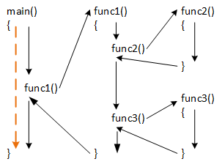
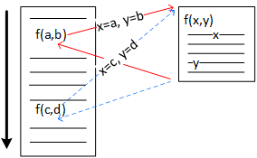
Basic Function behavior
Notes:
A function is a reusable set of statements that solves a specific problem. A compiler translates it into machine code and stores the code in a distinct memory location. We can conceptualize how programs use functions in various ways. First, we can imagine that a function is a single statement that performs a given task. This conceptualization allows us to treat the function as a “black box,” focusing on what it does rather than how it works. For example, previous demonstrations used the sqrt function without explaining how it performs the calculation. The gold arrow represents this conceptualization.
Second, we can think of a function as a “white box,” focusing more on what goes on inside. Specifically, function calls inside a function can change a program’s flow of control or the order in which it executes instructions. When a program executes a function call, it “jumps” from the call to the function’s machine code, executes that code, then returns to the statement following the call. The black arrows represent this conceptualization and demonstrate that while functions can call each other, they always return in the reverse order of the calls.
Functions always perform the same operations, but they can do so with different data. A function can have zero or more parameters or placeholder variables for data provided by another part of the program. Function calls provide the data as arguments that the calling mechanism passes or assigns to the corresponding parameters. In this way, two different calls perform the same operations on different data.

Slide 3
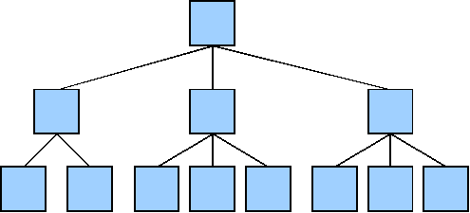
Functional Decomposition
Notes:
One way software developers design programs using the procedural programming model is through a process called functional decomposition. This process breaks or decomposes large problems into successively smaller ones, stopping when the smaller problems or functions are relatively easy to implement. Unfortunately, there aren’t any rules specifying how to decompose a problem or when to stop decomposing. Developers can either implement the decomposed functions from the top down, beginning with the top function, or start with the small, supporting functions and work from the bottom up.

Slide 4
Top-Down Implementation
Functions lower in the tree are stubbed in
Stub functions have just enough code to allow a program to compile
void print(int x, double y)
{
}
double pow(double x, double y)
{
return 1.0;
}
Notes:
Top-down implementation begins with the overall problem or application represented by the function at the top of the decomposition tree. Ideally, it creates complete, fully operational functions as it works its way down. In furtherance of that goal, whenever a high-level function calls an unimplemented, lower-level function, programmers create a simple, temporary “stub” function to satisfy the call. A stub function contains just enough code so that it compiles. Functions that must return a value are programmed to return a constant value that is sufficient to test the calling function. Developers replace stubs with “real” functions as development proceeds downward in the decomposition tree.
Creating a complete function with each downward step in the tree is unrealistically difficult and is further impeded by another beneficial practice. Incremental delivery is a strategy for delivering core features early, while adding enhancements in later releases. Following a branch down the decomposition tree is a convenient way to practice this strategy. However, adding enhancements generally implies making at least modest changes to previously complete, high-level functions. Consequently, developers typically take a more realistic, iterative approach, refining the functions and adding detail at each iteration.

Slide 5
Bottom-Up Implementation
void function(int x, int y, int z)
{
// completes an observable task
// like updating a database or
// visually altering the screen
}
int max(int x, int y)
{
return (x > y) ? x : y;
}
int main()
{
function(10, 20, 30);
int a = max(100, 200);
cout << a << endl;
return 0;
}
Notes:
Bottom-up implementation begins with the relatively simple support functions at the bottom of the decomposition tree. It’s possible for programmers to completely implement these functions if they only operate on their parameters. Void functions, functions with a “void” return type, perform an observable operation. For example, they may update a database, create a file, display a calculation, or modify the user interface. The effect might be visible during execution or require the developer to examine a database or file after execution. Non-void functions return a verifiable value that the developer can compare to a “hand-calculated” result.
Developers create temporary functions called “drivers” to test the functions as they implement them. Drivers are only temporary functions, so developers typically hardcode test data in them. As implementation proceeds up the tree, developers discard the drivers and replace them with functions that contribute to the problem solution. Bottom-up implementation is incompatible with incremental delivery but is well-suited for teaching and learning how to create, test, and use functions.

Slide 6
Function Benefits
Functions make programs better and programming easier
  Make programs smaller
  Make large programs easier to manage
  Make team programming possible
  Make it easier to conceptualize complex problems, helping to manage complexity
Notes:
Functions do many things to help make programs better and programming easier: For example:
They make programs smaller by eliminating the need to duplicate code when the same operations are needed many times.
They also make it easier to manage large programs by allowing programmers to write, edit, debug, and test small units of code.
They make it easier for multiple programmers to work on the same program simultaneously by allowing them to work on a function or set of functions independently of the others.
These benefits notwithstanding, I believe their most important contribution is their influence on how developers conceptualize or think about problems. It’s difficult or impossible to think about every aspect of large, complex problems at the same time. Functions allow us to break these problems down into smaller, more manageable sub-problems, alternately viewing them as black- or white-boxes as needed, and thereby managing the problem’s overall complexity.

