Slide 1
Linker/loader Errors
Assembly errors are detected by the linker or loader
Assembly errors are a problem with multi-file programs
Delroy A. Brinkerhoff
Notes:
Programs can contain many kinds of errors or bugs. However, in multi-file programs, functions typically cause one kind of error. These errors occur when a program defines a function in one file and calls it from other files. Discrepancies between the function header and the function calls prevent the compiler system from assembling the files into a complete program. The linker or loader detects and reports the assembly errors.

Slide 2
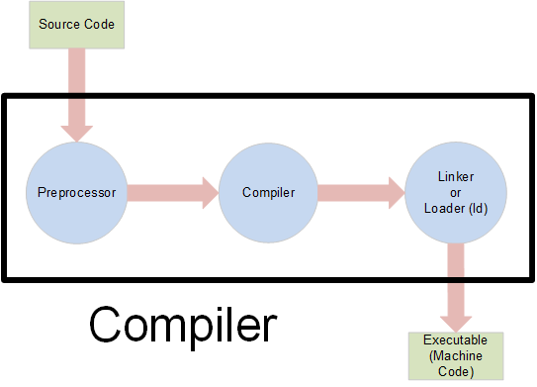
The C++ compiler system
Notes:
A C++ compiler system consists of at least three distinct parts. The first two, the preprocessor and the compiler component, are consistently named. The name of the third part varies: Windows calls it the linker, while Linux and similar operating systems call it the loader and implement it with the ld command.

Slide 3
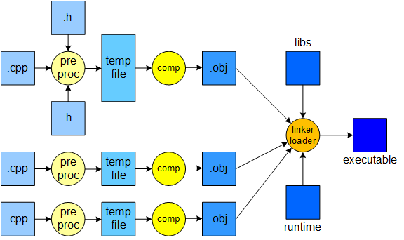
Compiling multi-file programs
Notes:
The preprocessor and the compiler component process each program file. The final part of the system assembles the individual program files, any library functions the program uses, and a runtime file to create the final executable.

Slide 4
Linker/loader errors
file1.cpp
file2.cpp
void foo(int x, int y, int z)
{
cout << x << " " << y <<
" " << z << endl;
}
void foo(int x, int y);
void Foo(int x, int y, int z);
int main()
{
foo(10, 20);
Foo(10, 20, 30);
return 0;
}
Notes:
In the example, file 1 contains a function definition, which compiles without error. File 2 contains two incorrect function prototypes and corresponding function calls. The prototypes help the compiler validate that the function calls are formed correctly. The calls match the prototypes, so file 2 compiles without error. However, the functions in file 2 don’t match the function in file 1, which prevents the linker or loader from assembling them into an executable program.

Slide 5
Reducing linker/loader errors
example.h and file1.cpp
file2.cpp
void foo(int x, int y, int z);
void foo(int x, int y, int z)
{
cout << x << " " << y <<
" " << z << endl;
}
#include "example.h"
int main()
{
foo(10, 20);
Foo(10, 20, 30);
return 0;
}
Notes:
One step programmers can take to help reduce the program assembly errors detected by the linker or loader is to put the function prototypes in a shared header file and include it in files that call the functions. Although they must still maintain the prototypes, updating them whenever a function header changes, they only have one prototype to maintain, rather than one in each using file. The prototypes serve as the interface between a function definition and a function call, essentially describing how one function uses another. A file including a header, file 2 for example, may safely ignore any prototypes or other declarations in the header it doesn’t use.

Slide 6
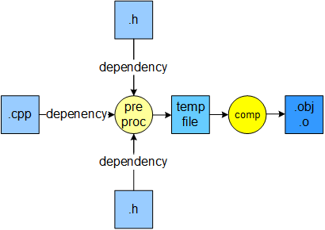
File dependencies
Notes:
Another step programmers can take to reduce assembly errors is to establish the dependencies between a program’s files. With the dependencies established, programming tools can automatically build the program. This example depicts a source code file that includes two headers. When the compiler compiles the source file the first time, it creates an object file whose name ends with the extension “.obj” or “.o”. The system only recompiles the source file if it or either header file changes, not when the body changes in a different source file. This process keeps object files up to date, reducing conflicts caused by a function change in another source file.

Slide 7
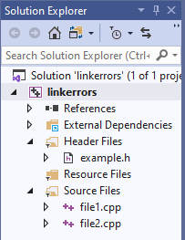
Establishing dependencies:
Automatically building programs
Visual Studio project
Makefile
linkerror : file1.o file2.o
g++ -o linkerror file1.o file2.o
file1.o : example.h file1.cpp
g++ -c file1.cpp
file2.o : example.h file2.cpp
g++ -c file2.cpp
Notes:
Most integrated development environments allow programmers to organize their code into individual projects. For example, Visual Studio solutions consist of one or more projects, where each project represents a program. Projects automate program building by calling the compiler and linker as needed, only recompiling a source file when it or an included header changes.
Makefiles are another way for programmers to specify program file dependencies and are often used with command-line compilers. The names preceding the colons are the target files the compiler creates. The names following the colons are the files the target depends on. The system must rebuild any target that is older than any of the files it depends on. The commands following a tab character, the Linux g++ compiler in this example, rebuild the target. When run with only object file inputs, g++ calls the loader, ld, to assemble the program.

