Slide 1
C-String Functions
Library or API Functions
#include <cstring>
Delroy A. Brinkerhoff
Notes:
C++ provides a useful set of library or API functions that make many operations based on C-strings much easier. This video introduces a number of features and concepts that are common to all of the C-string library functions. Understanding these common features will allow us to quickly study four very useful functions and prepare us to use the documentation whenever we need to learn about the other functions.

Slide 2
C-Strings are Primitive
C-Strings are based on arrays and pointers: they are a primitive data type
  Header file only needed when using the C-string functions
  #include <cstring>
  #include <string.h>
Notes:
C-strings are a primitive data type, so some operations based on them don’t require a specialized library. The cstring header file, or the older string.h header file, is only required when using the C-string library functions. In this and the subsequent videos, notice that most of the C-string functions begin with the characters “str.”

Slide 3
ASCII Encoding
Individual characters are encoded as integer values
  ‘0’ – ‘9’ as 48 – 57
  ‘A’ – ‘Z’ as 65 – 90
  ‘a’ – ‘z’ as 97 – 122
  punctuation characters are mixed in
  control characters are 0 – 31
  128 – 255 are the extended ASCII
Notes:
The individual characters stored in a string are based on the ASCII numerical character encoding standard. This impressive sounding encoding simply means that each character appearing in any computer data is represented by an 8-bit number. There are a total of 256 unique characters that can be formed by different patterns of 8-bits. Computer manufacturers have agreed, at least for some numbers, to use the same number to represent the same character.
Some important values are the digits 0 through 9, which are represented by the numbers 48 through 57. The capital letters A through Z are represented by the numbers 65 through 90, while the lower case letters, a through z, are represented by the numbers 97 through 122. The punctuation characters, including the space character, are interspersed within the other character ranges.
The first 32 numbers, that is 0 through 31, represent control characters. These characters are typically used to control devices connected to computers. Finally, the last 128 numbers form the extended ASCII characters, whose use or interpretation can vary from one geographic region to another or from one operating system to another.

Slide 4
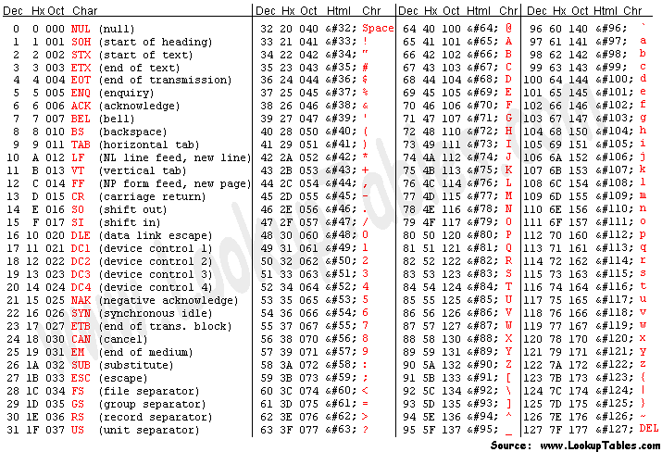
https://www.asciitable.com/
Notes:
This is one example of an ASCII table. You can find this table and many more by Googling “ASCII table.”
Many ASCII tables show the numeric value representing a specific character in decimal or base-10, in hexadecimal or base-16, and in octal or base-8. The control characters are grouped on the left. The digits, the upper case characters, and the lower case characters can all be seen in their respective ranges.
Note that the 2-byte Unicode character set, which is what Java uses, is, in a sense, replacing the ASCII encoding. Perhaps it would be more accurate to state that Unicode is subsuming ASCII as the first 127 characters in both encodings are identical.

Slide 5
nullptr
First introduced in chapter 4, nullptr indicates when a pointer variable isn’t pointing to anything (C++ also allows NULL and the numeral 0)
  char* p;
  p = nullptr;
  if (p == nullptr) . . .
  if (p != nullptr) . . .
Function arguments and return values can be nullptr
Notes:
nullptr was first introduced in chapter 4 as an address value that makes a pointer variable not point to anything. While nullptr is the preferred way of doing this, C++ still accepts the older NULL and the numeral 0 to denote the same thing.
nullptr is a value that can be stored in a pointer variable and then later tested for. Some of the C-string functions return nullptr in some cases and some will also accept nullptr as an argument. What nullptr means in any of these cases depends on the specific function and is always clearly described in the function’s documentation.
It’s always a good idea to store a value in a variable soon after it is defined. This can be done with a read operation or with an assignment operation. In the case of a pointer, if it is not soon initialized with “real” data, we should store nullptr in it so that we know that it does not point anything (otherwise the random bit pattern in memory might be mistaken as a legitimate address, which can lead to a difficult to find error).

Slide 6
Empty C-Strings
An empty C-string is not the same as a null C-string
Null C-strings do not have allocated memory
Empty C-strings have memory but do not have data
Must have the null-termination character
  char s[100] = "";
  char s[100]; s[0] = '\0';
Notes:
Recalling that C-strings can be manipulated as character pointers, it’s important to differentiate between a null string and an empty string. A null string does not point to anything, while an empty string points to some allocated memory but that the memory does not contain any valid data. It’s also important to differentiate between an uninitialized character array and an empty C-string. An empty string will have a null-termination character but that character will be the first character in the array, that is, it will be in array element 0.

Slide 7
Pseudo Data Types
Pseudo data types are
  aliases created as symbolic constants
  converted to real types at compile time
  used to improve code portability
  typically named end with a “_t” at the end
size_t
  an integer suitable for hold a data size
errno_t
  an integer that encodes an error number
Notes:
C++ uses pseudo data types in a number of situations. A pseudo data type is a symbolic name that the compiler system translates into a real data type. The name of a pseudo data type typically has an “_t” at the end.
Pseudo data types are used to improve code portability. For example, on some systems an int is 2 bytes in size, while on other systems an int is 4 bytes long. Two bytes may not be big enough to hold the size of something and four bytes may be a better choice. So, on the first system the pseudo type size_t might become an unsigned long, while on the second system size_t can become an unsigned int.

Slide 8
C-String Function Arguments
The C-string arguments for the C-string functions(<cstring>) are shown as char*
char* strcpy(char* destination, const char* source);
Pointers must point to allocated memory
  character array: char s1[100];
  dynamic: char* s2 = new char[100];
  strcpy(s2, s1);
Notes:
When dealing with C-strings, we must pay particular attention to how we convert the function prototypes found in C++ documentation into working function calls. As illustrated by the prototype for the string copy function, most C-string function arguments are specified as pointers. So it’s naturally tempting, especially for new C++ programmers, to define the variables passed to these functions as pointers. But we must remember that a pointer is just an address, which is not large enough to hold very many characters.
C-string function arguments are correctly defined as an array – again, remember that the array name is an address or pointer – or allocated with the new operator.

Slide 9
Character pointer return values
Many C-string functions return a character pointer
  char* strcpy(char* destination, const char* source);
  The pointer is often one of the arguments; return destination;
  This a convenience that allows embedding the call in a larger context:
  cout << strcpy(s2, s1) endl;
Notes:
As is again illustrated by the string copy function, some of the C-string functions also return a character pointer. The return value is sometimes described as a “convenience” operation. For functions like string copy and string concatenation, the first argument is an IN and OUT argument – data can pass both into and out of the function through the argument. These functions modify their first argument, that is, the destination contains the result of the work done by the function; so a return value is not needed.
But the function does have a return value – specifically, it returns the first argument or the destination. That means that it returns the same information in two different ways: through the argument list and as the function return value. This allows programmers to embed the function call in larger expressions when doing so is convenient.

Slide 10
Microsoft Visual Studio
Microsoft replaces many of the standard C-string functions with secure versions whose names end with “_s”
  One additional argument
  Integer return type
  Suppress with: #define _CRT_SECURE_NO_WARNINGS
  errno_t strcpy_s(char *strDestination,
  size_t numberOfElements,
  const char *strSource);
Notes:
Finally, we need to be aware that Microsoft Visual Studio has replaced many of the standard C-string functions with its own secure versions. Typically, the names of the Microsoft secure functions end with an “_s” and add one more argument, which is the size of the destination function argument. The secure functions use the size to prevent overflowing the array, that is, to prevent storing strings longer than the array. The Microsoft version also returns an error code in place of the traditional character pointer. The differences between the Microsoft and the traditional string copy function are highlighted in red.
We can still access the standard C-string functions by adding a #define directive before all of the #include directives.

